Slide 1

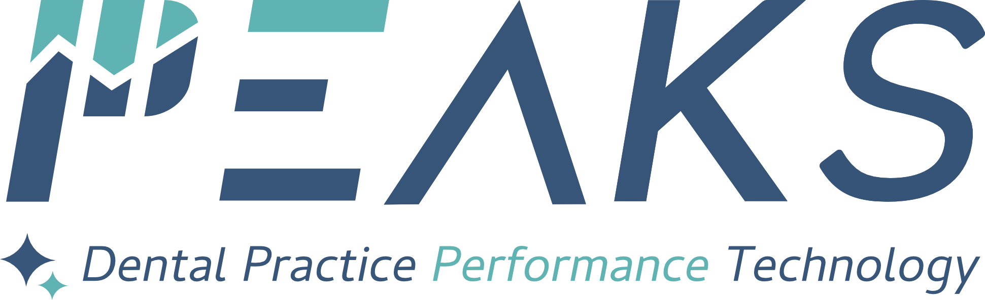

Practice performance technology that is purpose built around how dental teams really work.
Notes:
PEAKS suite of practice management technologies wasn't born in a garage — or even under its current name. Originally branded as EDDSON, the platform emerged from a decade-long, multi-million dollar endeavor headed by a former software analyst turned dental business consultant and backed by a full-service dental supply company. What came out the other side is one of the most advanced dental practice management solutions available — shaped by real industry experience from the very start.

Slide 2


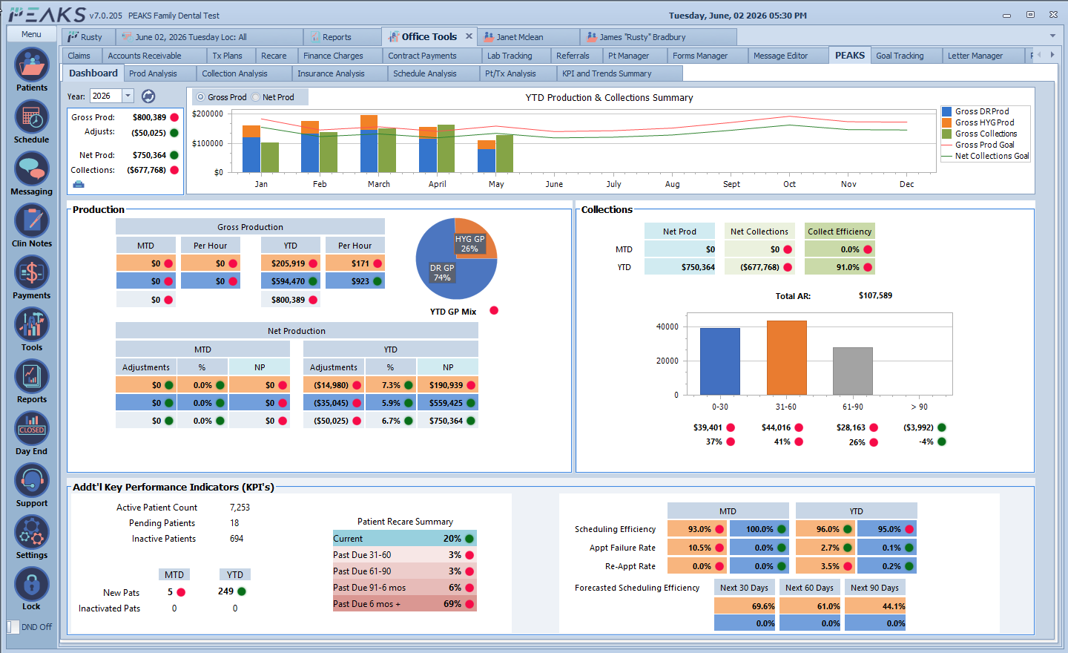
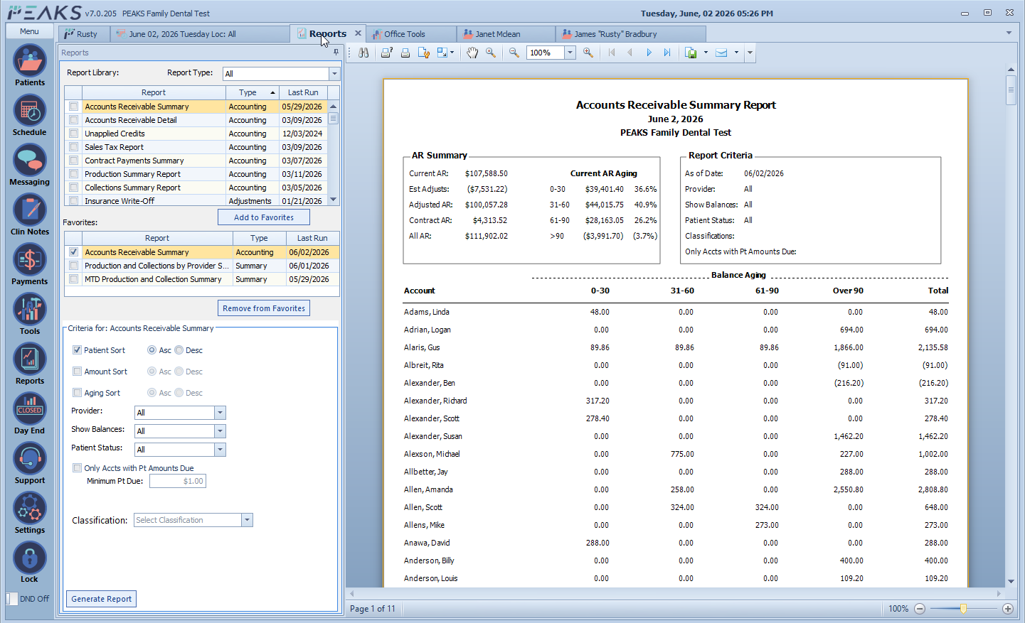
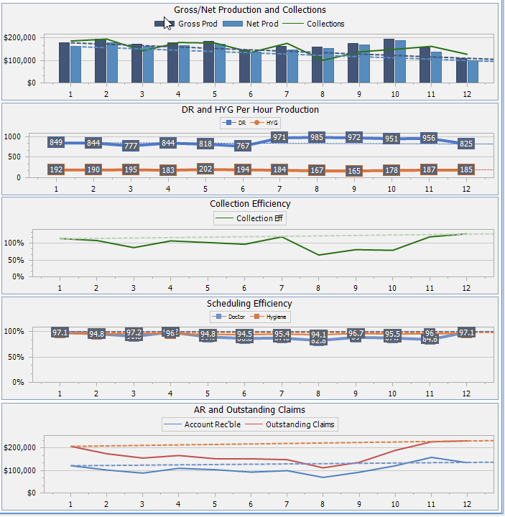
The Problem…
Legacy dental software is failing modern practices — outdated platforms, missing functionality, and no specialty focus leave dentists patching together expensive workarounds.
1. Outdated platforms with inadequate accounting & business tools — most platforms fail to meet modern practice needs
PEAKS delivers professional-grade accounting, reporting, and analytics — data insights simply unavailable in most dental software.
Notes:
PEAKS suite of practice management technologies wasn't born in a garage — or even under its current name. Originally branded as EDDSON, the platform emerged from a decade-long, multi-million dollar endeavor headed by a former software analyst turned dental business consultant and backed by a full-service dental supply company. What came out the other side is one of the most advanced dental practice management solutions available — shaped by real industry experience from the very start.

Slide 3




The Problem…
Legacy dental software is failing modern practices — outdated platforms, missing functionality, and no specialty focus leave dentists patching together expensive workarounds.
2. Incomplete solutions force costly patchwork add-ons — critical features missing from legacy platforms require expensive add-ons that never fully integrate
PEAKS is one of the first all-in-one solutions with fully integrated functionality not found in legacy software:
Patient Text Message and Appointment Reminders
Unique 2-Way Phone System Integration
Web Forms and Payment Processing Modules
Unparalleled Practice Performance Analytics
Notes:
PEAKS suite of practice management technologies wasn't born in a garage — or even under its current name. Originally branded as EDDSON, the platform emerged from a decade-long, multi-million dollar endeavor headed by a former software analyst turned dental business consultant and backed by a full-service dental supply company. What came out the other side is one of the most advanced dental practice management solutions available — shaped by real industry experience from the very start.

Slide 4
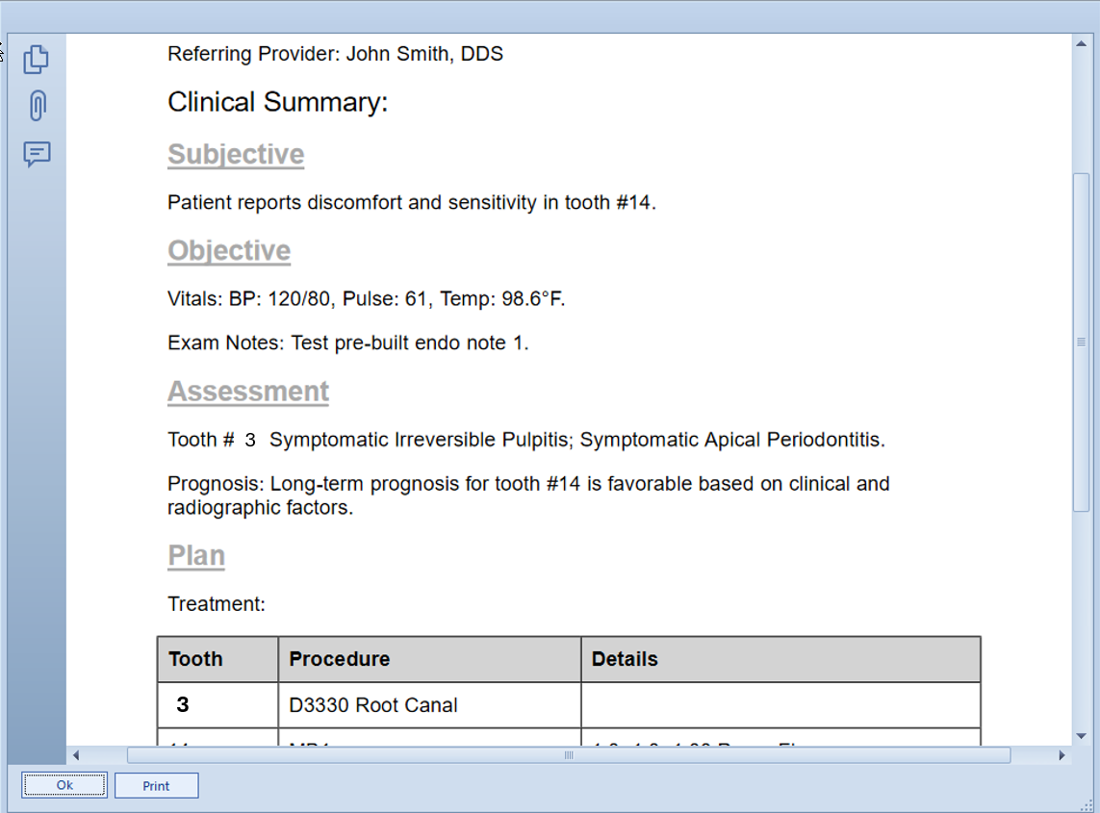
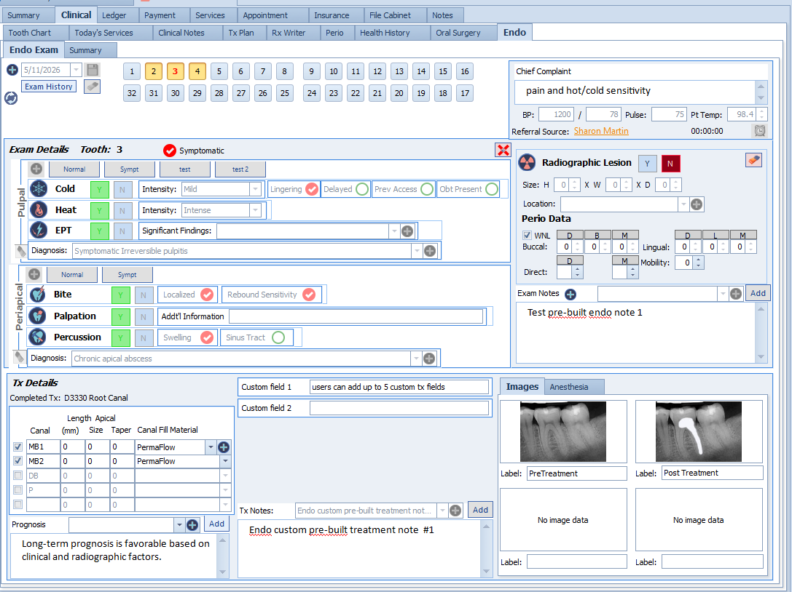
The Problem…
Legacy dental software is failing modern practices — outdated platforms, missing functionality, and no specialty focus leave dentists patching together expensive workarounds.
3. Endodontic specialists are underserved — 5,000+ U.S. endodontists have few viable software options; this segment has been largely ignored by major technology providers
PEAKS Endo Pro™ is the most advanced endo-specific platform available — featuring AI-enhanced clinical notes, advanced exam/treatment workflows, and robust referring provider management.
Notes:
PEAKS suite of practice management technologies wasn't born in a garage — or even under its current name. Originally branded as EDDSON, the platform emerged from a decade-long, multi-million dollar endeavor headed by a former software analyst turned dental business consultant and backed by a full-service dental supply company. What came out the other side is one of the most advanced dental practice management solutions available — shaped by real industry experience from the very start.

Slide 5
Our Team…
Management and Development
James “Rusty” Bradbury, MBA President/Co-Founder
MBA with a background in software analysis, accounting, and 10+ years as a dental business consultant — the firsthand experience that inspired and shaped PEAKS.
John Spano Chief Technology Officer
Seasoned developer with 25+ years building large-scale Windows applications on .NET and Microsoft SQL. Led PEAKS development from inception.
Ron Booth Chief Financial Officer (fractional)
CFO and CPA with Big 4 background, specializing in accounting, finance, and growth strategy. Experienced in supporting software models and founder-led businesses with strong reporting, capital planning, and long-term value creation.
Support and Implementation Resources
Rue George Implementation/Support Specialist
Full time resource with over 10 years dental experience and 5 years direct PEAKS experience.
Jodee Litfin Support Specialist (P/T)
Former dental office manager with over 9 years of direct PEAKS experience.
Michelle Morehead Implementation Specialist (P/T)
Former insurance coordinator and office administrator at a PEAKS beta office and has over 10 years direct experience.
Michel Kanda Support Specialist (P/T)
Former dental office manager/insurance coordinator with 5 plus years of direct PEAKS experience.
Natasha Nivens User Experience Specialist (P/T)
Former dental office manager with over 5 years direct PEAKS experience.
Notes:
PEAKS suite of practice management technologies wasn't born in a garage — or even under its current name. Originally branded as EDDSON, the platform emerged from a decade-long, multi-million dollar endeavor headed by a former software analyst turned dental business consultant and backed by a full-service dental supply company. What came out the other side is one of the most advanced dental practice management solutions available — shaped by real industry experience from the very start.

Slide 6
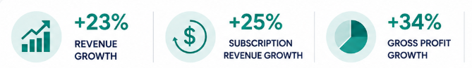
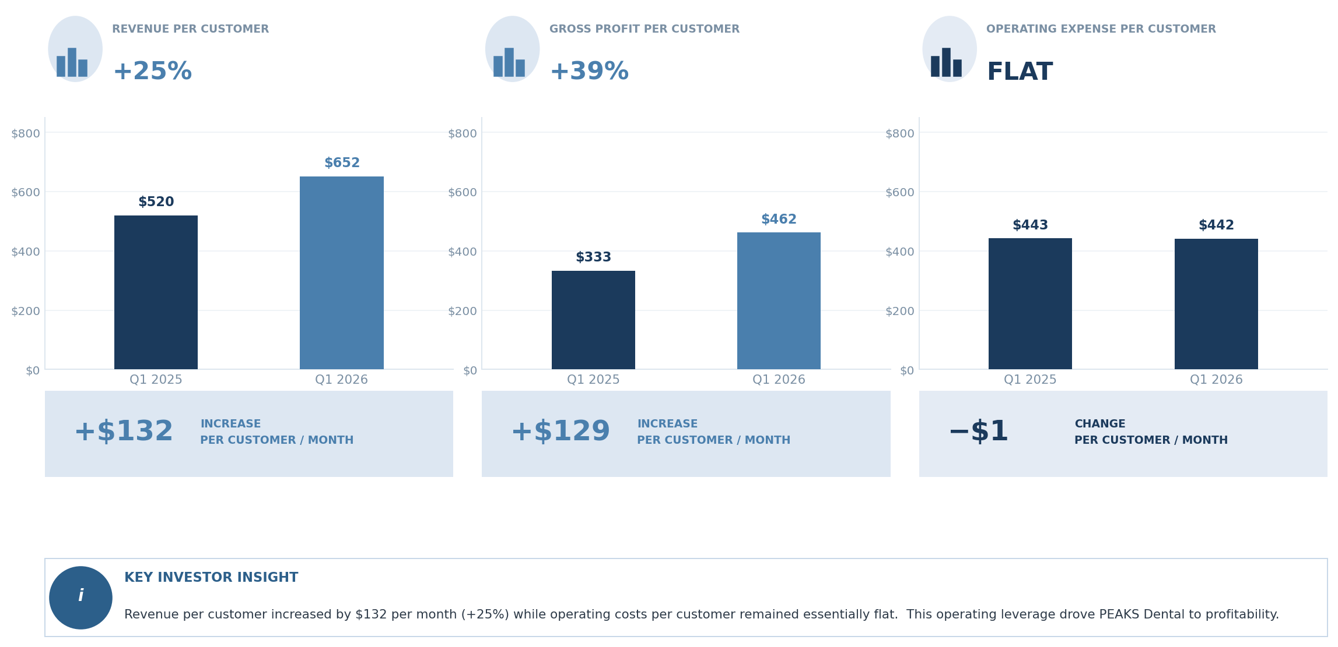
The Numbers: YOY Growth (1st QTR 2025 vs. 2026)…
Double-digit annual revenue and gross profit growth with no significant increase in overhead.
Revenue and Gross Profit
Revenue and Gross Profit Per Customer
Notes:
PEAKS suite of practice management technologies wasn't born in a garage — or even under its current name. Originally branded as EDDSON, the platform emerged from a decade-long, multi-million dollar endeavor headed by a former software analyst turned dental business consultant and backed by a full-service dental supply company. What came out the other side is one of the most advanced dental practice management solutions available — shaped by real industry experience from the very start.

Slide 7
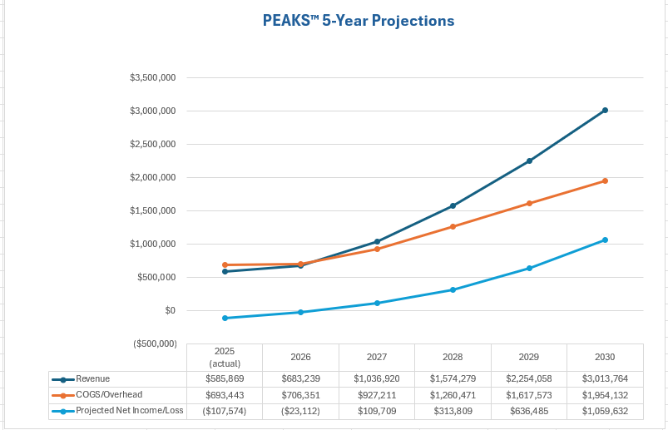
5 Year Financial Projections…
80+ offices and 1,600+ active user licenses. 2026 recurring revenue on pace for $700K, with $3M annual revenue projected by 2030.
Notes:
PEAKS suite of practice management technologies wasn't born in a garage — or even under its current name. Originally branded as EDDSON, the platform emerged from a decade-long, multi-million dollar endeavor headed by a former software analyst turned dental business consultant and backed by a full-service dental supply company. What came out the other side is one of the most advanced dental practice management solutions available — shaped by real industry experience from the very start.

Slide 8
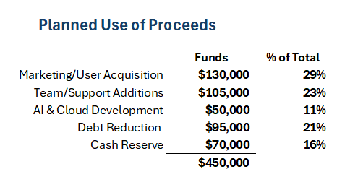
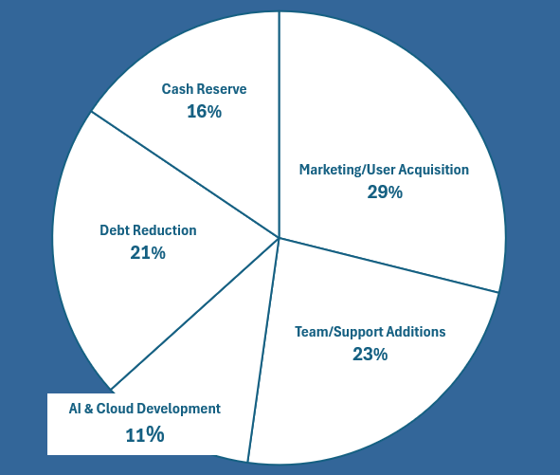
The Ask… $450,000
Seeking $450,000 to accelerate user growth through targeted marketing, expand support personnel, and advance AI and cloud development.
Current company valuation: $4 million*
* Valuation details available on request
Notes:
PEAKS suite of practice management technologies wasn't born in a garage — or even under its current name. Originally branded as EDDSON, the platform emerged from a decade-long, multi-million dollar endeavor headed by a former software analyst turned dental business consultant and backed by a full-service dental supply company. What came out the other side is one of the most advanced dental practice management solutions available — shaped by real industry experience from the very start.

Slide 9
Please Direct Any Inquiries To:
rusty@peaksdental.com
Notes:
PEAKS suite of practice management technologies wasn't born in a garage — or even under its current name. Originally branded as EDDSON, the platform emerged from a decade-long, multi-million dollar endeavor headed by a former software analyst turned dental business consultant and backed by a full-service dental supply company. What came out the other side is one of the most advanced dental practice management solutions available — shaped by real industry experience from the very start.

