Slide 1
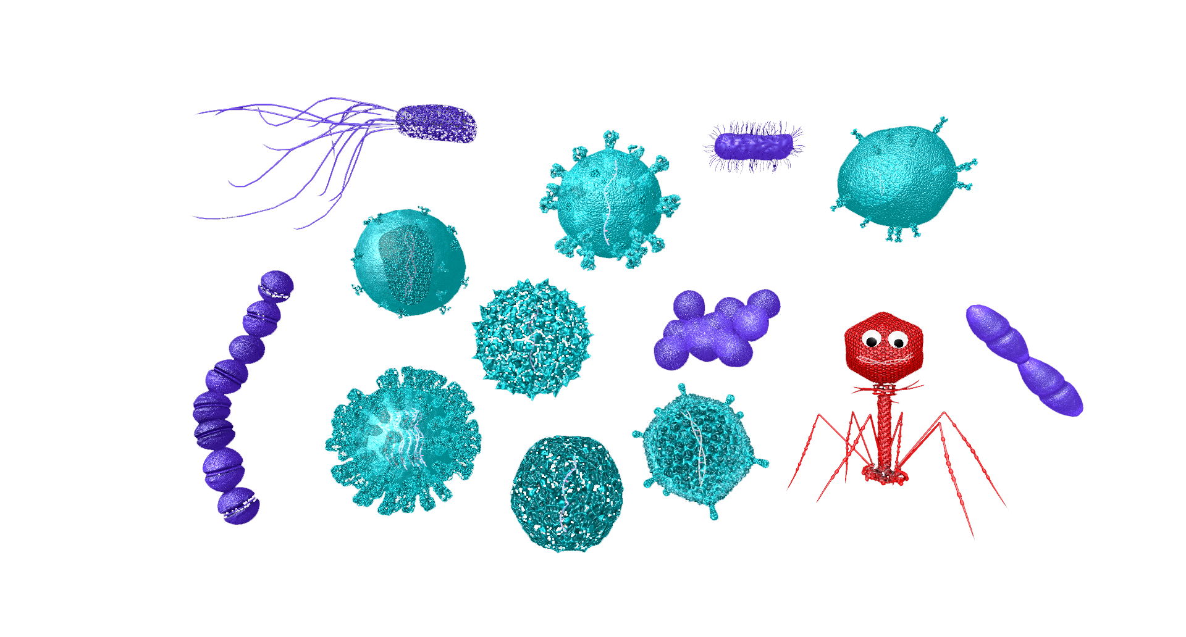

MedMicroMaps
The Atlas
Dr. Jane Harrington
Co-Founder/CEO, MedMicroMaps, Inc.
drjane@medmicromaps.com
www.medmicromaps.com
NOTE: For an optimal experience, please download and launch this presentation from your PowerPoint desktop application. Avoid using PowerPoint online in a web browser.

Slide 2
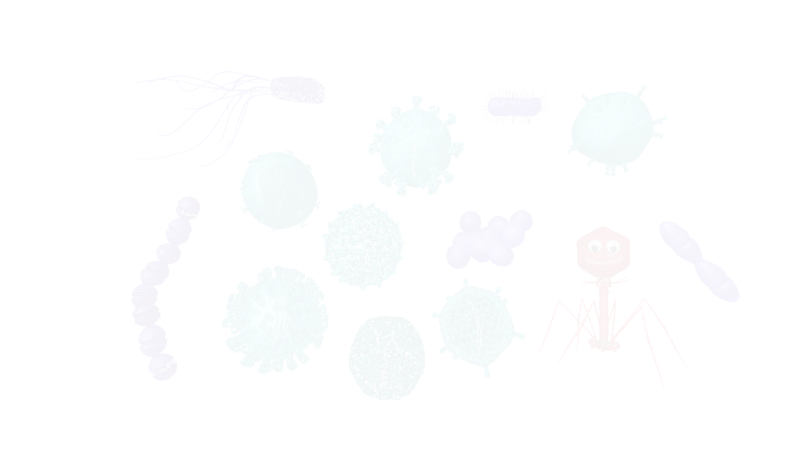
MedMicroMaps: The Atlas
Table of Contents
Overview of Atlas
Biological Classifications
Skin and Soft Tissue Infections
Respiratory Infections
Gastrointestinal Infections
Urogenital Infections
Cardiovascular-Lymphatic Infections
Nervous System Infections
Multi-System Infections
HIV-AIDS
Congenital

Slide 3

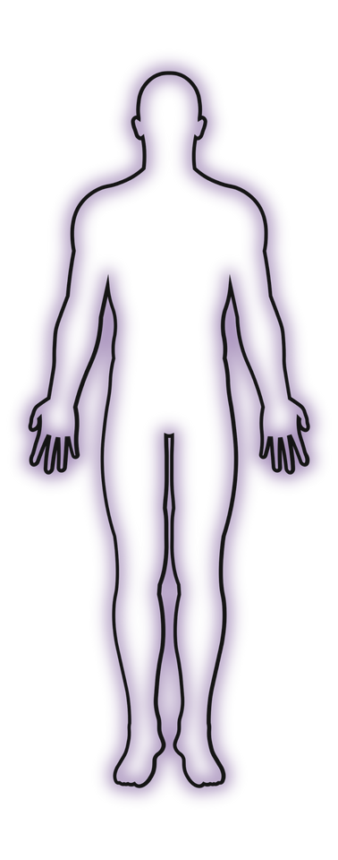
Superficial or Proximal Anatomy
Method Overview
Upper Body
Slow Onset
Fast Onset
West =
Chronic > 30 days
East=
Acute < 7 days
Lower
Deeper or Distal Anatomy

Slide 4
Systems Based Overview
Muco-Cutaneous Infectious
Skin and Soft Tissue
Urogenital
Cutaneous
Subcutaneous
UTI
STI
Respiratory
Gastrointestinal
Upper
Upper
Lower
Lower
Non-inflammatory
Inflammatory
Typical Pneumonia
Atypical Pneumonia

Slide 5
Systems Based Overview
Blood-Borne Infections
Cardiovascular/Blood Lymphatic
HIV-AIDS
Endocarditis
Sepsis
Cutaneous
Organ Systems
Multi-Organ
Nervous
Congenital
Vector Transmission
Inhalation, Ingestion, Penetration
Meningitis
Focal
Intrauterine
Intrapartum
Encephalitis

Slide 6
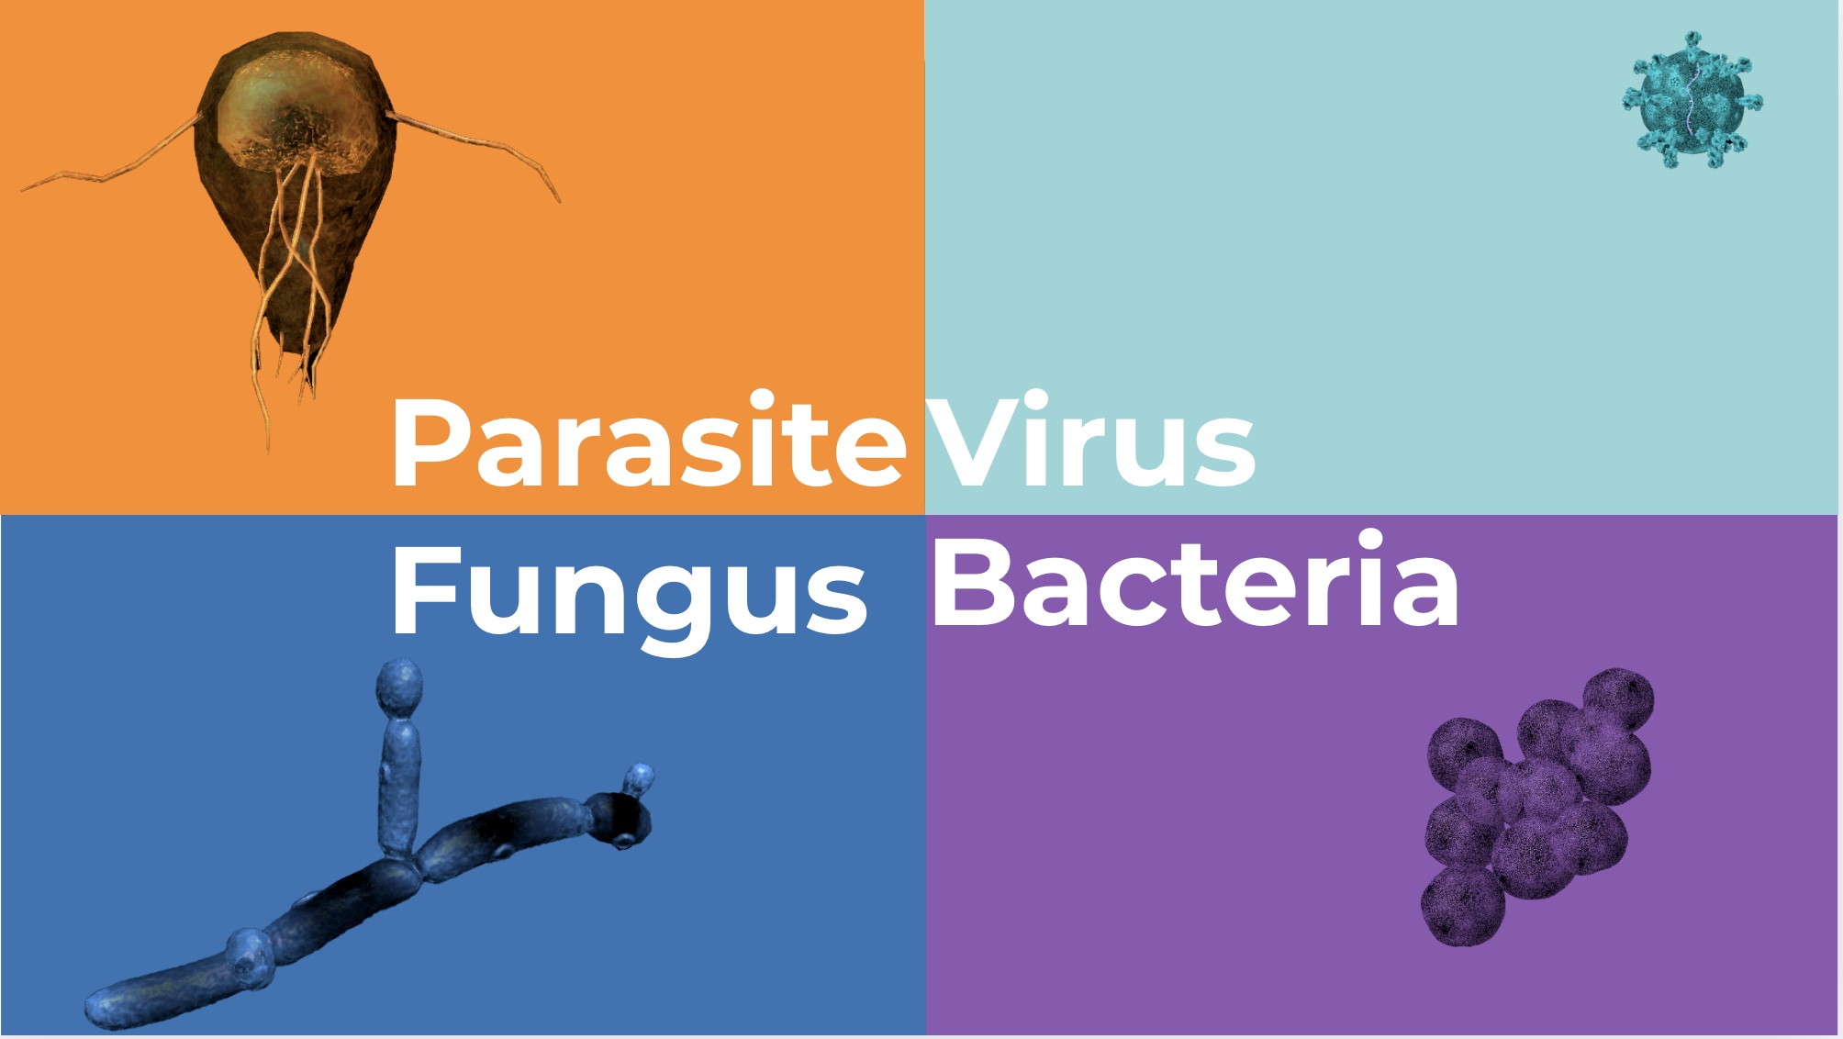
Microbes are classified by color & size

Slide 7
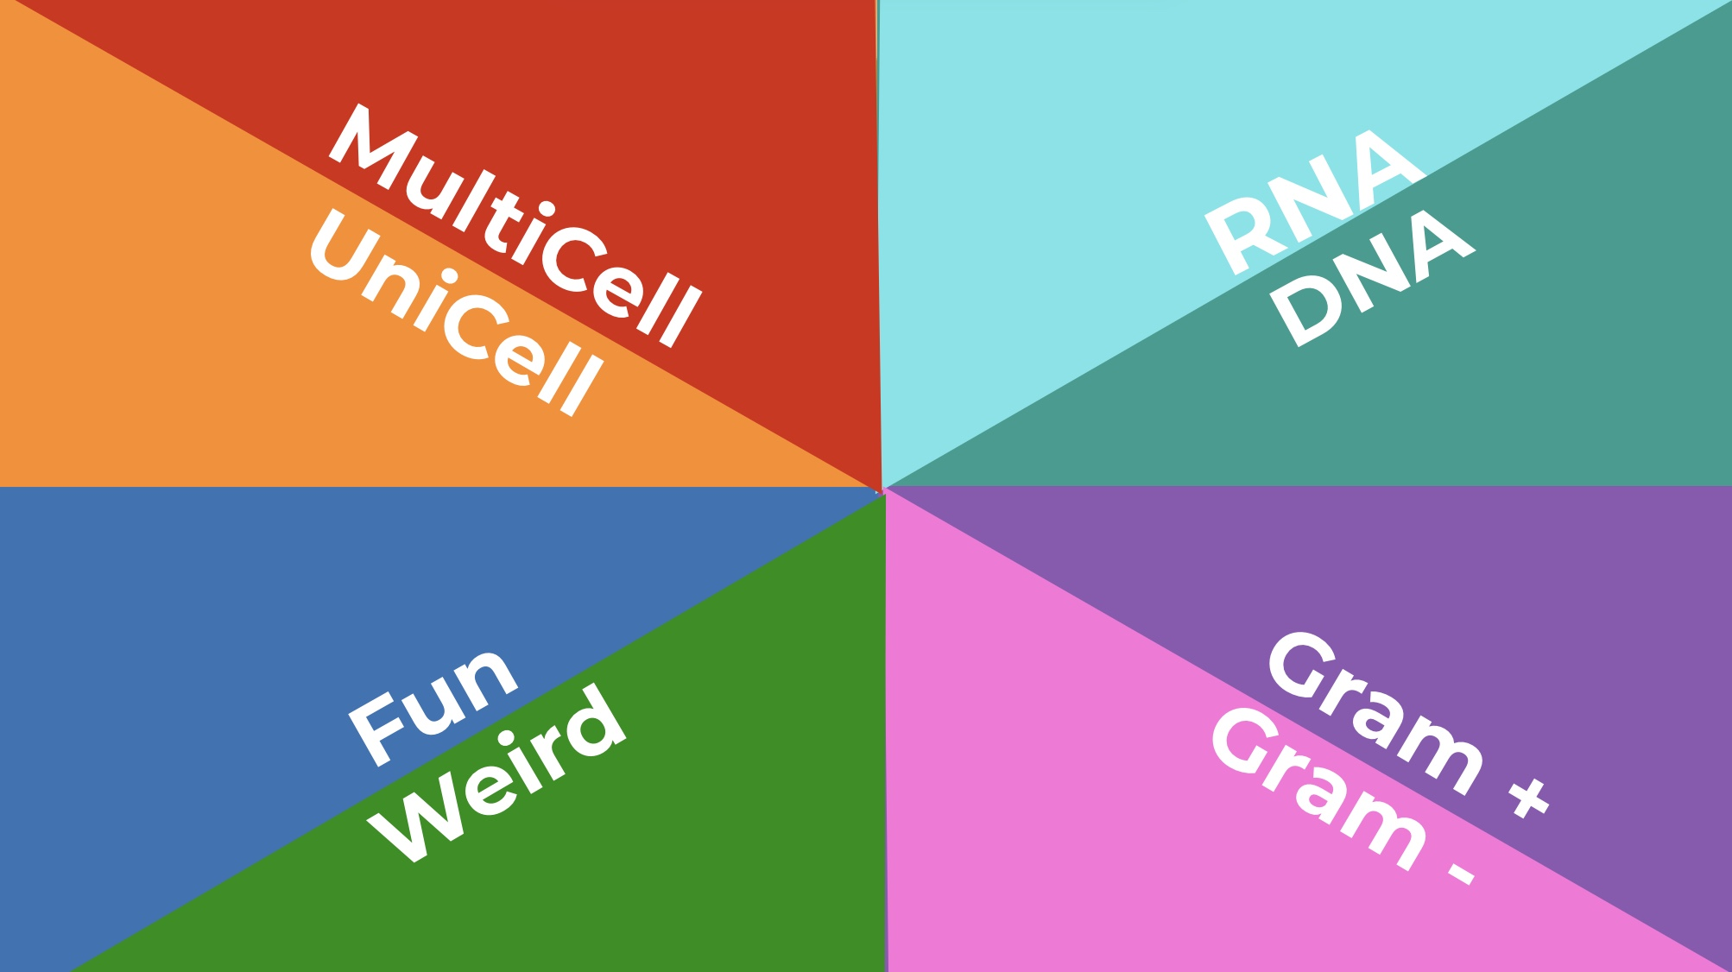
Learner Level
Microbes are sub-classified by biology

Slide 8
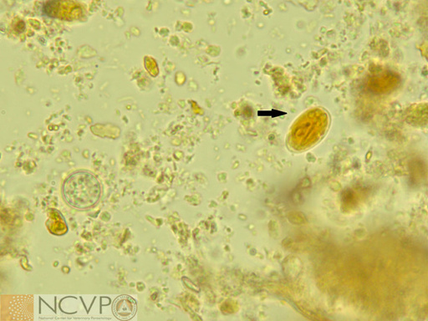
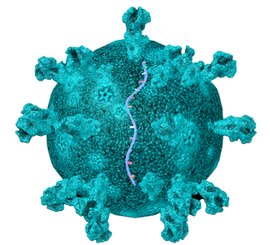
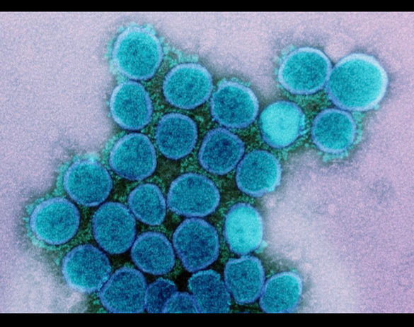
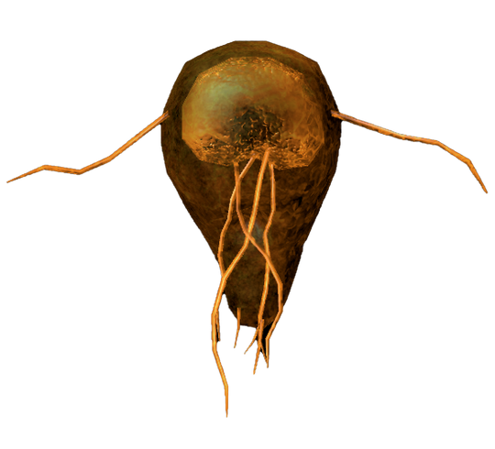
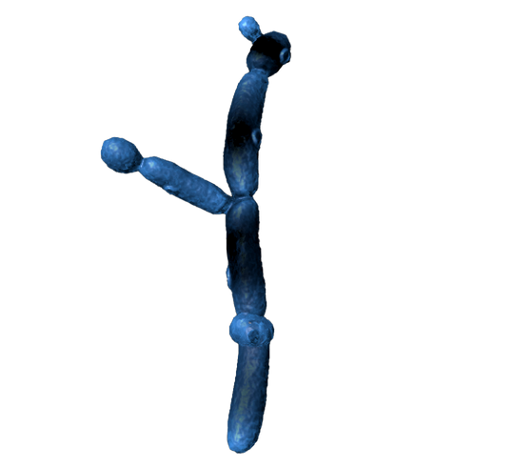
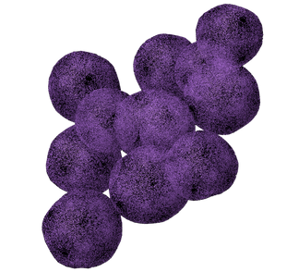
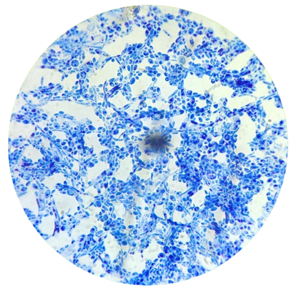
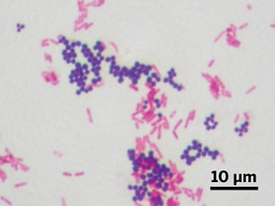
North-West =Parasites
Multicellular on top
Unicellular on bottom
North-East = Viruses
RNA on top
DNA on bottom
South-West = Weird Fun
Blue = Fungi
Green = Weird Bacteria
South-East = Bacteria
Purple = Gram + , Pink = Gram -
Cocci on top, Rods on bottom

Slide 9
Genome
Structure
Family
Virus
Viruses
Learner
Naked (CHRP)
Picorna
Rhino
ss+RNA
Corona
SARS-CoV2
Enveloped (CFTR)
RNA
Retro
HIV
ss-RNA
Enveloped (BAD PROF)
Paramyxo
Measles
Virus
Orthomyxo
Influenza
Naked (PAPP)
Adeno
Adeno
DNA
Herpes
Herpes
RNA Virus
Enveloped (HHP)
DNA Virus

Slide 10
Gram Positive
Bacteria
Learner
Beta
Staph aureus
Catalase +
Cocci
Beta
Strep pyogenes GAS
Catalase -
Gram Positive Bacteria
Alpha
Pneumococcus
Aerobic
Bacillus spp.
Spore Formation
Anaerobic
Clostridium spp.
Bacilli
Gram Positive

Slide 11
Gram Negative
Bacteria
Learner
Cocci
Glu +,
Neisseria gonorrhea
Pleiomorphic
Coccoid-Bacilli
Haemophilus influenzae NTHi, Hib
Gram Negative Bacteria
Lactose +
E. Coli
Motile +
Salmonella
Lactose -
GN Bacilli
Non Motile
Oxidase +
Pseudomonas
Gram Negative

Slide 12
Weird Bacteria
Learner
Mycobacterium tuberculosis
Bacilli
Acid Fast
Filamentous Branching
Nocardia spp.
Spirochetes
Atypical Bacteria
Borrelia
Mycoplasma
No Cell Wall
Chlamydia spp.
Obligate Intracellular
Atypical Bacteria

Slide 13
Fungi
Learner
Candida
Yeast
Cysts
Pneumocystis
Fungus
Blastomyces
Lung/ Systemic
Histoplasma
Mold
Lung/ Systemic
Aspergillus (septate)
Fungus

Slide 14
Parasite Learner
Giardia
Flagellates
Ciliated
Unicellular
Amoeba
Parasite
Sporozoan/ Non-motile
Cryptosporidium
Cestode Tapeworm
Taenia sp.
Multicellular
Trematode Flukes
Nematode Roundworm
Ascaris (adult roundworm)
Parasite

Slide 15
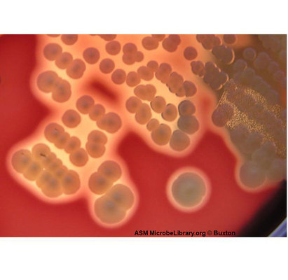
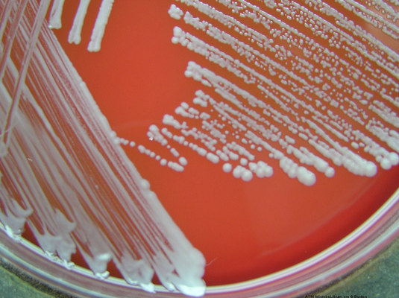
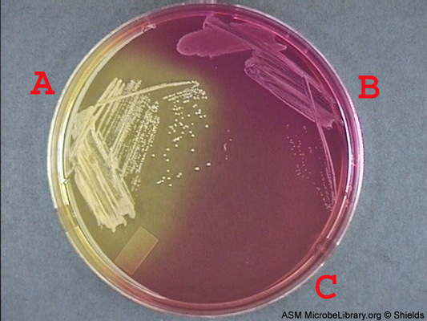
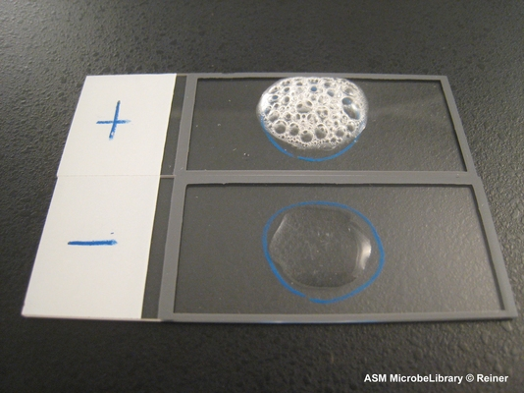
Gram Positive Laboratory Studies
Blood agar
S. aureus
Coagulase +
Staph epidermidis
Beta
Gamma
Catalase +

Slide 16
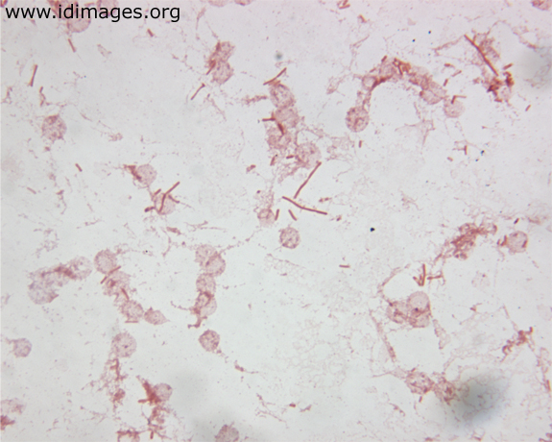
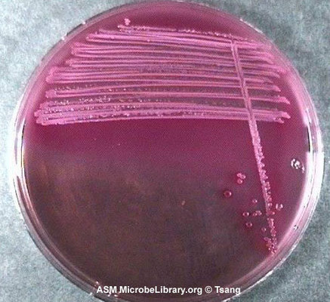
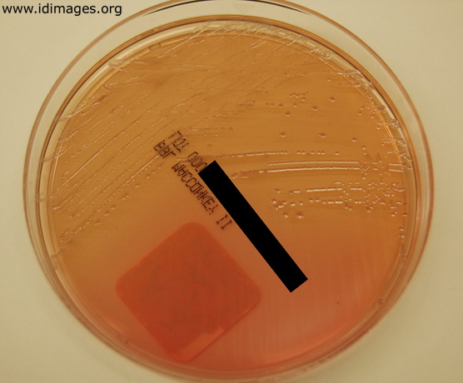
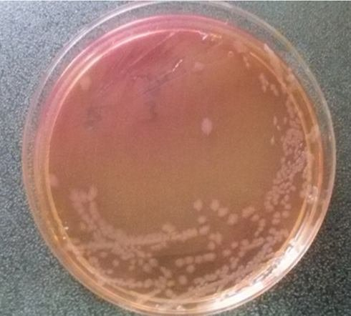
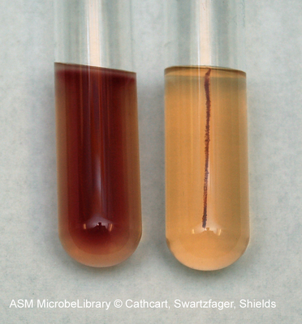
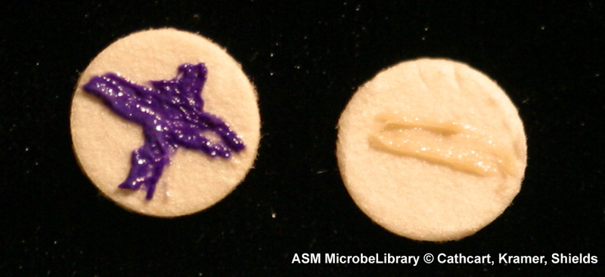
Gram Negative Laboratory Studies
MacConkey agar
Lactose Fermenter
Lactose Non-Fermenter
E. Coli
Salmonella
Pseudomonas
Oxidase +
Motility +

Slide 17
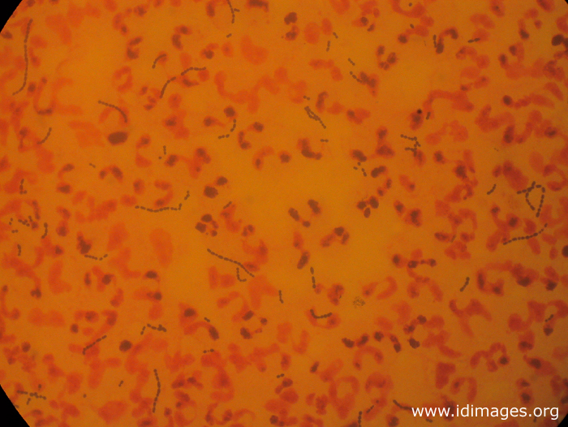
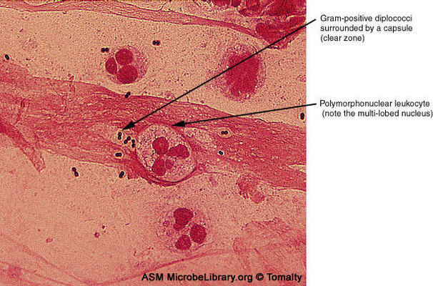
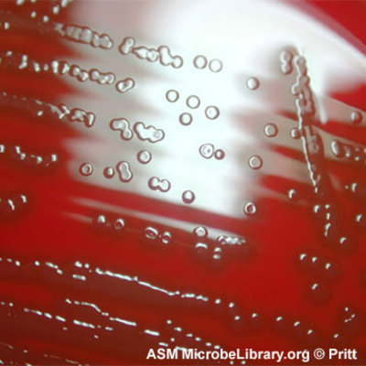
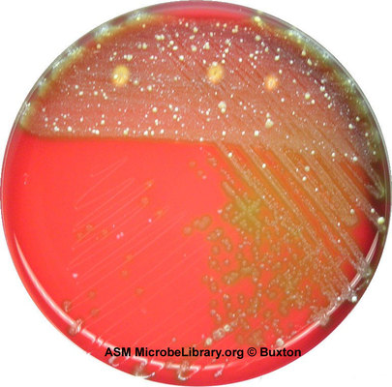
Gram Positive Laboratory Studies
S. pyogenes GAS
S. pneumoniae Quelling +
Blood agar
Alpha
Beta

Slide 18
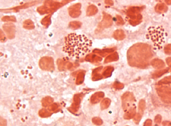
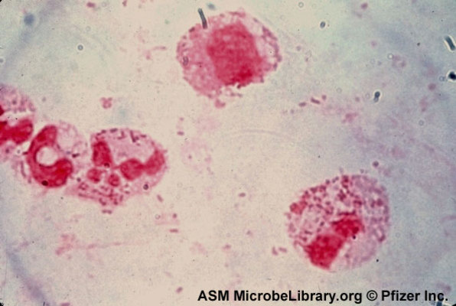
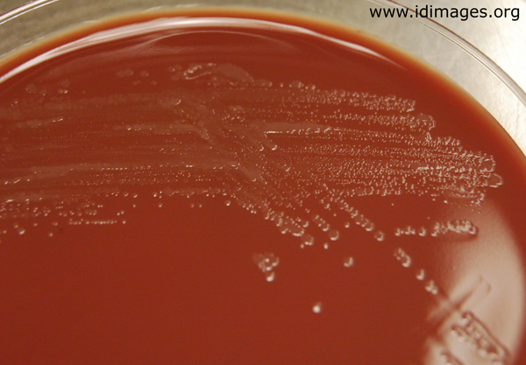
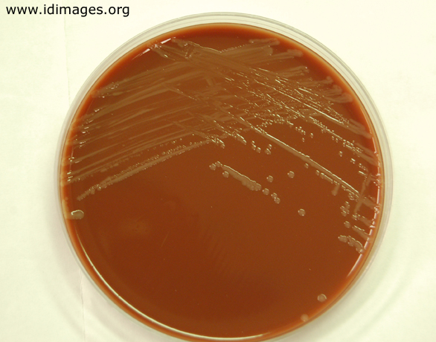
Gram Negative Laboratory Studies
Neisseria gonorrhea
Haemophilus influenzae
Chocolate agar

Slide 19
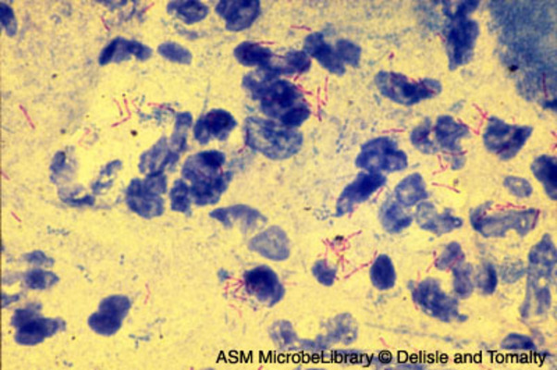
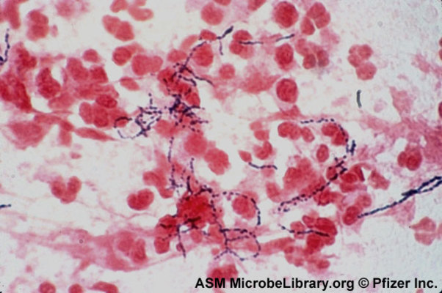
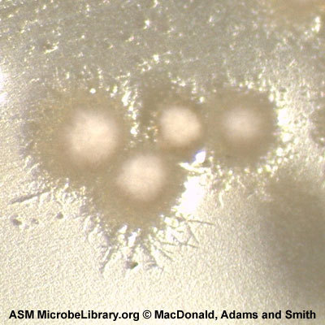
Mycobacterium tuberculosis
Acid Fast stain
Nocardia spp.
Gram stain

Slide 20
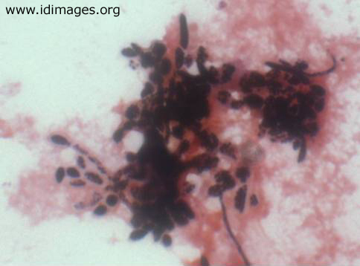
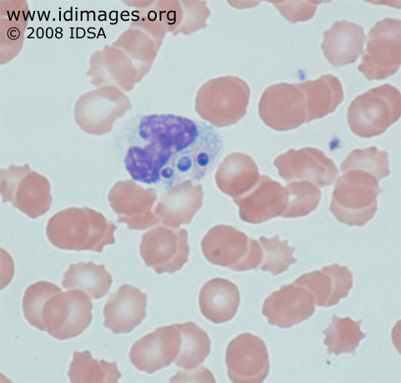
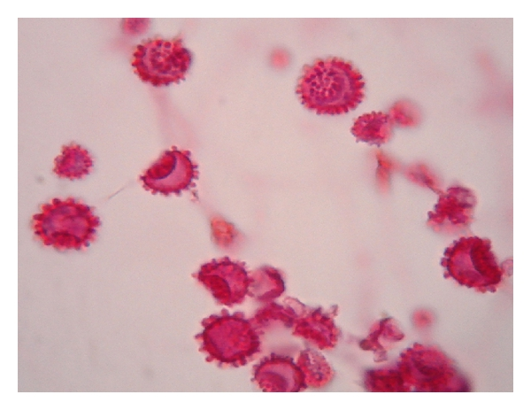
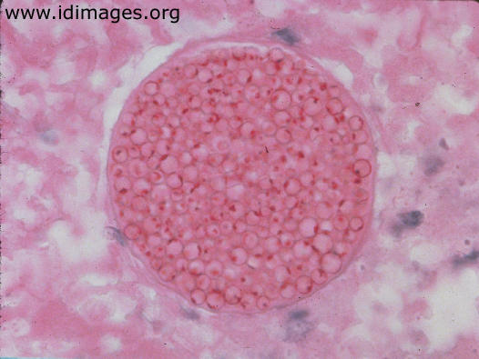
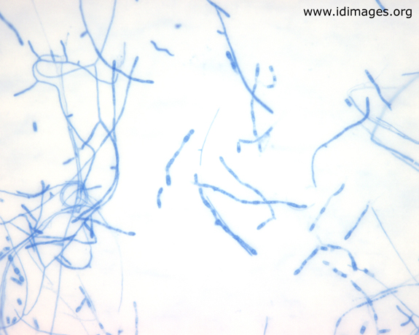
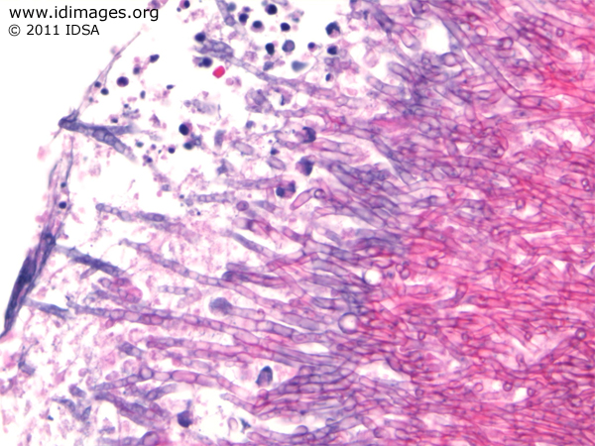
Fungal Laboratory Studies
Histoplasma – Tuberculate conidia 25℃
Intracellular 37℃
Candida - pseudohyphae + yeasts
Coccidioides -Arthroconidia 25℃
Spherule 37℃
https://doi.org/10.1155/2012/643104
Aspergillus – acute angle septate hyphae

Slide 21
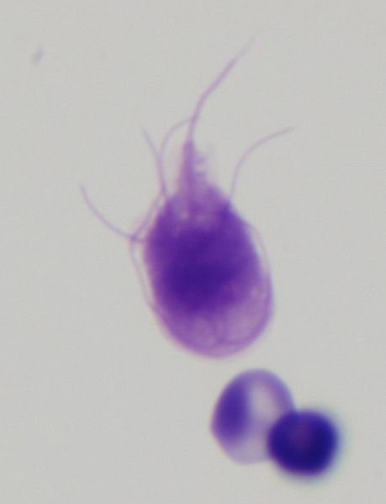
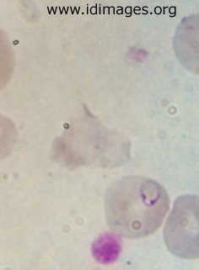
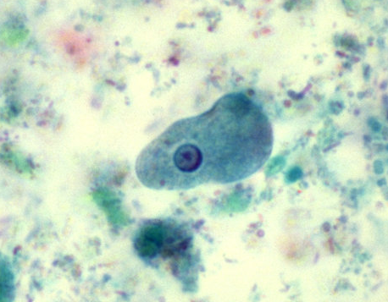
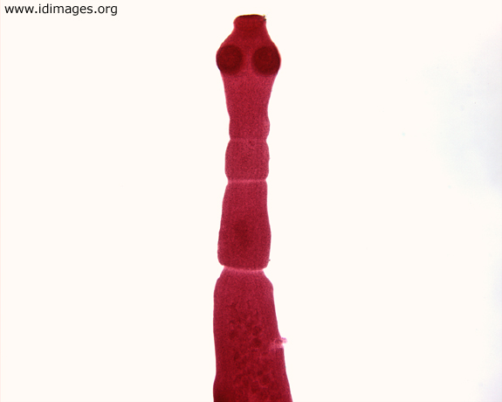
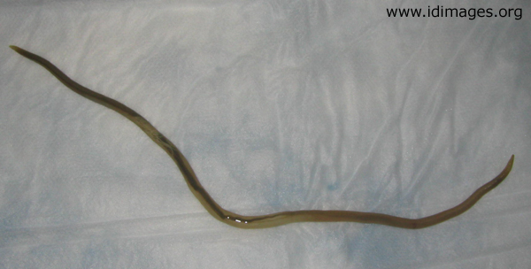

Parasite Laboratory Studies
Giardia - flagellate
Entamoeba - pseudopodia
Plasmodium - Sporozoa
CDC/ Dr. Mae Melvin
Wikipedia Commons
Echinococcus - Cestode
Clonorchis - Trematode
Ascaris - Nematode

Slide 22
MedMicroMaps Compass has 16 groups!
Nematode Roundworm
ss+RNA Virus
Trematode Flatworm Cestode Tapeworm
ss-RNA Virus
Unicellular Non-motile Parasite
Retro Virus
Unicellular Motile Parasite
DNA Virus
Multicellular Fungi
Gram + Cocci
Unicellular Fungi
Gram + Bacilli
Weird Bacteria
Gram - Cocci
Acid Fast Bacteria
Gram -Bacilli
Master Level

Slide 23
Genome
Structure
Family
Virus
Viruses
Master
Naked (CHRP)
Calici, Hepe
Noro, HepE
Reo
Rota
Picorna
Rhino, Entero
ss+RNA
Corona
SARS-CoV2
Flavi
Arbovirus, HepC
Enveloped (CFTR)
Toga
Arbovirus, Rubella
RNA
Retro
HIV, HTLV
Bunya
Hanta
Arena
Lassa
Enveloped (BAD PROF)
Delta
HepD
ss-RNA
Paramyxo
Measles, Mumps, PIV, RSV
Virus
Rhabdo
Rabies
Orthomyxo
Influenza
Filo
Ebola, Marburg
Papilloma
HPV
Naked (PAPP)
Adeno
Adeno
Polyoma
BK, JCV
DNA
Parvo
Parvo B19
Herpes
HSV1/2, VZV, EBV, CMV, HHV6/7, HHV8,
RNA Virus
Enveloped (HHP)
Hepadna
HepB
DNA Virus
Pox
Small, Monkey, Mollusc

Slide 24
Gram Positive
Bacteria
Master
Beta
Staph aureus
Catalase +
Novobiocin R
Staph saprophyticus
Gamma
Novobiocin S
Staph epidermidis
Cocci
Bacitracin R
Strep agalactiae GBS
Beta
Bacitracin S
Strep pyogenes GAS
Catalase -
Optochin R
Viridans Strep
Gram Positive Bacteria
Alpha
Optochin S
Pneumococcus
Strep mutans
Gamma
Enterococcus
Aerobic
Bacillus spp.
Spore Formation
Anaerobic
Clostridium spp.
Bacilli
No-spores
C. diphtheriae
Gram Positive
Listeria
Actinomyces

Slide 25
Gram Negative
Bacteria
Master
Mal +, Glu +
Neisseria meningitidis
Cocci
Glu +,
Neisseria gonorrhea
Moraxella catarrhalis
Haemophilus influenzae NTHi, Hib
Bordetella Pertussis,
Brucella, Francisella,
Bartonella, Acinetobacter,
Bacteroides, Gardnerella
Legionella
Pleiomorphic
Coccoid-Bacilli
Gram Negative Bacteria
Lactose +
E. Coli, Klebsiella, Citrobacter, Serratia
Proteus spp.
Motile +
Salmonella
Lactose -
Yersinia
GN Bacilli
Non Motile
Shigella, Pasteurella
Oxidase +
Pseudomonas
H. pylori
GN
Curved Rods
(Oxi+)
Campylobacter
Gram Negative
Vibrio spp.

Slide 26
Weird Bacteria
Master
Mycobacterium tuberculosis
Bacilli
M. leprae
Acid Fast
Filamentous Branching
Nocardia spp.
Treponema
Spirochetes
Atypical Bacteria
Borrelia
Leptospira
No Cell Wall
Mycoplasma spp.
Chlamydia spp.
Obligate Intracellular
Rickettsia spp.
Ehrlichia Anaplasma
Atypical Bacteria
Coxiella

Slide 27
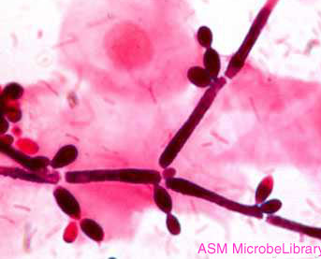
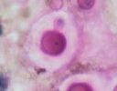
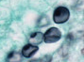
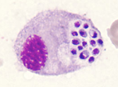
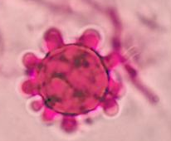





Fungi
Master
Candida
Yeast
Cryptococcus
Cysts
Lung
Pneumocystis
37˚
25˚
Fungus
Histoplasma
Lung/ Systemic
Coccidioides
Blastomyces
Mold
Lung/ Systemic
Aspergillus (septate)
Fungus

Slide 28
Parasite Intestinal
Master
Giardia
Flagellates
Trichomonas *STD*
Ciliated
Balantium
Unicellular
Amoeba
Entamoeba
Parasite
Sporozoan/ Non-motile
Cryptosporidium
Cyclospora
Cestode Tapeworm
Taenia sp.
Multicellular
Trematode Flukes
Fasciolopsis
Enterobius (pinworm)
Ascaris (adult roundworm)
Ancylostoma/Necator (hookworm)
Trichuris (whipworm)
Strongyloides
Nematode Roundworm
Parasite

Slide 29
Parasite Tissue
Master
Flagellates
Trypanosoma sp
Leishmania sp
Unicellular
Amoeba
Naelgeria
Acanthamoeba
Sporozoa/ Non-motile
Plasmodium, Toxoplasma
Parasite
Cestode Tapeworm
Echinococcus sp.
Schistosoma – Lymphatics
Paragonimus – lung
Fasciola – liver
Clonorchis – liver
Trematode Flukes
Multicellular
Trichnella
Nematode Roundworm
Parasite
Wuchereria
Onchocerca
Brugia

Slide 30

An 8-year-old child with 1-day history of fever and sore throat
Physical exam:
Purulent exudate from pharynx and tonsils
Chest sounds are unremarkable
Upper Body
Other relevant history:
Up-to-date with vaccines
Slow Onset
Fast Onset
Lower
Key questions:
  How long?
  Vaccination status?
  Cough or other symptoms

Slide 31
A 8-year-old girl with 1-day history of fever and sore throat.
What are your top differential diagnosis?
Staph aureus
Strep pyogenes
Escherichia coli
Salmonella
Neisseria
Clostridium spp.
Mycobacterium spp.
Nocardia
Mycoplasma spp.
Rickettsia spp.

Slide 32
An 8-year-old girl with 1-day history of fever and sore throat
Gram Stain of throat swab
Blood agar culture of throat swab

Slide 33







Gram Positive Laboratory Studies
Streptococcus
Cocci in chains
Hydrogen Peroxide (H₂O₂ ➜ H₂O+O₂)
Catalase -
✗
✓
Strep Viridans
Cocci in chains
β-hemolysis
(clear halo)
⍺-hemolysis
(green halo)
Blood agar plate
S. pyogenes
Lancefield Group A
S. Viridans

Slide 34

Skin and Soft Tissue
A 32-year-old man with a painful lesion on his knuckle, worsening over a 72-hour period
Key questions:
  How long?
  Is there a fever, headache?
  Exposure history?
Other relevant history:
Cut hand doing yard work
Unremarkable health history
Physical exam:
Draining exudate on left middle digit
Patient is alert and responsive

Slide 35
A 32-year-old man with a painful lesion on his knuckle, worsening over a 72-hour period. What are your top differential diagnosis?
Staph aureus
Strep pyogenes
Escherichia coli
Salmonella
Neisseria
Clostridium spp.
Mycobacterium spp.
Nocardia
Mycoplasma spp.
Rickettsia spp.

Slide 36

A 32-year-old man with a painful lesion on his knuckle, worsening over a 72-hour period
Gram Stain of purulent discharge

Slide 37






Gram Positive Map
Hydrogen Peroxide (H₂O₂ ➜ H₂O+O₂)
Catalase +
Beta
S. aureus
Catalase +
Gamma
Staph epidermidis
Cocci
Beta
Bacitracin S
S. pyogenes
Gram Positive Bacteria
Catalase -
Alpha
Optochin S
S. pneumoniae
Gram stain (+ purple / - pink)
Shape and arrangement (round / rod)
Catalase (+ bubbles / - no bubbles
Hemolysis (Alpha/Beta/Gamma)
MacConkey agar (Lactose fermenter/non-fermenter)
No-spores
Aerobic
Listeria
Bacilli
Spore Formation
Anaerobic
Clostridium sps.
Clostridium difficle
Gram Positive

Slide 38



Gram Positive Laboratory Studies
Hydrogen Peroxide (H₂O₂ ➜ H₂O+O₂)
Catalase +
✓
✗
Staphylococcus
Cocci in clusters
β-hemolysis
(clear halo)
Ɣ-hemolysis
(no lysis)
Staphylococcus
Cocci in clusters
Blood agar plate
S. aureus
Staph epidermidis

Slide 39

A 32-year-old man with a painful lesion on his knuckle, worsening over a 72-hour period
Antibiotic Susceptibility of Staph aureus isolate
Sensitive to β-lactams
Resistant to fluoroquinolones

