Slide 1



C.R.E.W Pilot Competent, Resilient, Engaged Workforce Building a future ready workforce
Stantec UK Case Study

Slide 2

The Challenge
Stantec senior leaders recognised that:
As artificial intelligence advances, human intelligence must advance with it.
Sustainable performance will require a workforce capable of applying judgement, discernment, intuition and emotional intelligence to work effectively alongside powerful technology.

Slide 3
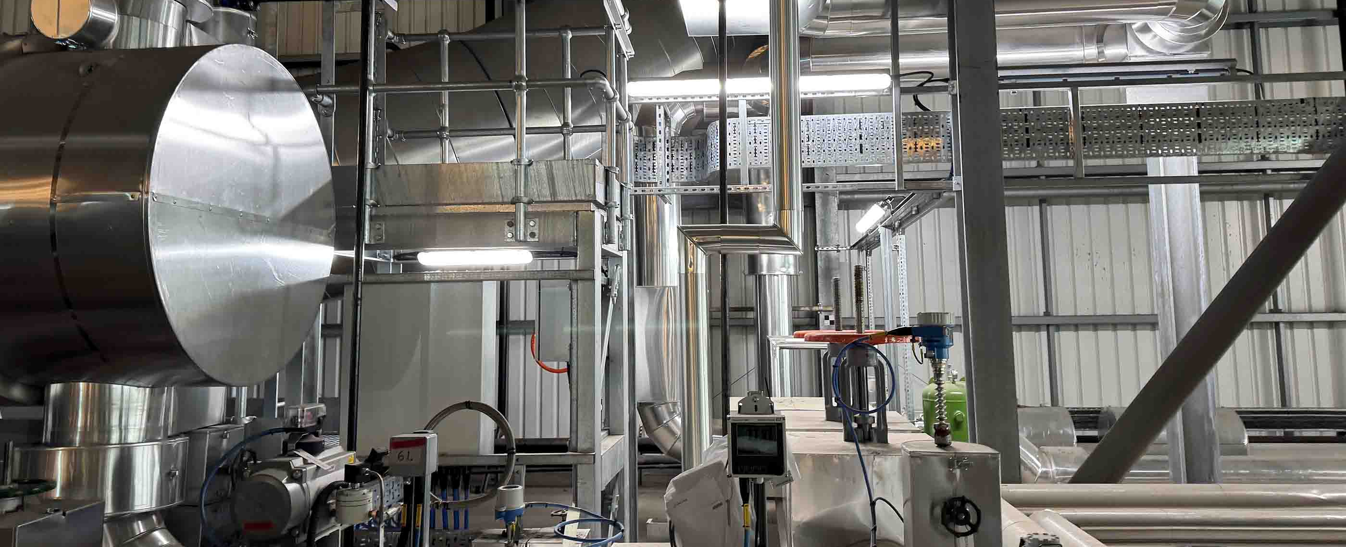
The Pilot
Stantec's Operations & Maintenance division partnered with The Golden Thread to test a scalable approach to enhancing human intelligence and capability skills in the workforce.

Slide 4

Introducing CREW - Competent, Resilient, Engaged Workforce
The Online Pilot Program Included:
11 video modules
A Learning Guide
64 activities
E-book
4+ hours learning
Focus: Self, Relational & Team skills

Slide 5
Stantec Internal Engagement Evaluation
70%
of the pilot group would recommend the program
to colleagues
The voluntary pilot generated strong engagement, with some participants completing the full program, and others engaging with modules most relevant to their development.

Slide 6

Evaluation Highlights
Interpersonal skills - improved collaboration, reading the room
Emotional awareness -understanding behaviours of other people
Future orientation - clearer vision, goals and motivation
Practical mindset tools -particularly the “shelf” concept to engage with new ideas over time
Stantec's internal review identified these improvements

Slide 7

Behaviour Shifts
Participants reported the following:
Improved self-awareness
Proactively supporting colleagues
Adopting a growth mindset
Open to new perspectives
Clarified personal and professional direction
Aligned individual goals with team and department goals

Slide 8
Applied Learning
The evaluation demonstrated that pilot participants were able to apply learning to daily work.

Slide 9

Participant Insights
“I am more mindful of my emotions and less reactive.” “I proactively support others now and rethink how I engage.” “I link my goals with team and departmental goals."
"I can read the room better now - which influences how I act".

Slide 10

Improvement Feedback
A consistent theme emerged from Stantec's internal evaluation of the pilot.
Participants recommended:
Structured development time
Facilitated discussion and reflection
Face-to-face or live virtual sessions alongside online learning

Slide 11

CREW Program Evolution
In response to the evaluation feedback, the program has evolved into a blended model - one that combines flexible online learning with regular online coaching.
This approach strengthens:
✔ Behaviour change
✔ Accountability
✔ Real-world application

Slide 12

Organisational Impact
The CREW pilot program demonstrates that:
Employees engage when development feels relevant and practical.
The digital model enables scalable delivery.
There is a strong appetite for personal development within Stantec’s workforce.

Slide 13

Proven Impact
CREW is a tested, endorsed and scalable solution that created measurable behavioural impact in the Stantec pilot group.

