Slide 1



Build a Future-Ready Workforce
AI is no longer a concept on the horizon - it's here, reshaping every job, industry and profession.
Notes:
According to McKinsey's Future of Work Report (2024), 40% of global work tasks will be automated by 2030.
Yet paradoxically, the demand for human-centric skills - emotional intelligence, creativity, judgement, discernment - is increasing fast than ever. The question isn't how to compete with AI - it's how to leverage it.

Slide 2

Two Capabilities Will
Drive Performance in an AI Enabled World
Handling the disruption will require a dual focus - AI capability to enhance productivity - and HI (human intelligence) to translate that productivity into performance.
Both must be scalable, cost-effective and deliver lasting results.

Slide 3
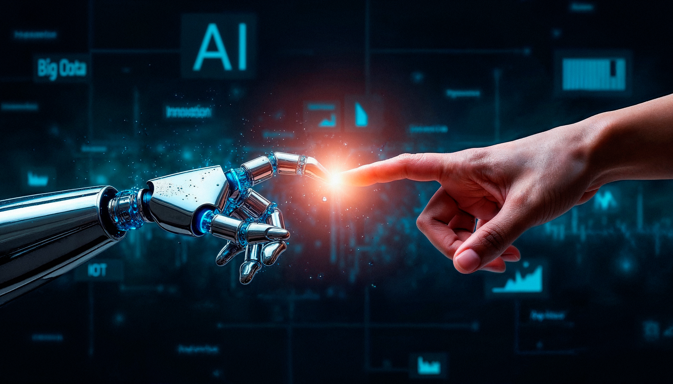
Human Intelligence & Capability at Scale
For people to perform and thrive alongside Artificial Intelligence, organisations will need to intentionally develop Human Intelligence and capability within a structured, scalable framework.

Slide 4



Introducing C.R.E.W.
Competent, Resilient, Engaged Workforce
A structured digital learning program designed to build human intelligence and capability across self, relational and team skills.
SELF
RELATIONAL
TEAM
Notes:
We have now explored five modern workforce challenges - attraction, engagement and retention, generational integration, technological disruption, and performance.
But beneath them all lies one solution: developing your people.

Slide 5

C.R.E.W.
Competent, Resilient, Engaged Workforce
CREW provides the framework, and a clear pathway to strengthening:
Self-leadership skills
Relational skills
Team performance skills
At scale and designed for lasting impact.

Slide 6


CREW Digital Foundation
✔ Full access to 10 structured, animated learning modules
✔ Practical tools to strengthen human intelligence - self-leadership, relational skills and team performance skills
✔ On-demand, scalable development across the workforce
✔ LEO (Life Education Online) included free for employees’ families
INVESTMENT – £275 per participant

Slide 7

2. Digital Foundation + Coaching Integration
Digital learning combined with structured monthly coaching to embed behavioural change.
• Online CREW Foundation
• Monthly 60-minute small-group coaching
• Real-world application
• Peer learning and accountability
• Sustained momentum across the program
Notes:
We have now explored five modern workforce challenges - attraction, engagement and retention, generational integration, technological disruption, and performance.
But beneath them all lies one solution: developing your people.

Slide 8
CREW Digital Foundation + Coaching Includes
Full CREW Digital Foundation program
10 monthly group coaching sessions (up to 5 people)
LEO online program complimentary for families
Annual program investment : £1,225 per participant
The cost of replacing a single employee can equal 1-2 x their annual salary -
even modest improvements in retention and engagement justify this investment.

Slide 9
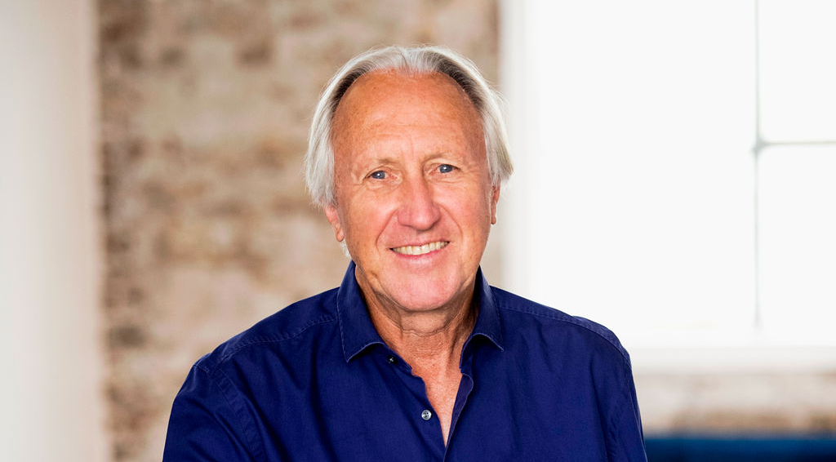
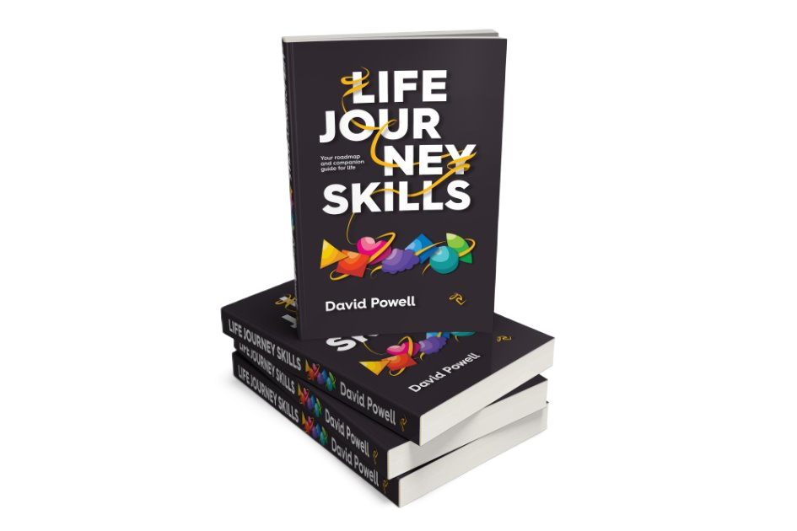









Proven Leadership Behind CREW
David Powell is an author, executive mentor and coach, and the founder of The Golden Thread programs. He has four decades of experience strengthening leadership and team performance across global organisations. His work demonstrates that when people develop their full human capability, sustained high performance follows naturally.
CREW is the structured digital evolution of this work, designed for scale.

Slide 10
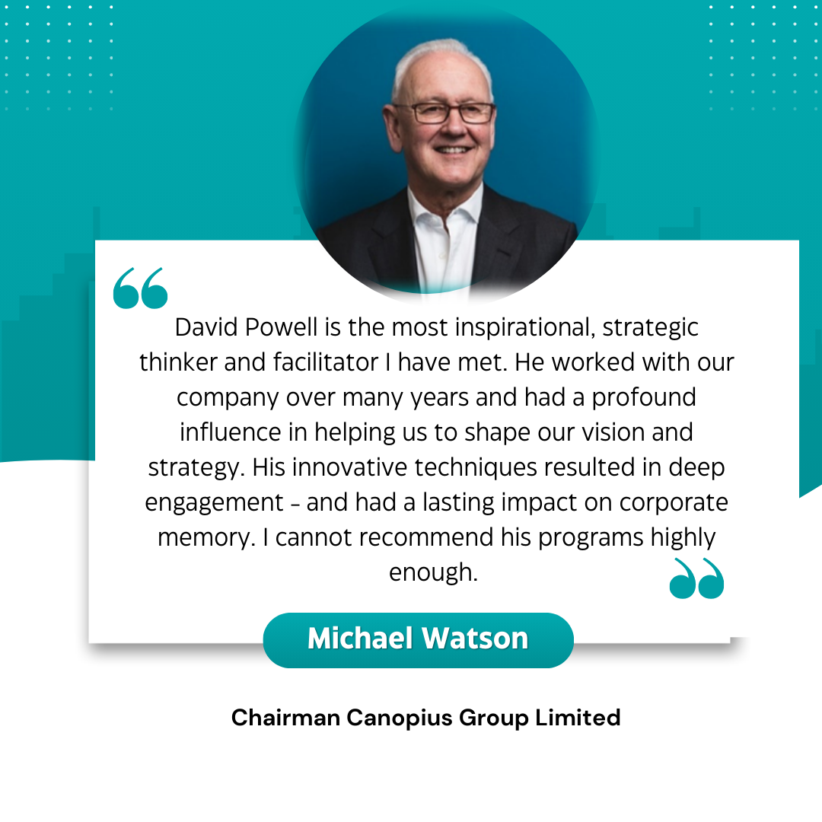
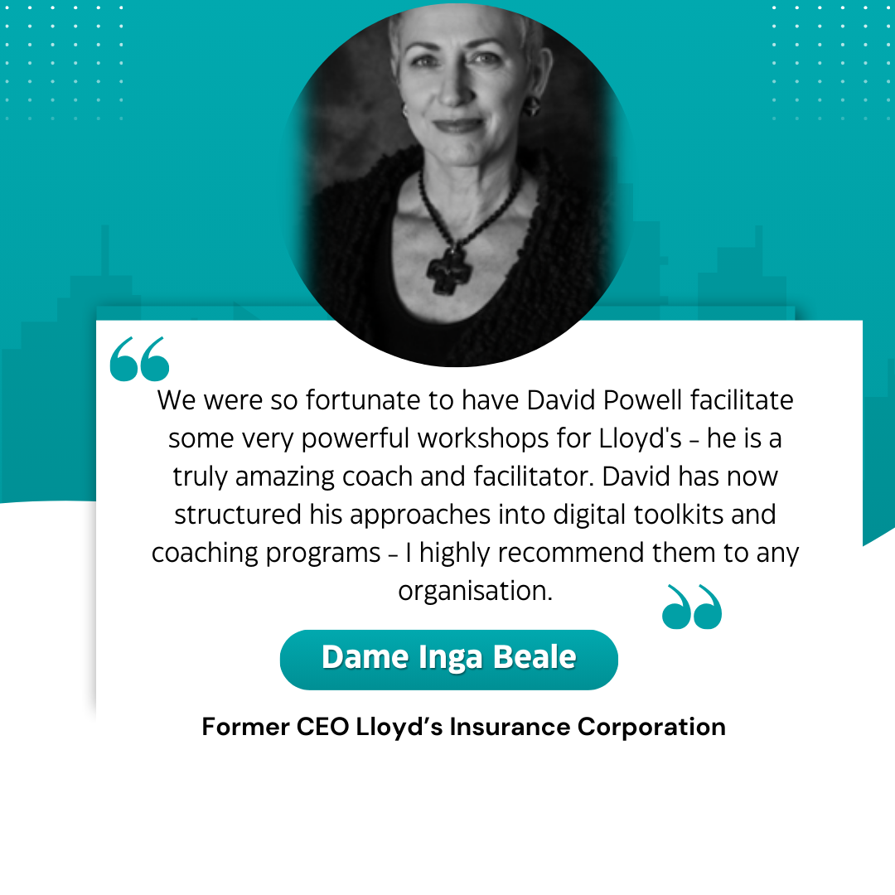
What people say about David Powell's Work

Slide 11
Ready to Build a Future-Ready Workforce?
In an AI-enabled world, organisations that invest in human intelligence and capability today, will protect future performance.
A CREW pilot allows you to:
Test engagement and impact with a defined cohort.
Gather measurable feedback to determine if a wider - rollout could be of value.
Let's schedule a strategic conversation if this interests you.

