Slide 1
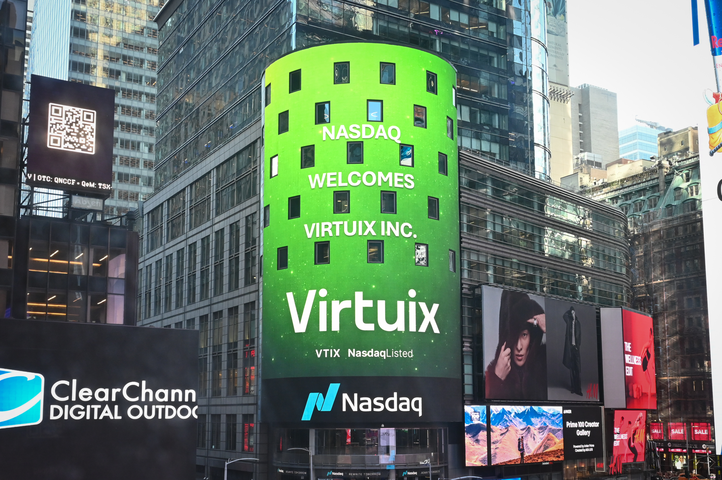

Q3 & Nine-Month Fiscal 2026 Earnings Results
Three and Nine Months Ended December 31, 2025
March 5, 2026
NASDAQ: VTIX
Presenters: Jan Goetgeluk, CEO | Thomas McGinnis, CFO

Slide 2
Disclaimer & Forward-Looking Statements
This presentation may contain forward-looking statements and information relating to, among other things, the company, its business plan and strategy, and its industry. These statements reflect management's current views with respect to future events based on information currently available and are subject to risks and uncertainties that could cause the company's actual results to differ materially.
Investors are cautioned not to place undue reliance on these forward-looking statements as they contain hypothetical illustrations of mathematical principles, are meant for illustrative purposes, and they do not represent guarantees of future results, levels of activity, performance, or achievements.
In some cases, you can identify forward-looking statements by terminology such as "may," "will," "should," "expects," "intends," "plans," "anticipates," "believes," "estimates," "predicts," "potential," "continue" or the negative of these terms or other comparable terminology.
The forward-looking statements in this presentation represent our views as of the date of this presentation. We anticipate that subsequent events and developments will cause our views to change. However, while we may elect to update these forward-looking statements at some point in the future, we assume no obligation to update or revise any forward-looking statements except to the extent required by applicable law.
This presentation does not constitute an offer to sell or an invitation to purchase or subscribe for any securities of the Company for sale in the United States or anywhere else. Any decision to purchase the Company's securities should be made solely on the basis of the information contained in the Company's public filings. Neither the Securities and Exchange Commission nor any state securities commission has approved or disapproved of these securities or passed upon the accuracy or adequacy of this presentation.
Virtuix Holdings Inc. (NASDAQ: VTIX) |Third Quarter and Nine Months Ended FY2026 Earnings Presentation | March 5, 2026

Slide 3


Agenda
CORPORATE OVERVIEW
KEY HIGHLIGHTS
On the Call Today:
Jan Goetgeluk
STRATEGIC MILESTONES
Founder, CEO & Chairman
Virtuix Inc.
CEO COMMENTARY
Thomas McGinnis
Chief Financial Officer
Virtuix Inc.
FINANCIAL RESULTS
PRIORITIES & OUTLOOK
Virtuix Holdings Inc. (NASDAQ: VTIX) |Third Quarter and Nine Months Ended FY2026 Earnings Presentation | March 5. 2026

Slide 4
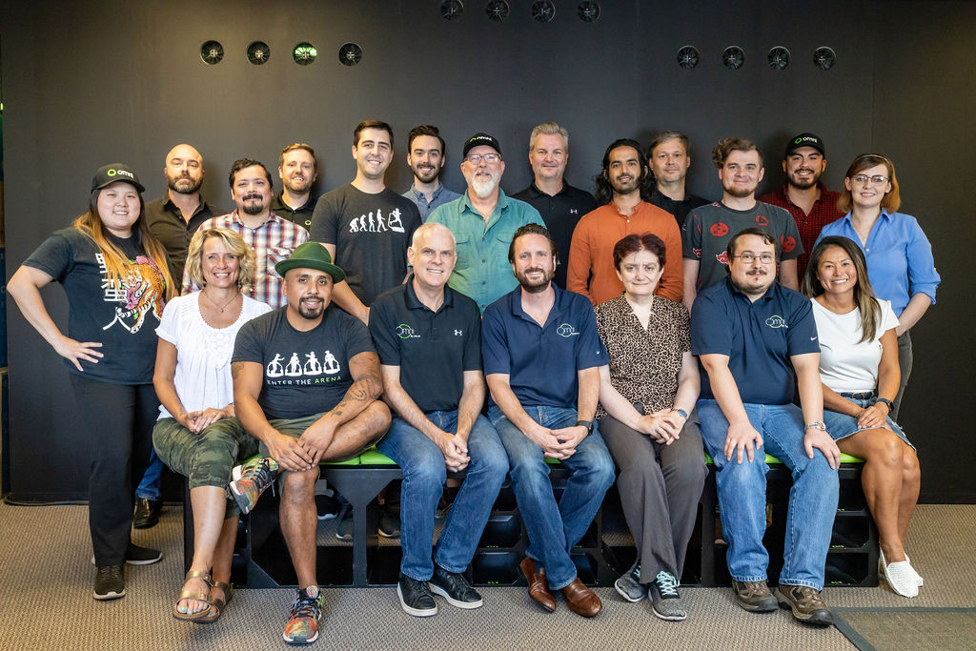
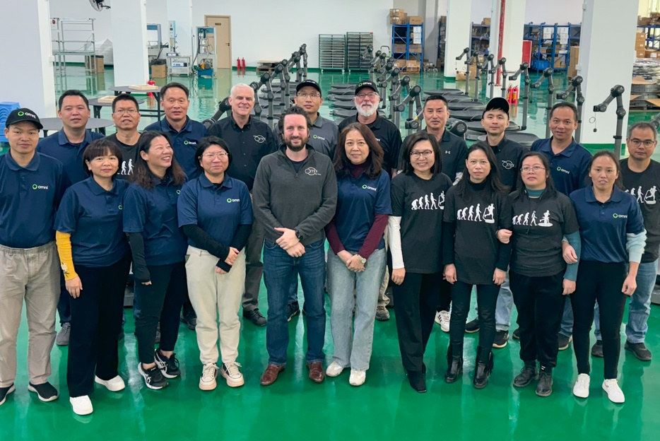
Virtuix’s U.S. team in Austin, TX
Corporate Overview
A Leader in Full-Body VR for Gaming, Enterprise, and Defense
NASDAQ Listed (VTIX) — Trading since January 27, 2026 — validating a decade of investment in full-body VR technology.
Omni One: Flagship Product — Omni-directional treadmill that enables natural full-body movement in 360 degrees inside VR games or simulations.
We are hardware experts and have a track record of success
4 Products | 25 Patents — Omni One & Omni One Core (consumer), Omni One Enterprise, and Virtual Terrain Walk (VTW) defense simulation system.
Manufacturing at Scale — Facility ready for up to 3,000 units/month — $100M+ annual revenue potential at full utilization.
Multi-Use Revenue Strategy — High-volume consumer gaming + high-value defense & enterprise training with recurring revenues from software.
AI-Driven Gaussian Splatting — Transforms 360° footage into photorealistic walkable 3D worlds in hours — powering VTW defense training.
Virtuix’s China team in Zhuhai, China
Virtuix Holdings Inc. (NASDAQ: VTIX) |Third Quarter and Nine Months Ended FY2026 Earnings Presentation | March 5, 2026

Slide 5





Key Highlights
FINANCIAL PERFORMANCE
+41%
29%
−45%
+43%
Revenue Growth
Gross Margin
OpEx Reduction
Net Loss Improvement
9M YoY to $3.0M
Q3: (24%) to $1.0M
9M vs. (17%)
Q3: 30% vs. (2%)
9M: $6.3M vs. $11.4M
Q3: $2.1M vs. $1.8M
9M: ($6.9M) vs. ($12.0M)
Q3: ($2.7M) vs. ($2.0M)
STRATEGIC MILESTONES
NASDAQ Listed
Made for Meta
Europe Launch
UCF & 1HMX Partnerships
VTW + AI
VTIX | Jan 27, 2026
Quest ecosystem
UK, DE, FR & EU
Robot teleoperation
Gaussian splatting
Virtuix Holdings Inc. (NASDAQ: VTIX) |Third Quarter and Nine Months Ended FY2026 Earnings Presentation | March 5, 2026

Slide 6
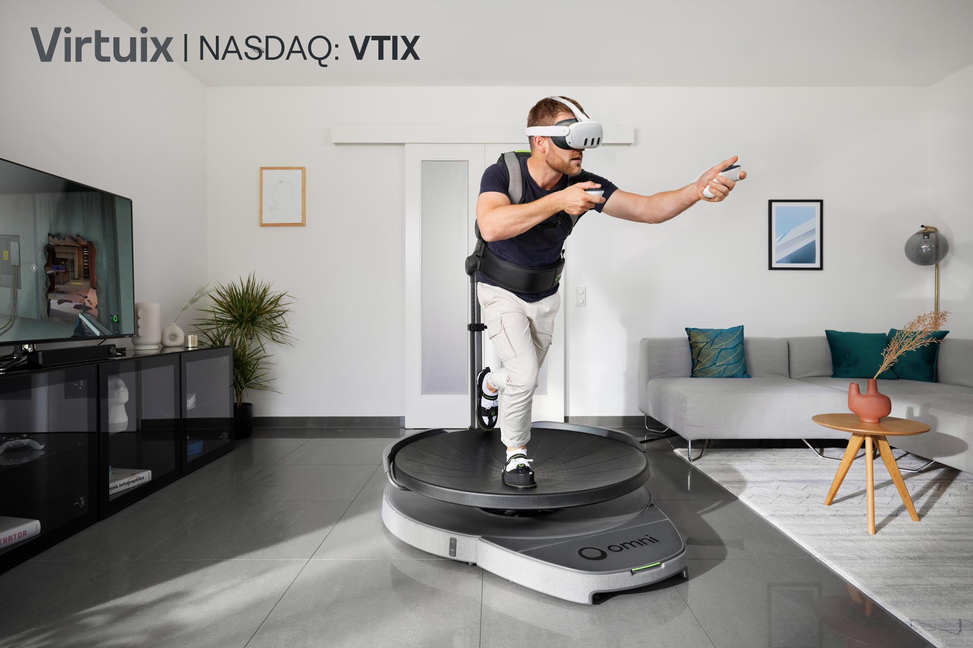


Strategic Partnership: Made for Meta
Expanding Addressable Market to Millions of XR Users
Meta Certified Partnership
Omni One joins the exclusive 'Made for Meta' program — Meta's certified ecosystem for Quest headsets and games.
20M+ Quest Headsets Sold | Estimated 6M Active Users
Expands Omni One's addressable market to an estimated 6 million active Quest users who can use Omni One with their existing headset and games.
Broadens Distribution
Omni One gains certified integration and will be promoted on Meta’s Made for Meta website.
Mass Market Opportunity
Foundational step toward bringing full-body VR with Omni One to a truly mass audience.
Virtuix Holdings Inc. (NASDAQ: VTIX) |Third Quarter and Nine Months Ended FY2026 Earnings Presentation | March 5, 2026

Slide 7

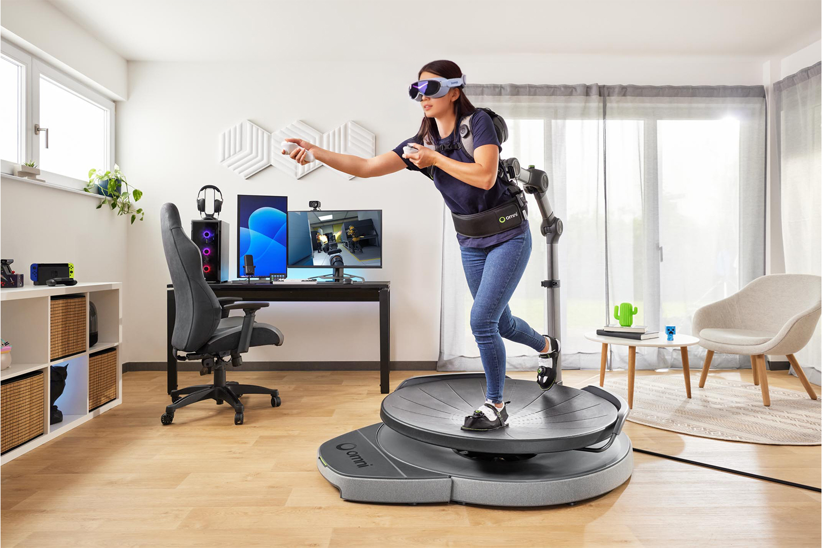

International Expansion & New Partnerships
EU Launch + Pimax Collaboration + HSA/FSA Eligibility
European Market Launch
Omni One Core now available across UK, Germany, France, and all other EU countries via dedicated storefronts. Initial shipments expected April 2026.
Pimax Partnership at CES 2026
Exhibited at CES 2026 with Pimax showcasing Omni One + Pimax Dream Air headset for PC VR / SteamVR compatibility.
HSA/FSA Eligible via Truemed
Omni One purchasable with pre-tax health savings dollars — saving buyers ~30%. Wellness angle broadens consumer appeal.
Virtuix Holdings Inc. (NASDAQ: VTIX) |Third Quarter and Nine Months Ended FY2026 Earnings Presentation | March 5, 2026

Slide 8
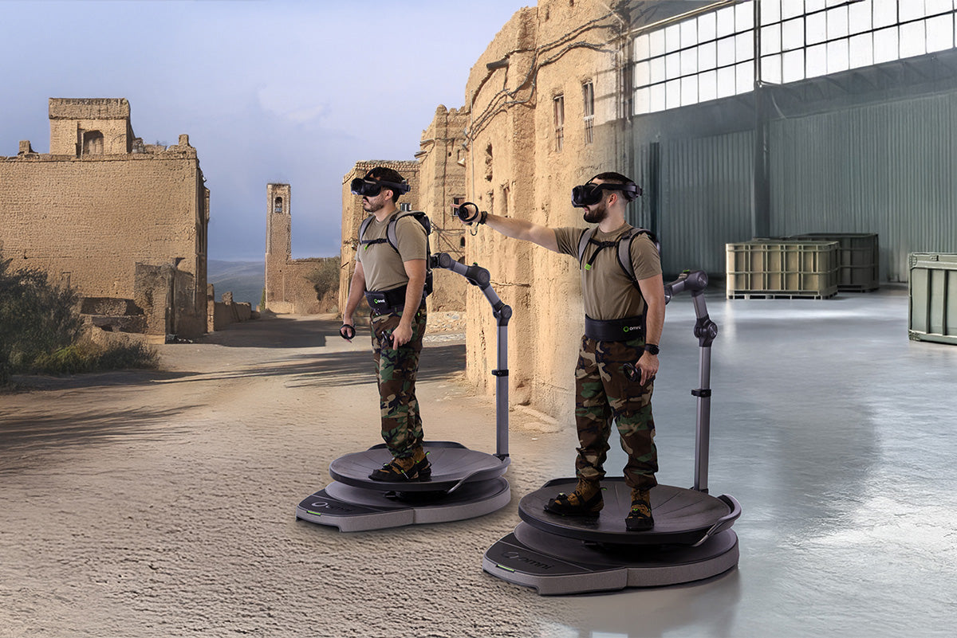


Defense Segment: Virtual Terrain Walk + AI Integration
High-value government contracts advancing alongside consumer sales
AI-Powered 3D Terrain Reconstruction
Gaussian splatting AI transforms 360° camera footage into photorealistic, walkable 3D environments — reducing build time from weeks or months to just hours
Early defense adoption: test units purchased by Yokota Air Force Base, U.S. Air Force Academy, and U.S. Military Academy at West Point
Supports 12+ soldiers simultaneously for immersive mission planning, terrain recon, and leader rehearsals
Defense contracts add high-margin recurring revenues from software licensing and customized simulation development
Virtuix Holdings Inc. (NASDAQ: VTIX) |Third Quarter and Nine Months Ended FY2026 Earnings Presentation | March 5, 2026

Slide 9
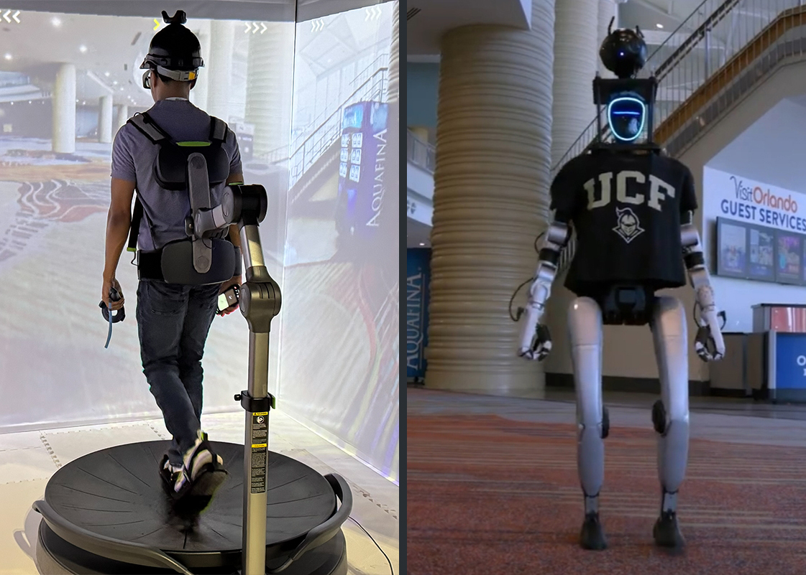
Technology Advances: Embodied AI
Humanoid Robot Teleoperation and Movement Data Collection
Humanoid Robot Teleoperation
Collaborated with University of Central Florida's Institute for Simulation &
Training to demonstrate real-time humanoid robot control using Omni One Enterprise
Translated natural 360-degree walking into intuitive robot teleoperation
Showcased Omni One’s role in embodied AI for both robot teleoperation and movement data collection to help train robots
Partnership with 1HMX to Develop Nexus NX1
NX1 combines Omni One Enterprise with HaptX gloves G1 to deliver lifelike tactile and force feedback
Enables real-time operator control with immersive sensory feedback for intuitive humanoid robot teleoperation and physical AI training
Virtuix Holdings Inc. (NASDAQ: VTIX) |Third Quarter and Nine Months Ended FY2026 Earnings Presentation | March 5, 2026

Slide 10
Financial Results – Revenue & Gross Margin
Nine Months Ended December 31, 2025 vs. Prior Year
▲ 41% Revenue Growth | $0.9M increase driven by new Omni One sales including from a strong holiday season
▲ 41% Margin Improvement: 29% vs. (17%) — driven by higher ASP and fulfillment of crowdfunding units
Virtuix Holdings Inc. (NASDAQ: VTIX) |Third Quarter and Nine Months Ended FY2026 Earnings Presentation | March 5, 2026

Slide 11
Operating Expenses & Net Loss Improvement
Nine Months Ended December 31, 2025 vs. Prior Year - Significant Cost Discipline Driving Path to Profitability
G&A Expenses
▼ $4.7M decrease
R&D Expenses
▼ $1.4M decrease
Selling Expenses
▲ $1.0M increase
Net loss improved 43% YoY: ($6.9M) vs. ($12.0M)
Note: Net loss in 9M FY2025 included ~$4.7M one-time non-cash stock-based compensation expense
Virtuix Holdings Inc. (NASDAQ: VTIX) |Third Quarter and Nine Months Ended FY2026 Earnings Presentation | March 5, 2026

Slide 12
Financial Results – Revenue & Gross Margin
Three Months Ended December 31, 2025 vs. Prior Year
▲ Prior year Q3 included shipments of a large backlog of Omni One
▲ New orders increased 60% in Dec. ’25 compared to Dec. ‘24
▲ Margin Improvement: 30% vs. (2%) — driven by increase in selling price and lower per-unit manufacturing overhead
Virtuix Holdings Inc. (NASDAQ: VTIX) |Third Quarter and Nine Months Ended FY2026 Earnings Presentation | March 5, 2026

Slide 13
Operating Expenses & Net Loss
Three Months Ended December 31, 2025 vs. Prior Year
G&A Expenses
▼ $0.1M decrease
R&D Expenses
▼ $0.1M decrease
Selling Expenses
▲ $0.5M increase
Higher interest expenses and amortization of debt discount associated with Streeterville notes and higher advertising costs resulted in a higher net loss despite underlying improvement in gross profitability
Virtuix Holdings Inc. (NASDAQ: VTIX) |Third Quarter and Nine Months Ended FY2026 Earnings Presentation | March 5, 2026

Slide 14
Balance Sheet Summary
December 31, 2025 vs. March 31, 2025
($ in 000’s) | Dec 31, 2025 | Mar 31, 2025 | Change/Comments
Cash & Equivalents | $1,075 | $478 | ▲ $597
Assets | $6,355 | $5,775 | ▲ $580
Liabilities | $9,308 | $6,569 | ▲ $2,739
Streeterville Notes | $3,340 | — | Will Convert Into Equity
Second 2025 Unsecured Notes | $1,650 | — | $715K Converted Into Equity
2024 Unsecured Notes | $1,968 | $2,368 | ▼$400
Stockholders Deficit | ($2,953) | ($794) | ▲ $2,159
Accumulated Deficit | ($69,385) | ($62,493) | ▲ $6,892
Net Loss (9M) | ($6,892) | ($12,024) | ▼ 43%
Virtuix Holdings Inc. (NASDAQ: VTIX) |Third Quarter and Nine Months Ended FY2026 Earnings Presentation | March 5, 2026

Slide 15
Production Capacity & Revenue Scale Potential
Manufacturing Ready for 3,000 Units/Month
3,000
$100M+
$3,495
40%
Units/Month
Capacity
Annual Revenue
Potential
Retail Price of
Complete Omni One System
Target
Gross Margin
Consumer
US + EU international expansion is live
Meta Quest compatibility on the way
HSA/FSA eligible
Enterprise
Targeting industrial training, education, and other applications
AI-driven 3D reconstruction is boosting adoption.
70% target GM
Defense
VTW system for mission planning and rehearsal
High-value contracts with recurring revenues from software licensing and custom simulation work
Virtuix Holdings Inc. (NASDAQ: VTIX) |Third Quarter and Nine Months Ended FY2026 Earnings Presentation | March 5, 2026

Slide 16


LOOKING AHEAD
Priorities & Outlook
Scale Consumer Revenue
Grow Defense Pipeline
Advance Enterprise & AI
EU expansion is live.
Meta ecosystem access expands addressable market to estimated 6 million active Quest users.
Add sales to additional military bases and departments.
Pursue high-value VTW contracts with software licensing and simulation work.
Broaden Omni One Enterprise into embodied AI and build on Gaussian Splatting 3D reconstruction capabilities.
Improve Gross Margins
Expand Internationally
Path Toward Profitability
Target 40%+ consumer and 70%+ enterprise gross margins through volume pricing leverage and continued cost optimization.
Scale EU operations and evaluate entry in additional consumer markets.
Expand Asia Enterprise sales.
Revenue growth + opex discipline = improving loss trajectory. Multi-use strategy supplements consumer volume with high-value defense and enterprise contracts.
Virtuix Holdings Inc. (NASDAQ: VTIX) |Third Quarter and Nine Months Ended FY2026 Earnings Presentation | March 5, 2026

Slide 17
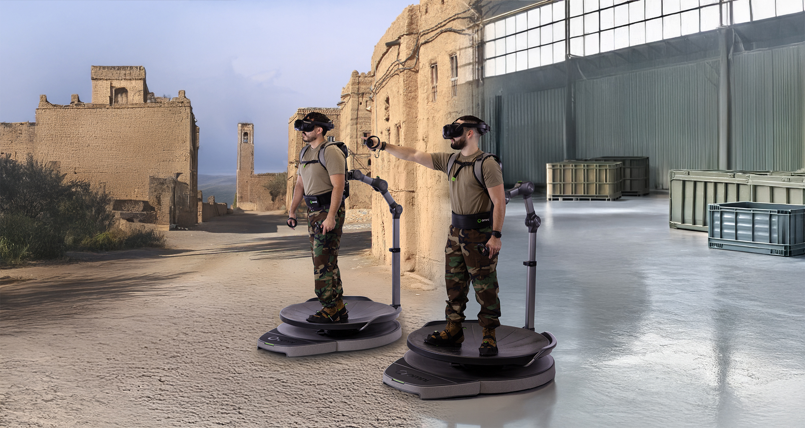
THANK
QUESTIONS
YOU
& ANSWERS
NASDAQ: VTIX
Investor Relations
Chris Tyson
Executive Vice President, MZ Group
949-491-8235
VTIX@mzgroup.us
Company Contact: Lauren Premo | press@virtuix.com | www.virtuix.com

