Slide 1
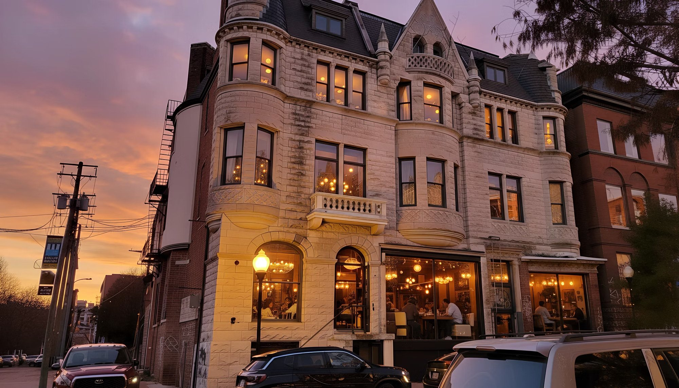

BDC RESUBMISSION · SEPTEMBER 2026
Charles Street Mansion Reunification
1816 · 1818 · 1820 N. Charles Street — one developer, one design, one historic mansion
Live Life As You Dream (LLAYD) LLC & Tyjuan Amor LLC · for the Baltimore Development Corporation and NIIF
Notes:
The mansion at 1816–1820 N. Charles was one building before the City subdivided it into three addresses. We own 1816 and 1818. We are asking for 1820, the last piece, so the building can be restored as one project.

Slide 2
SUMMARY
The ask
Everything else in this deck supports these four numbers.
18 + 4
$8.24M
$2.72M
$943,874
Program
Total development cost
NIIF senior loan
BDC / City request
18 apartments and 4 storefronts, fully furnished
Phase 1 $2.07M · Phase 2 $6.17M
5.0% · LTV 80% · LTC 44%
15.3% of Phase 2
What we need from BDC
Board approval to move forward on 1820 (ENP → LDA) at the offered price and terms.
Gap participation of $943,874 as deferred subordinate financing, repaid at refinance or sale.
Façade Improvement Grants for 1818 and 1820, and letters of support for the 2027 bond bill and DHCD applications.
Figures as of September 17, 2026. Full model and live dashboard: llayd.net/bdc
Notes:
The request is $943,874 — 15.3% of Phase 2 cost. It is the last piece after private capital, sponsor equity, a deferred fee, and every state and federal program we can reach.

Slide 3
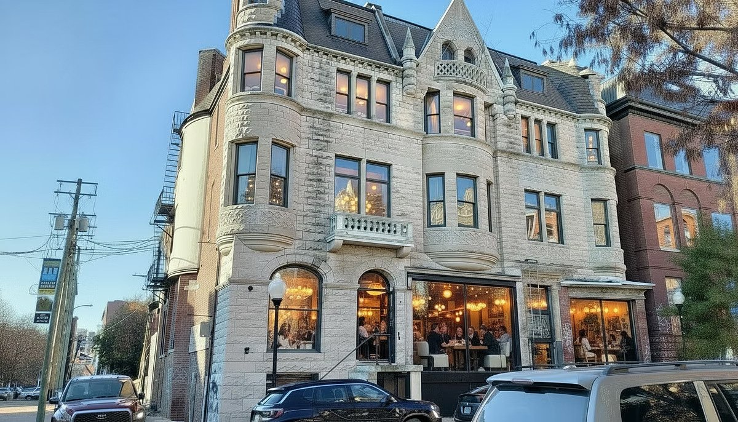
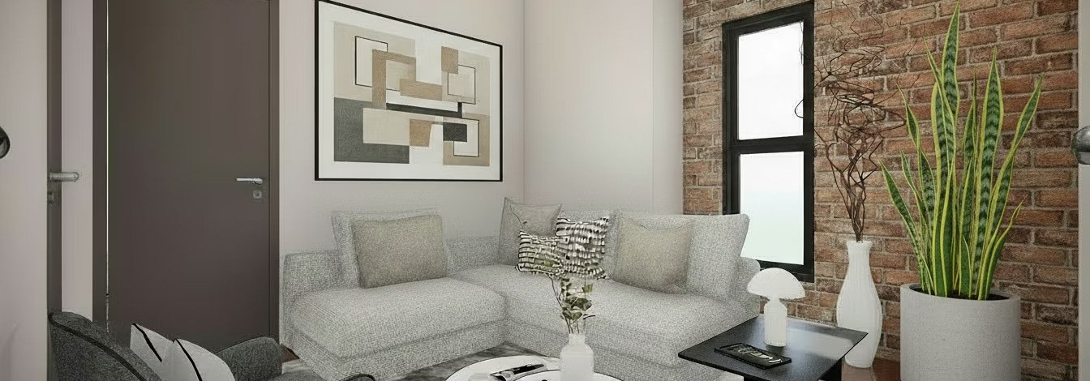
THE PROJECT
One building, three addresses
The City subdivided the mansion. LLAYD controls two parcels and is asking for the third.
Parcel
Status
Apts
Commercial
Target rents
Cost
1816 N. Charles
Owned · ~25–35% built
6
2 (2,280 SF)
$1,850–$2,050
$2.07M
1818 N. Charles
Acquired Mar 6, 2026
6
1 (2,400 SF)
$2,050–$2,300
$3.29M
1820 N. Charles
City-owned · BDC RFP
6
1 (1,350 SF)
$2,150–$2,300
$2.87M
Total
18
4 (6,030 SF)
avg $2,119
$8.24M
1816: six apartments plus two commercial units; structure and 4th-floor addition shell complete, ~$1.1M invested.
1818: food & beverage space kept on the ground and lower levels; six apartments above, including a new 3rd–4th floor addition.
The mansion today — 1800 block of N. Charles Street
1820: parlor-floor commercial space with six apartments above, including 2BR fronts on each floor.
Gross area ≈18,700 SF across the three parcels
Concept rendering: furnished apartment interior
Notes:
Each parcel carries six apartments. The commercial space differs: two storefronts at 1816, the former restaurant at 1818, and a parlor-floor gallery or café space at 1820.

Slide 4
SITE & COMMUNITY
Charles North, three blocks from Penn Station
Station North Arts & Entertainment District · Census Tract 1205 · Legislative District 40
96
<1%
Walk Score
Residential vacancy
$61,338
60%
Median income, tract 1205
Bachelor's degree or higher
Zoned C-2, mixed use; North Central National Register District; CHAP review.
Opportunity Zone and Enterprise Zone; Sustainable Community / BRNI area.
Neighbors: the Charles Theatre, SNF Parkway (≈$18M restoration), North Avenue Market (≈$30M, NIIF-financed), MICA and JHU.
Support letters from the Charles North Community Association and Central Baltimore Partnership (December 2025).
The mansion restored (concept rendering)
Sources: SDAT, Census ACS, Walk Score, HSA Q2-2025, BPD Part 1 crime data — see llayd.net/bdc-research-community-profile
Notes:
Part 1 crime in Midtown fell from 99.5 to 64.5 per 1,000 between 2011 and 2022, and median household income in the Midtown CSA rose from $35k to between $57k and $65k. The block itself still has vacant, graffitied buildings.

Slide 5
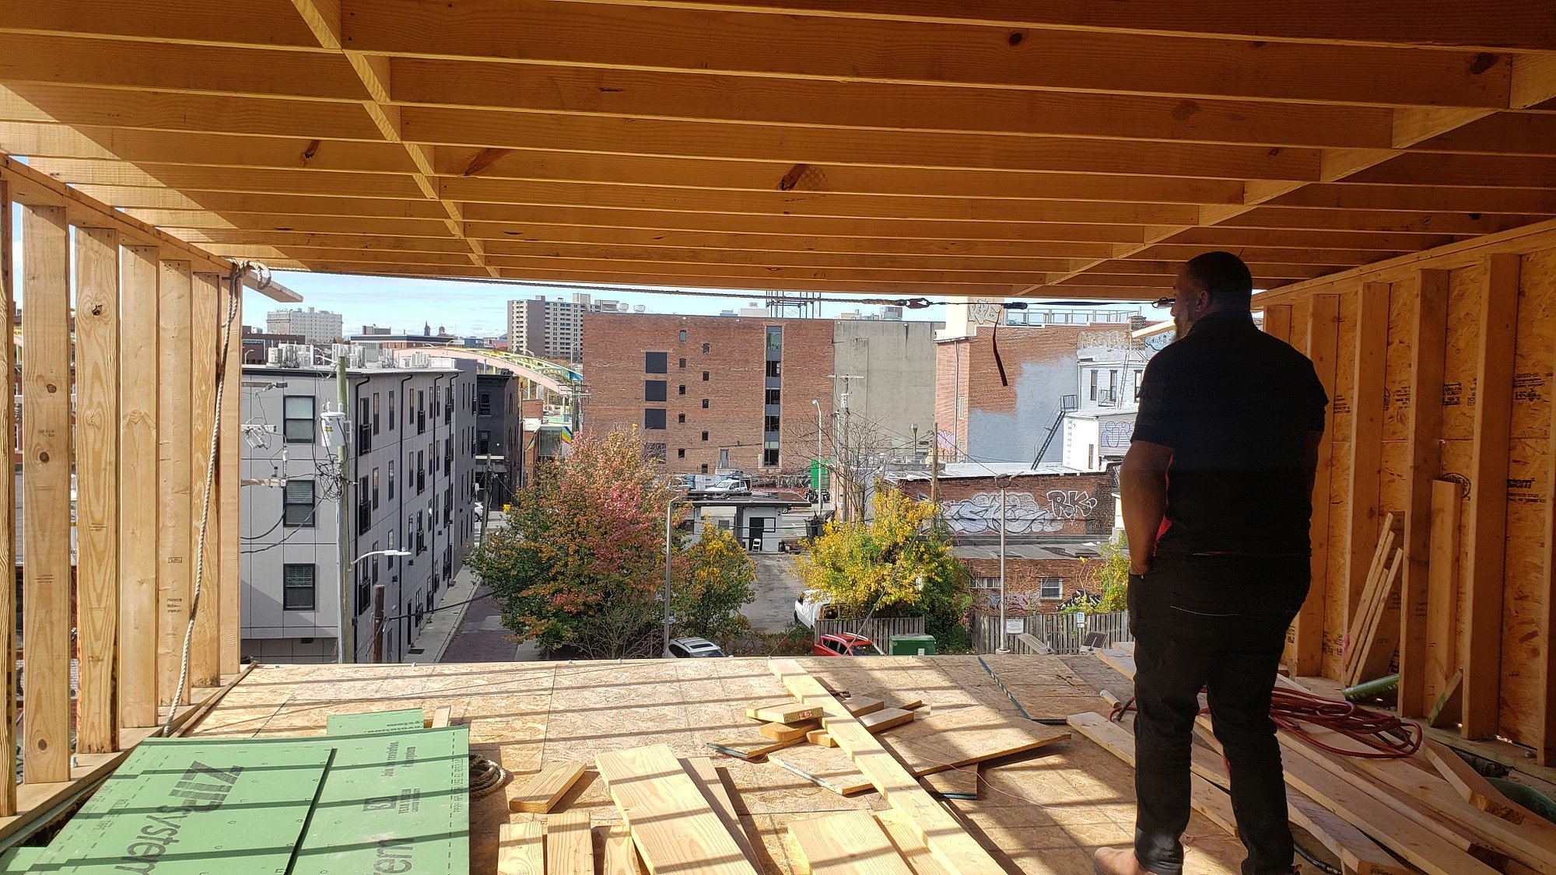
PROGRESS TO DATE
1816 is already under construction
Roughly 25–35% built, about $1.1M invested, with a BRNI award funding the next scope.
1816 scope
Status
Acquisition, design, appraisal
Complete
Structure & 4th-floor addition shell
Complete
2nd-floor electrical / HVAC rough-in
~80–90%
Plumbing rough-in
~30–50%
Sprinklers, drywall, finishes, fit-out
Next (BRNI-funded)
Overall
~25–35%
$250k 2025 bond bill and $250k DHCD BRNI award (BRNI-2026-LLAYD-00539-R) in hand.
1816: 4th-floor rear addition framed, structure in place
1818 won at the March 6, 2026 trustee's sale.
Stamped drawings No. 2023-1947 · Bowery appraisal $1.34M stabilized (Feb 2024)
Notes:
This is not a concept. The structure is up, the addition shell is framed, and the rough-ins are partly done. The BRNI award funds the commercial fit-out and façade next.

Slide 6
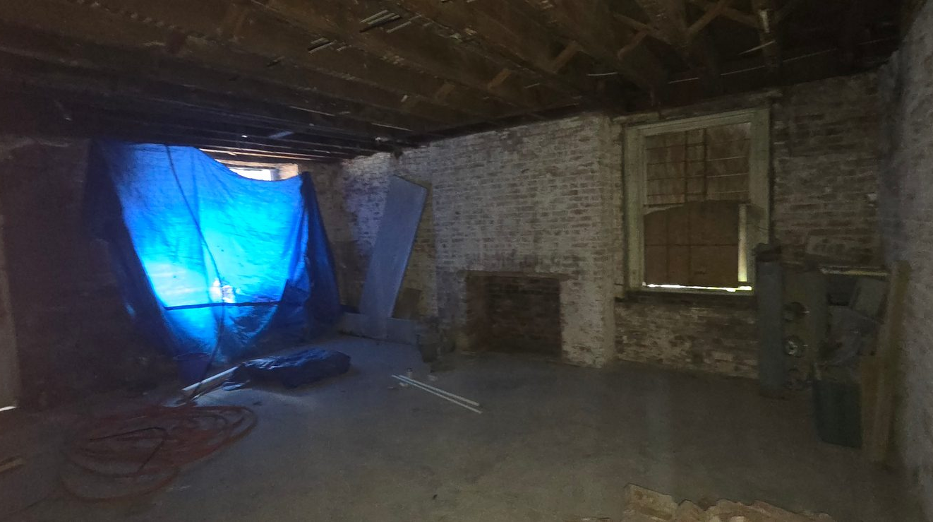
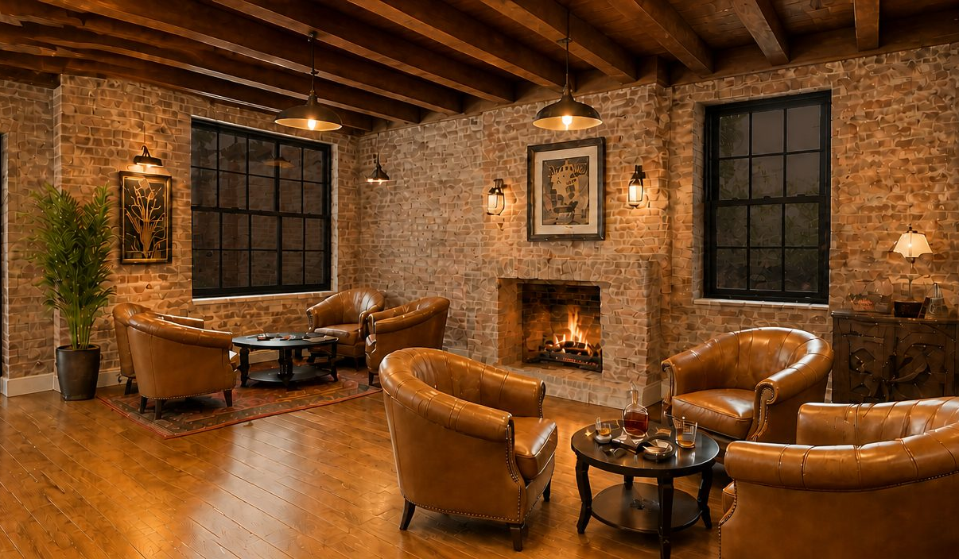
DESIGN
Concept design — 1816 ground level
The space today, and the restored commercial level.
Front entry area today
Front entry area, restored (concept)
Every rendering for 1816, 1818 and 1820 is on llayd.net/bdc-project-summary
Notes:
The full set of renderings — front entry, back area, middle enclosed area, entrance and hallway — is on the project summary page of the site.

Slide 7
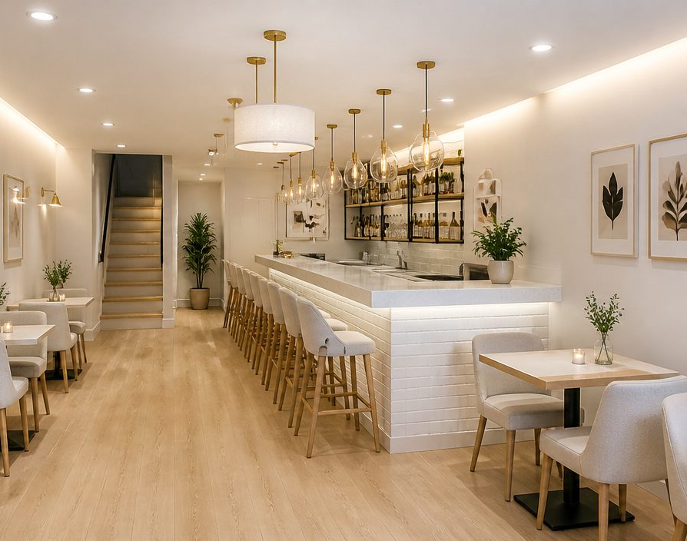
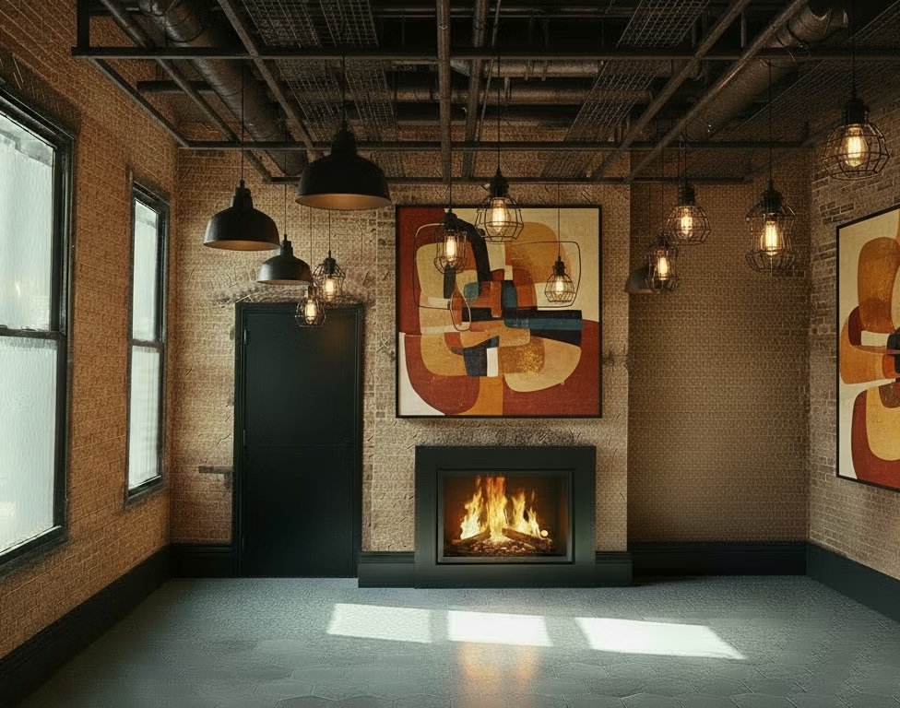
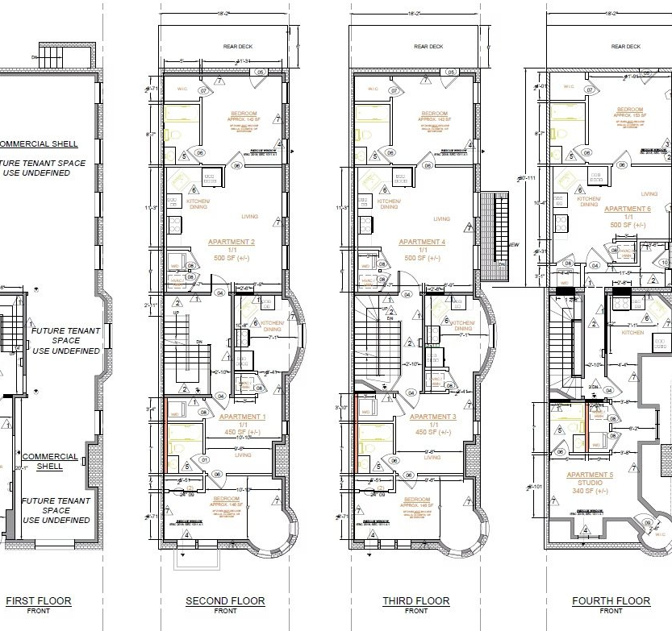
DESIGN
Concept design — 1818 and 1820
A food-and-beverage level at 1818; gallery or retail at 1820, apartments above.
1818 first level (concept)
Ground-floor commercial (concept)
1820 proposed floor plans (Jan 2026)
1818's addition is subject to structural study and CHAP review
Notes:
1818's ground and lower levels keep a food-and-beverage use — it was a restaurant and lounge until 2025, so the infrastructure is there.

Slide 8
MARKET & RENT ROLL
Rents the market supports
Target rents are the proposal. The NIIF loan is sized on comparable-supported market rents, so repayment does not depend on the premium.
Comparable (Sept 2026)
Unit
Rent / mo
Rent roll (Year 1 = 2029)
Target
Underwriting
Nelson Kohl (2 blocks, Class A)
1BR 538–667 SF
$1,425–$1,500
Average apartment rent
$2,119
$1,790
Nelson Kohl
2BR/2BA 874 SF
$2,255
Average commercial rent
$3,500
$2,976
The Fitzgerald (Bolton Hill)
1BR 684–804 SF
$1,988–$2,297
Year 1 NOI (all parcels)
$376,502
$326,663
The Fitzgerald
2BR
$2,493–$3,026
NIIF DSCR (1818 + 1820)
1.34x
1.27x
Mount Vernon average (RentCafe)
2BR 977 SF
$1,912
Station North submarket (HSA Q2-25)
All units
$1,505 avg
Comps are unfurnished; these units are fully furnished. Furnished rentals typically command 15–30% — underwriting uses 10%.
The $1,800–$2,300 band is well supported for 2BR and 1BR+den layouts; 1818 and 1820 lean toward those units.
Rear units add private 18′ × 8′ decks: +$150 target, +$75 underwriting.
The 2,400 SF restaurant space at 1818 is underwritten below market at $3,800.
Vacancy: 7% residential + 1% credit loss; 10% commercial.
Smaller storefronts still need tenant letters of intent.
Full comparable set and sources: llayd.net/bdc-research-market-rents
Notes:
The premium is real but it is not what repays the loan. NIIF's coverage is tested on the unfurnished comps plus a conservative 10% furnished markup.

Slide 9
COST
Development budget
$8,237,803 across three parcels — hard costs carry the GC fee, escalation and contingency.
Use
Amount
Hard costs
$5.02M
Soft costs
$0.58M
Furniture, fixtures & equipment
$0.25M
Acquisition, closing & work to date
$1.53M
Financing costs & reserves
$0.42M
Developer fee (50% deferred)
$0.44M
Total development cost
$8.24M
1818 and 1820 hard costs run ≈$343 per gross SF all-in.
Benchmarks: DHCD rehab limits $202–$277/SF before contingency, and 1816's actual bids.
Escalation 6% · contingency 12.5% · GC fee 8% (disclosed related party).
Line-by-line budget: llayd.net/bdc-development-budget and the Construction_Budget tab of the Excel model
Notes:
The GC is a related party — Tyjuan Amor LLC — disclosed, at an 8% fee, below the DHCD 17% cap, with open-book costs and third-party draw inspections.

Slide 10
SOURCES
Phase 2 capital stack
$6,166,023 for 1818 + 1820. Private and CDFI capital first, then public programs, then BDC.
Source
Amount
%
Source
Amount
%
NIIF senior construction-to-permanent loan
$2,724,000
44.2%
MD historic tax credit equity
$438,000
7.1%
Sponsor cash equity
$200,000
3.2%
BDC façade improvement grants
$50,000
0.8%
Sponsor land equity — 1818
$150,000
2.4%
DHCD BRNI — FY2029
$150,000
2.4%
Deferred developer fee
$222,149
3.6%
DHCD Strategic Demolition Fund
$250,000
4.1%
MD bond bill — 2027 session (District 40)
$500,000
8.1%
DHCD Community Legacy
$100,000
1.6%
Federal historic tax credit equity
$438,000
7.1%
BDC / City subordinate gap financing (request)
$943,874
15.3%
Phase 1 (1816) is separately funded at $2,071,780: permanent loan $782,036, sponsor equity and carry $789,744, BRNI $250,000, 2025 bond bill $250,000
Notes:
Every source except the BDC request is either funded, awarded, or something we are applying for on a known schedule. The BDC number is the residual.

Slide 11
GAP ANALYSIS
The funding gap
Private capital first, then state and federal programs, then a targeted BDC request.
Step (Phase 2)
Amount
Why a gap exists
Total Phase 2 uses
$6,166,023
Less: NIIF loan, sponsor cash, 1818 land, deferred fee
−$3,296,149
Phase 2 costs $6,166,023.
The finished buildings are worth $3,405,893 at a 7.5% cap rate.
The unlevered project return is 0.6%.
Restoring historic buildings on this block costs more than conventional capital can carry. The public investment delivers 18 homes, 4 storefronts and a restored landmark.
Gap before any public source
$2,869,874
Less: 2027 bond bill, historic tax credits, façade grants
−$1,426,000
Gap after Priority 2
$1,443,874
Less: BRNI FY2029, Strategic Demolition Fund, Community Legacy
−$500,000
Remaining gap — BDC / City request
$943,874
The request shrinks dollar-for-dollar if any other award comes in higher
Notes:
The cost to restore exceeds the finished value by roughly $2.8M on Phase 2. That is the whole argument for public participation — no restructuring changes it.

Slide 12
STRATEGY
Ranked funding strategy
Four priorities. Hard money is only a bridge, never the plan.
1
2
3
4
PRIORITY 1
PRIORITY 2
PRIORITY 3
PRIORITY 4
Private & CDFI capital
State & federal programs
DHCD grants via CDO partner
BDC request
NIIF senior loan $2,724,000 at 5.0%
2027 bond bill $500,000 — due 11/23/2026
BRNI FY2029 $150,000
$943,874 — deferred subordinate financing
Strategic Demolition Fund $250,000
Sponsor cash $200,000 · 1818 land $150,000
Historic tax credits $876,000 on $2,576,470 QRE
Repaid at refinance or sale
Community Legacy $100,000
Deferred developer fee $222,149
BDC façade grants $50,000 (2 × $25k)
Shrinks if other awards land higher
Also available: DHCD Small Business Lending (4% fixed, up to $2M) for the commercial component · Opportunity Zone equity (tract 1205 through 2028) · CBP funds · MHT Historic Preservation Loan Fund · furniture leasing or a $150/mo furnished amenity fee.
A last-resort hard-money bridge of the pre-public gap would cost about $760,000 over 24 months — which the project cannot absorb
Notes:
The bond bill has precedent: the 2025 session awarded LLAYD $250,000 for 1816, so the District 40 delegation knows the project.

Slide 13
DEBT
NIIF underwriting
The loan is the lesser of three limits — coverage, value, and the program cap.
Loan sizing — 1818 + 1820
Amount
Metric
1816
1818 + 1820
NOI at market rents (with CHAP)
$243,585
Permanent debt
$782,036
$2,724,000
Max loan at 1.25x DSCR
$2,777,842
Annual debt service
$67,831
$191,091
Stabilized value (7.5% cap)
$3,405,893
DSCR — target rents
1.78x
1.34x
Max loan at 80% LTV
$2,724,714
DSCR — market rents
—
1.27x
NIIF program cap
$3,000,000
LTV / LTC
48% / 38%
80% / 44%
NIIF loan (the lesser)
$2,724,000
Debt yield
15.5%
9.4%
Covenant test
Requirement
Result
Terms modeled
DSCR at market rents (NIIF)
≥ 1.25x
1.27x
PASS
Consolidated DSCR
≥ 1.25x
1.45x
PASS
5.0% fixed · 18-month interest-only · 25-year amortization on a 7-year term · fee <= 1.5%
If NIIF also refinances 1816 at 5.0%, consolidated DSCR rises to 1.53x.
LTV (as-completed)
≤ 80%
80.0%
PASS
LTC
≤ 80%
44.2%
PASS
Loan size
≤ $3.00M
$2.72M
PASS
Excluding the CHAP credit, NIIF coverage is 1.11x on target rents — shown on the Debt_Metrics tab
Notes:
We size on market rents and still clear 1.25x. LTV is the binding constraint at exactly 80%, not coverage.

Slide 14
CASH FLOW
Ten-year pro forma
Rents +2%/yr, expenses +3%/yr, CHAP credit for 10 years, exit at a 8.0% cap.
Returns
Value
Year 1 NOI (2029)
$376,502
Year 1 DSCR
1.45x
Year 10 DSCR
1.66x
Levered IRR (sponsor)
11.6%
Unlevered IRR (project)
0.6%
Return on cost
4.6%
Average cash-on-cash
10.7%
Equity multiple
2.16x
Net reversion to sponsor
$1,014,112
The deferred developer fee is fully repaid by Year 4; cash flow after that is distributable.
Full ten years, including the deferred fee schedule: llayd.net/bdc-pro-forma and the Pro_Forma tab
Notes:
Coverage improves every year because rents grow at 2% while the debt service is fixed. The weakest year is Year 1.

Slide 15
SENSITIVITY
Stress tests
Every scenario re-runs the whole model, with the NIIF loan held at the base amount.
Scenario
Yr 1 NOI
Consol. DSCR
NIIF DSCR
BDC gap
NIIF capacity
Levered IRR
Base case — target rents
$376,502
1.45x
1.34x
$943,874
$2,724,000
11.6%
Market-rent case (comparable-supported rents)
$326,663
1.26x
1.27x
$943,549
$2,598,000
0.5%
Target residential rents −10%
$336,490
1.30x
1.19x
$943,116
$2,429,000
3.3%
Commercial rents −25% & 20% commercial vacancy
$328,622
1.27x
1.21x
$943,191
$2,458,000
1.1%
Interest rates +200 bps (NIIF 7.0%, 1816 9.25%)
$376,502
1.21x
1.11x
$1,011,387
$2,297,000
5.3%
Hard costs +15%
$376,502
1.43x
1.34x
$1,484,425
$2,724,000
7.5%
No historic tax credit equity (federal or state)
$376,502
1.45x
1.34x
$1,819,874
$2,724,000
5.7%
Expenses +15%
$344,314
1.33x
1.23x
$954,938
$2,497,000
4.5%
Option — $150/mo furnished amenity fee per apartment
$407,282
1.57x
1.44x
$944,435
$2,943,000
16.3%
Upside — NIIF also refinances 1816 at 5.0%
$376,502
1.53x
1.34x
$943,874
$2,724,000
12.9%
The binding risks: a 200 bps rate rise cuts NIIF coverage to 1.11x, and losing both historic credits raises the request to about $1.82M.
The upside: a $150/month furnished amenity fee lifts Year 1 NOI to $407,282 and the levered IRR to 16.3%.
Three more scenarios and a full DSCR grid (rent change × interest rate): llayd.net/bdc-sensitivity
Notes:
Test your own cases on the interactive dashboard — sliders for rents, vacancy, rates, costs, cap rates, the 1820 price, equity and the bond bill.

Slide 16
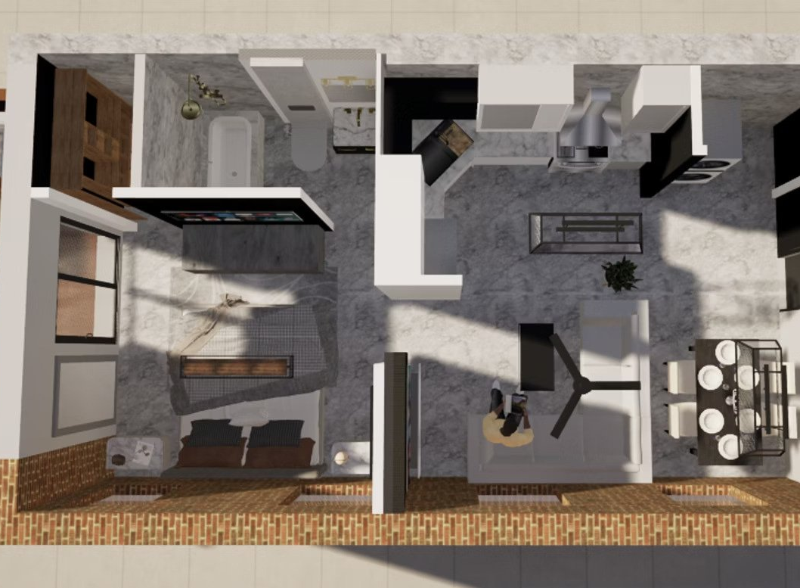
1820 N. CHARLES
The 1820 offer: $3,000
Restoring 1820 costs more than the finished building will be worth.
Residual land value test — 1820
Amount
Stabilized value (target rents, 7.5% cap)
$1,742,757
Stabilized value (market rents)
$1,600,820
Cost to restore and lease (excluding land)
$2,869,477
Implied as-is land value
−$1,126,719
Offer
$3,000
The nominal price reflects negative residual value, not a discount being sought.
1820 was conveyed in 2015 and returned to the City in 2022 without a restoration.
Control of 1816 and 1818 is what makes finishing the mansion as one project possible.
1820 concept: restored floor plan and interiors
LLAYD accepts LDA conditions: start deadline, reverter, CHAP scope, MBE/WBE compliance.
The City's return comes from the restoration, the tax base, the jobs and the MBE participation
Notes:
This is the question BDC asked most directly. The answer is arithmetic: cost to cure exceeds finished value, so the as-is residual is negative.

Slide 17
PUBLIC BENEFIT
What the public investment buys
$2.01M
17–27
≈25
$87,320
Construction payroll
Permanent jobs
New residents
Property tax / yr
≈36 job-years; ~31 at peak
Tenants + building staff
18 apartments
vs ≈$15,165 today
MBE 27% / WBE 10% goals; developer and general contractor are MBE-certified and Baltimore-based; 55% of the construction workforce expected to be City residents; Employ Baltimore certification signed.
Storefronts prioritized for Baltimore-based minority- and women-owned businesses through LLAYD's BRNI-backed Small Business Hub.
Restores a contributing mansion in the North Central National Register District to the Secretary of the Interior's Standards.
Returns a vacant City-owned building to the tax rolls and adds street-level activity between the Charles Theatre and Penn Station.
Payroll estimated at 40% of hard costs; property tax shown before the CHAP credit
Notes:
The CHAP credit runs ten years and is modeled as an expense reduction, not a capital source — after it expires the full tax bill is on the rolls.

Slide 18
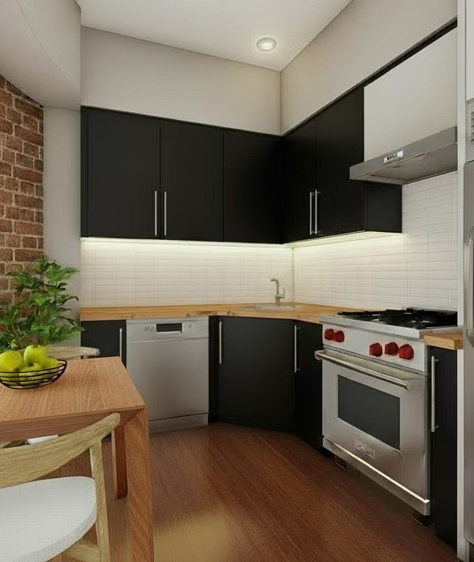
REQUESTS & NEXT STEPS
What we're asking for
Board approval to move forward on 1820 (ENP → LDA) at the offered price and terms.
Gap participation of $943,874 as deferred subordinate financing, or an equivalent grant.
Rehabilitation Façade Improvement Grants for 1818 and 1820; Enterprise Zone coordination on the commercial space.
Letters of support for the 2027 District 40 bond bill and the DHCD applications.
Oct 2026
NIIF intake & site visit; CHAP pre-application; MHT/NPS Part 1
Nov 23, 2026
District 40 bond bill application due
Q4 2026
BDC board; ENP; right of entry; survey, Phase I, structural
Q1–Q2 2027
LDA; design & permits; NIIF commitment; 1816 CO & refinance
Jul 2027
Phase 2 construction start (18 months)
2029
Full mansion stabilized
Bradford T. Phillips · Live Life As You Dream (LLAYD) LLC & Tyjuan Amor LLC
Full package, research appendices and interactive dashboard: llayd.net/bdc
Notes:
We are ready to move on the schedule shown. The near-term dependency is the BDC board and the ENP, which unlocks the bond bill application in November.

