Slide 1
Intro to Nativescaping
Emily Bowyer and Scott Butler - Missouri Master Naturalists, Chert Glades Chapter

Slide 2
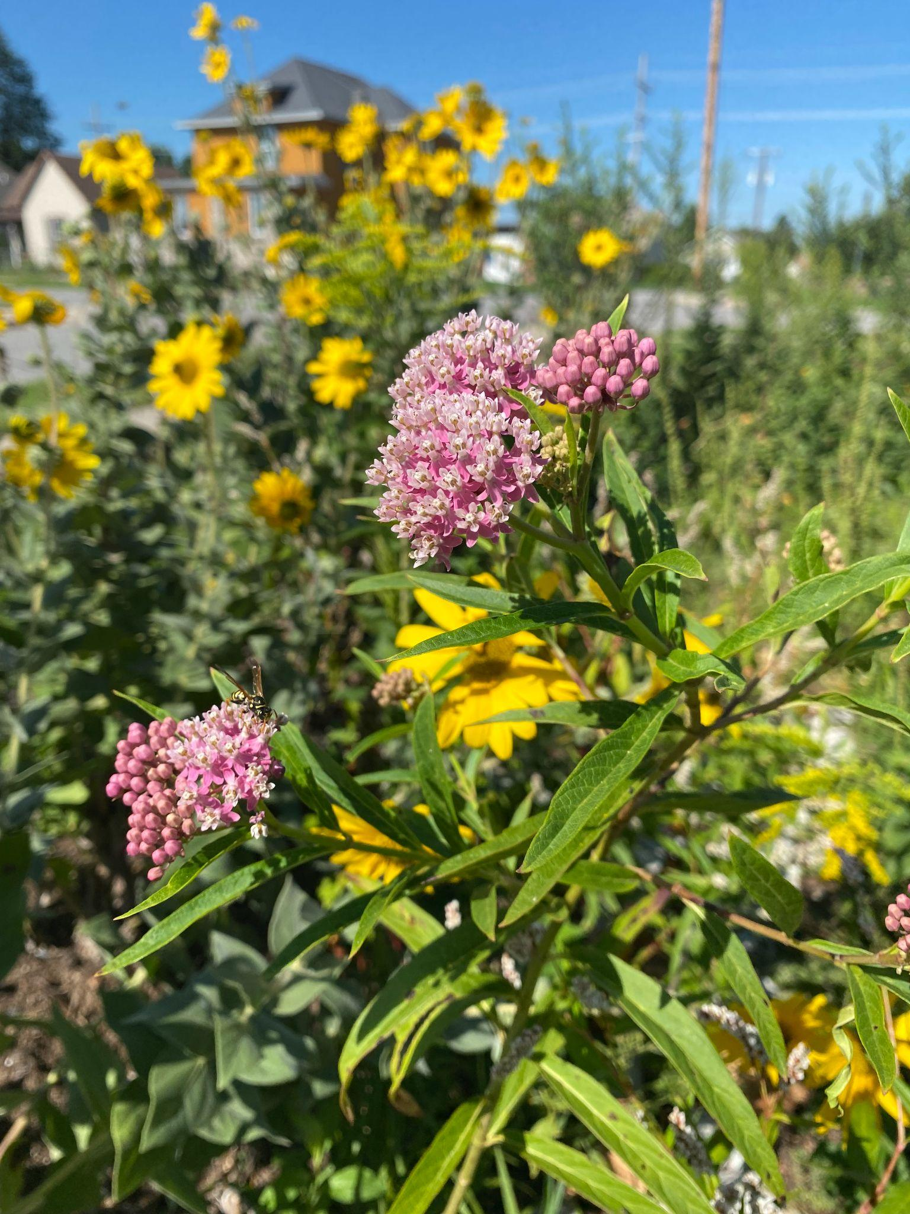
What is a Native Plant?
Native plants evolved in this area for the last few million years
These plants have formed relationships with local insects, birds, and all other wildlife
Native plants create our local ecosystem

Slide 3
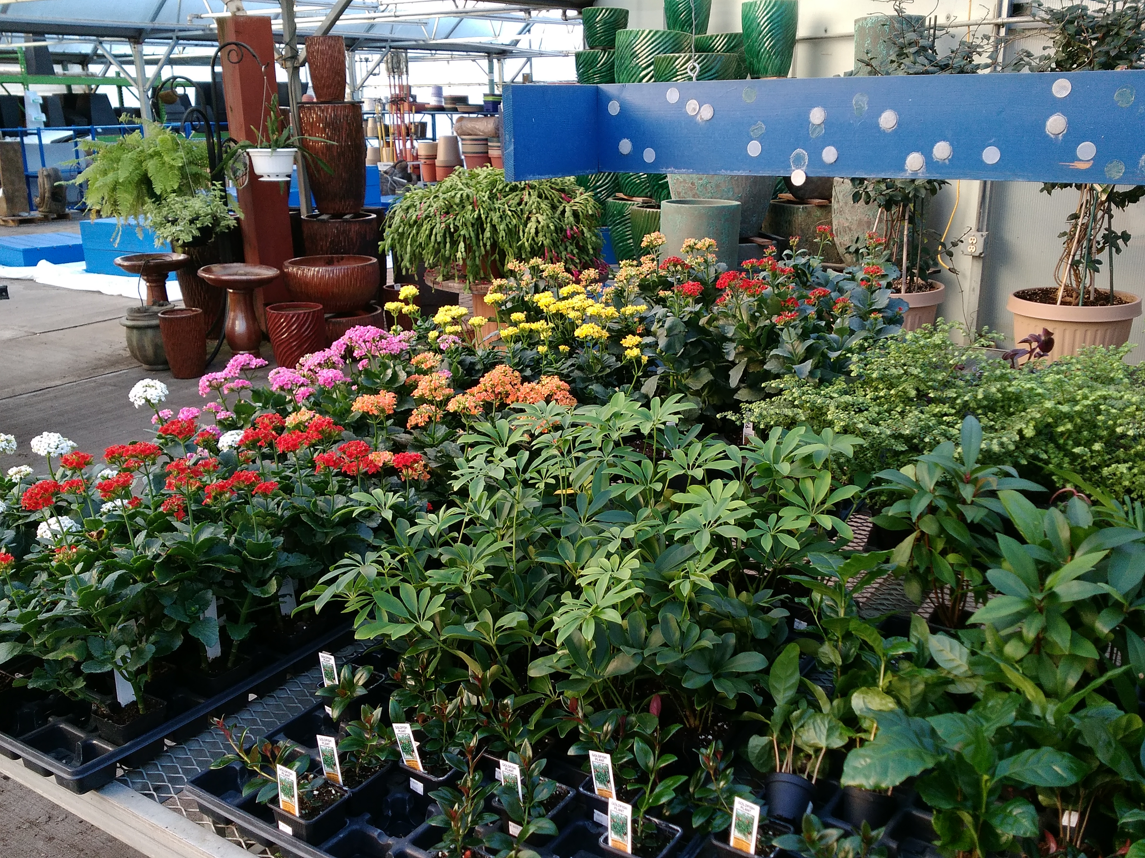
Why Don’t We See Native Plants in Every Yard?
Popular landscaping has featured plants from other parts of the world for the last few decades
Since these plants aren’t eaten by native wildlife, they don’t suffer from damage that might not look good
Some traditional landscaping plants are even invasive - such as burning bush and bradford pear
Notes:
Native landscaping being less common may lead people to think that native plants are not as beautiful as traditional landscaping plants, that they’re “weedy” or “messy”. That is not at all true, and the reason for other plants being selected instead of natives is because of long lasting traditions and commercial pressure rather than inherent worth

Slide 4
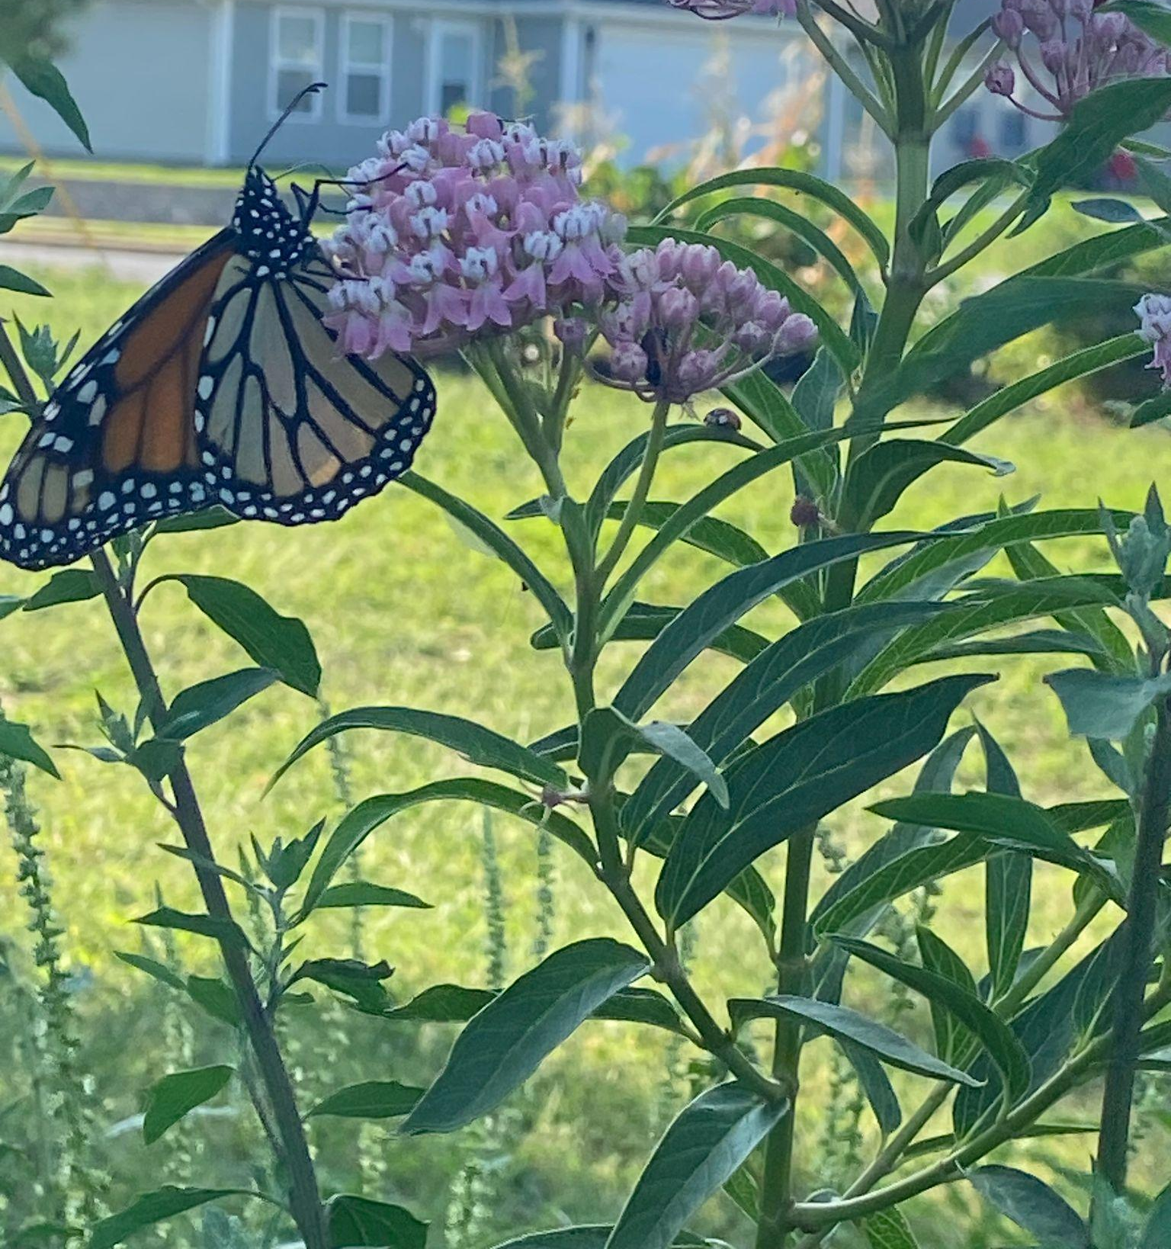
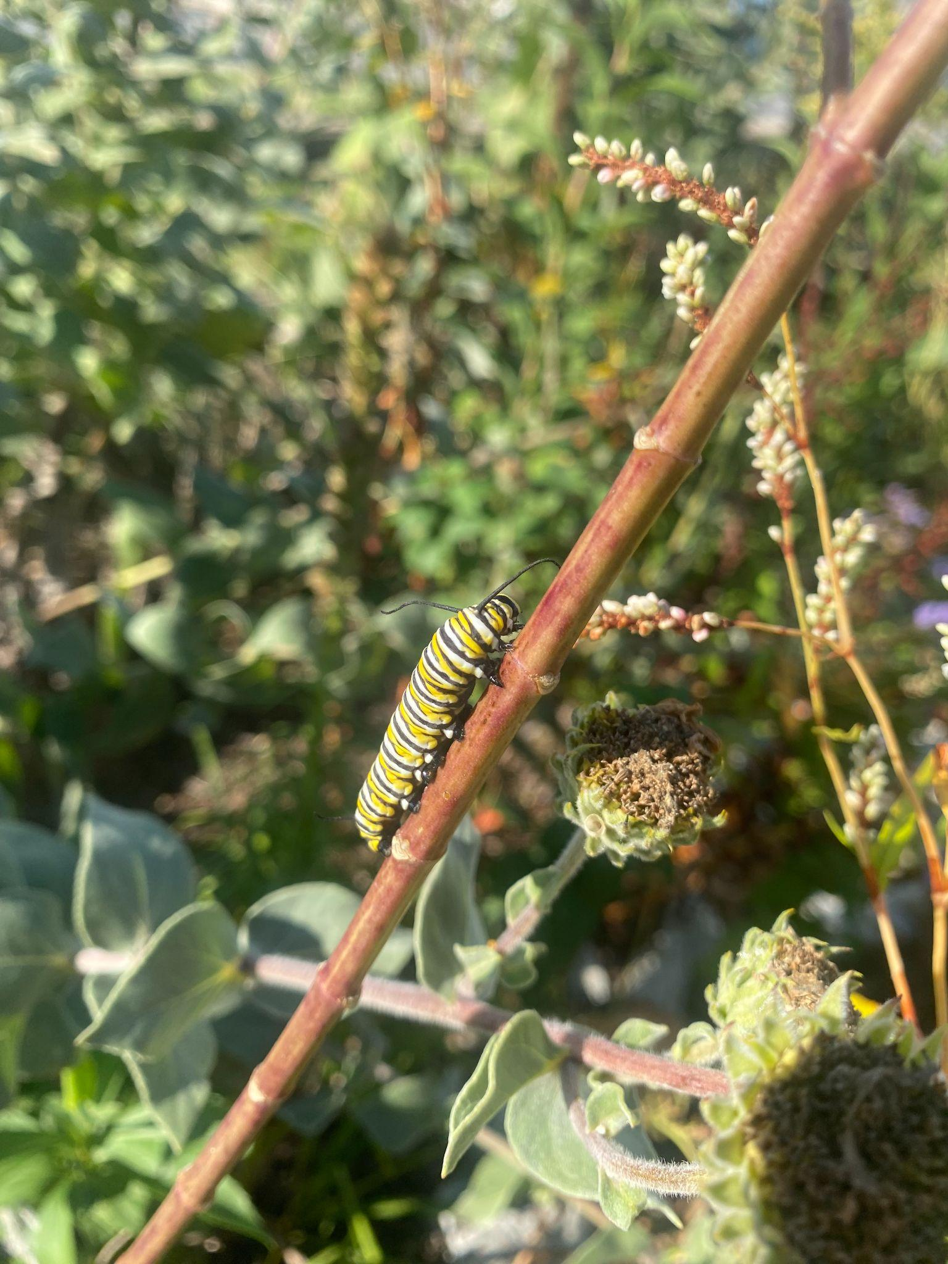
Why is Planting Native Important?
“Monarch butterflies east of the Rocky Mountains used to number in the hundreds of millions but the population has declined by approximately 80%.” - Xerces Society (2)
Habitat loss is the main threat to our wildlife
Local efforts to return habitat to our developed spaces is critical to preserving these species
Any amount of native plants can help!

Slide 5
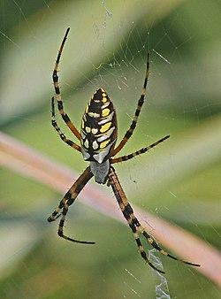
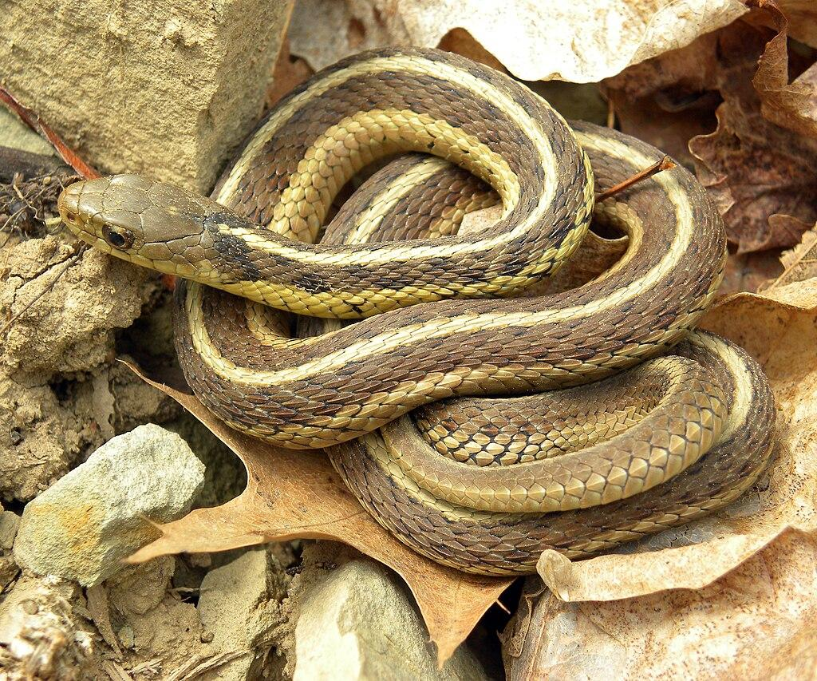
Common Misconceptions about Native Plant Gardening
Native plant gardens are weedy or unkempt
They don’t require maintenance
They only include wildflowers
They attract pests or are unsafe
They can’t be mixed with non-natives
The city will make me mow it
I need to amend my soil first
Not a pest!

Slide 6
How Can Nativescaping Make Your Life Easier?
Native wildflower beds, *once established* need little care in the form of fertilizing, weeding, or watering
Lawns, by comparison, need constant work to keep short, and even more work in order to look their best - fertilizing, spraying, aerating, and watering
Native landscaping encourages less typical “cleanup” than traditional landscaping - it is better for wildlife if you leave leaves rather than rake them up, avoid cutting back stems in the fall, and avoid spraying for pests
Notes:
Nativescaping can often be seen as a way to avoid yard work all together - that’s not really the case. Instead, the work you do in the yard will be different than typical lawn maintenance, and less of a constant pressure. There will be seasonal tasks to maintain an established native garden as opposed to mowing every week or two. A young garden bed will take more work like weeding and watering before it can take care of itself.

Slide 7
How Can We Start to Add Native Plants?
Native plants are great for “problem areas” in a yard
  Areas that are on a dry slope
  Spots that get too wet
  Overly shady areas under a big tree or next to a building
Native plants grow in various plant communities in our area
  Glades
  Prairies
  Savannas
  Woodlands and forests
  Creek and riverbanks
“Right Plant, Right Place”
Notes:
One of the main advantages of using native plants for landscaping is that these plants are adapted for our local conditions. They don’t need any special care to deal with our often extreme changes in weather. But there are a variety of different plant communities in Missouri, so we need to make sure that the native plants will thrive in your own yard conditions.
Can mix with non-natives

Slide 8
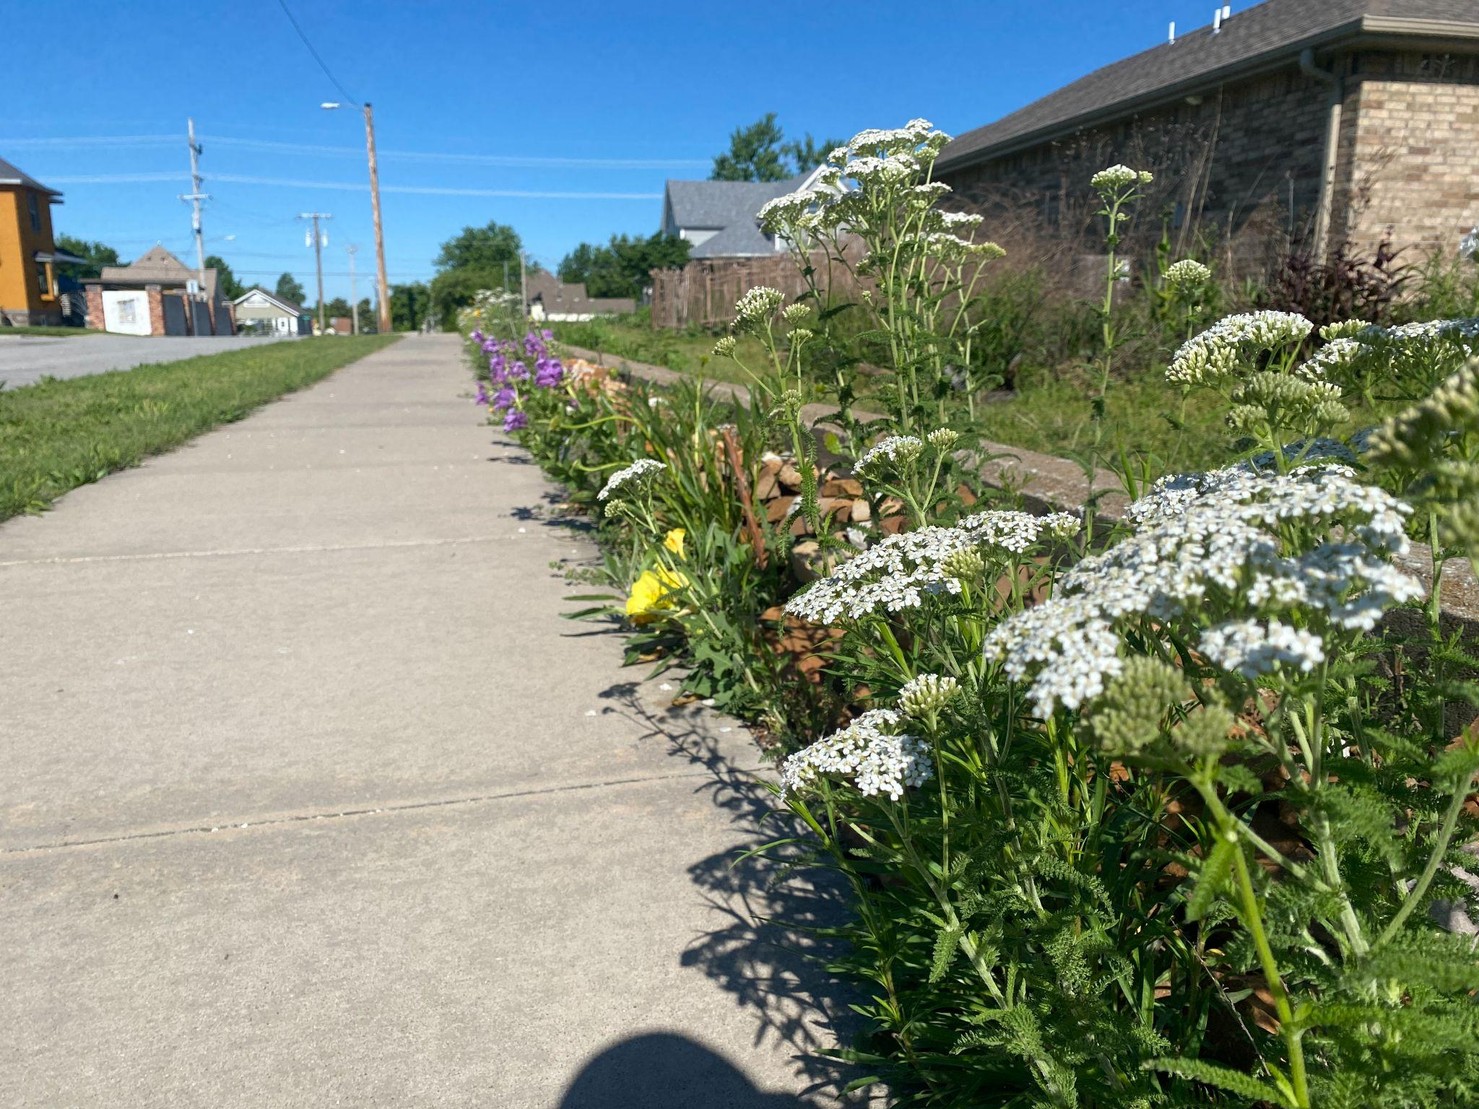
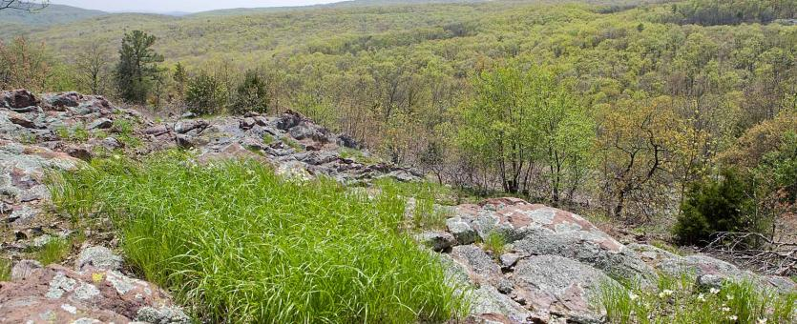
Dry, Rocky Sections
Glades are defined by a particular kind of rock
This habitat is distinguished by thin, rocky soils
Plants that live in glades are accustomed to dry, harsh conditions

Slide 9
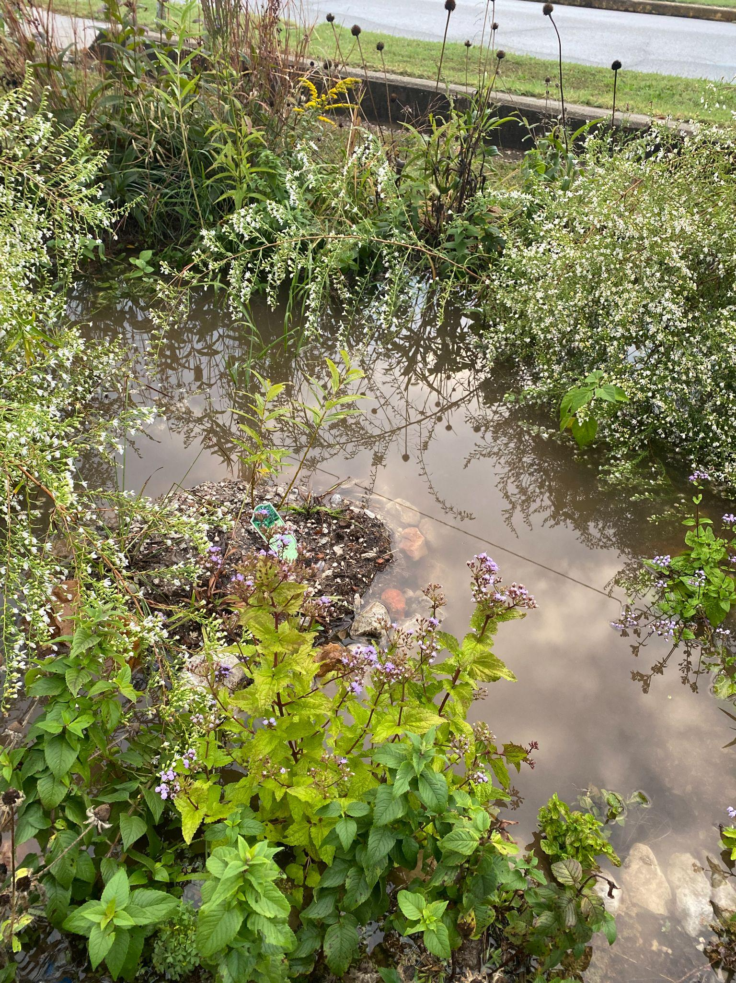
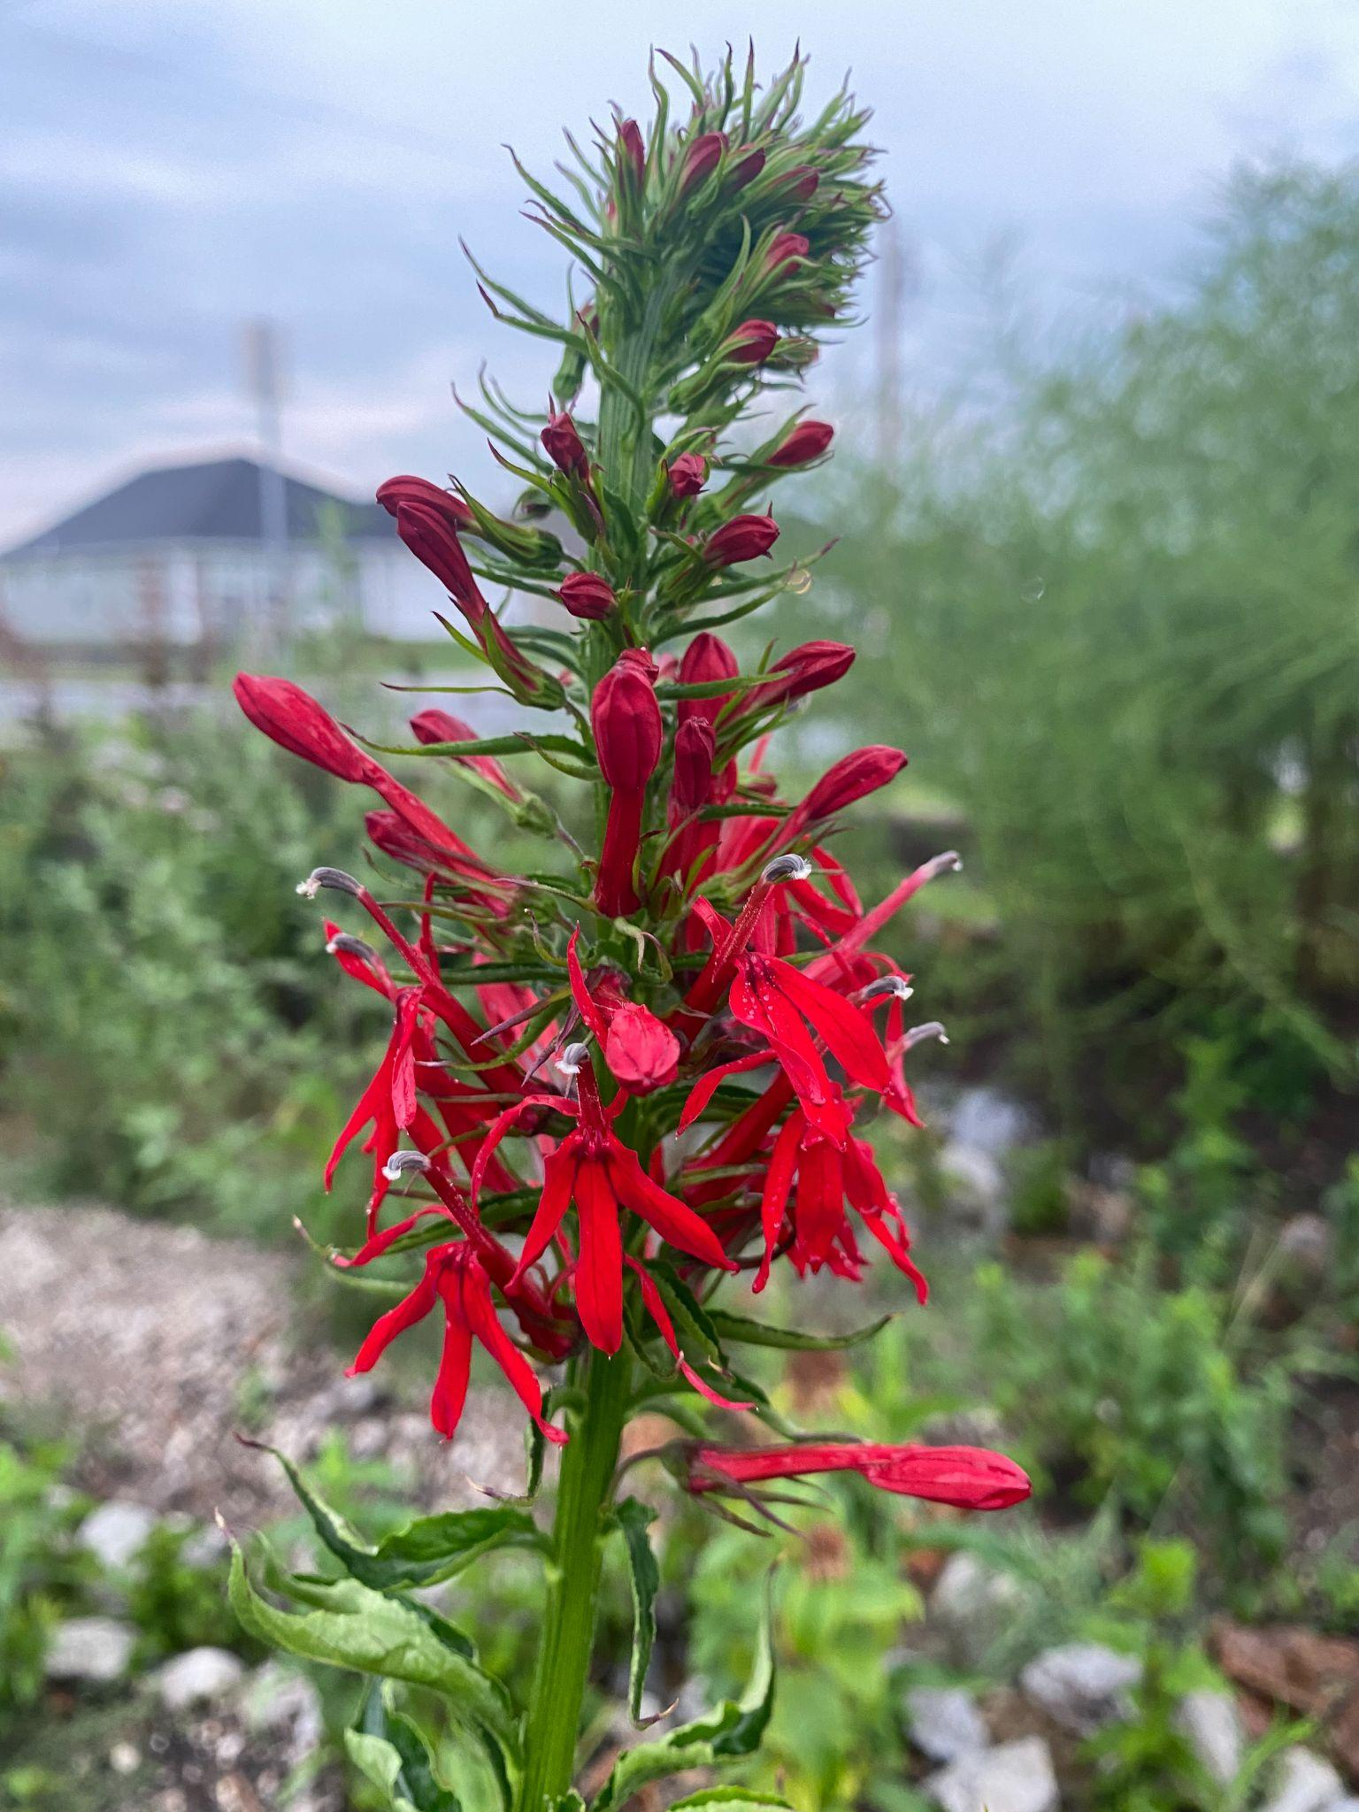
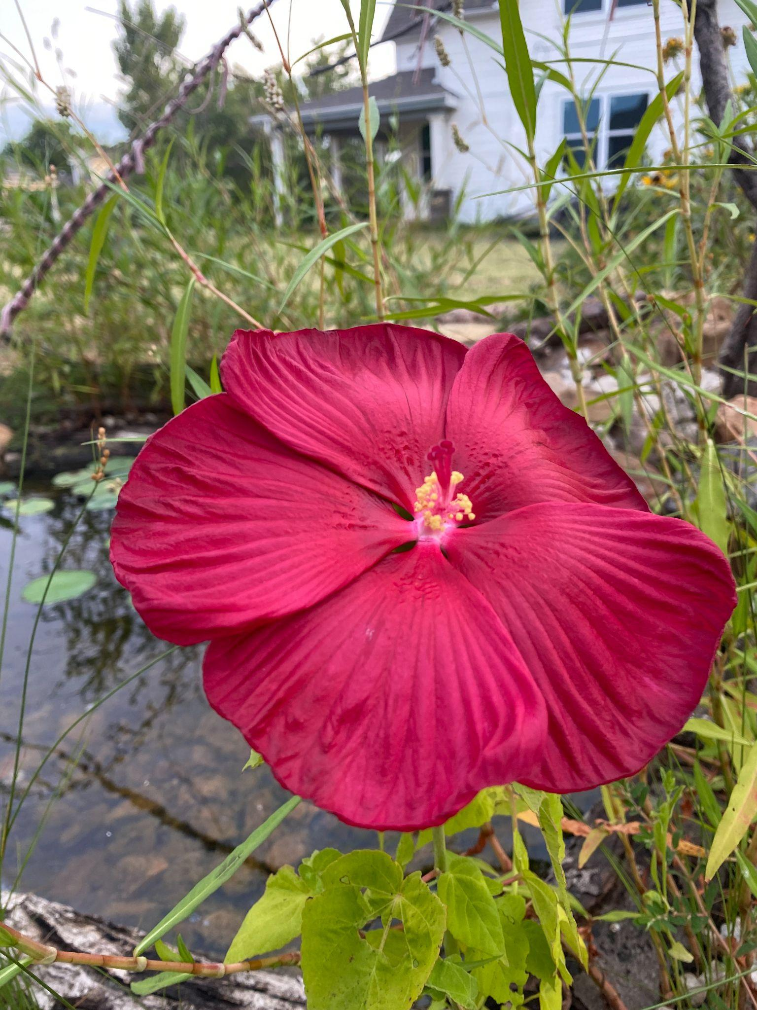
Wet Areas
Rain Gardens are designed to capture water runoff from the roof
These gardens make temporary pools after rainstorms, which slowly absorb the water into the soil
Rain Gardens prevent pollutants from getting into local waterways
There are many native plants adapted to wet and dry periods

Slide 10
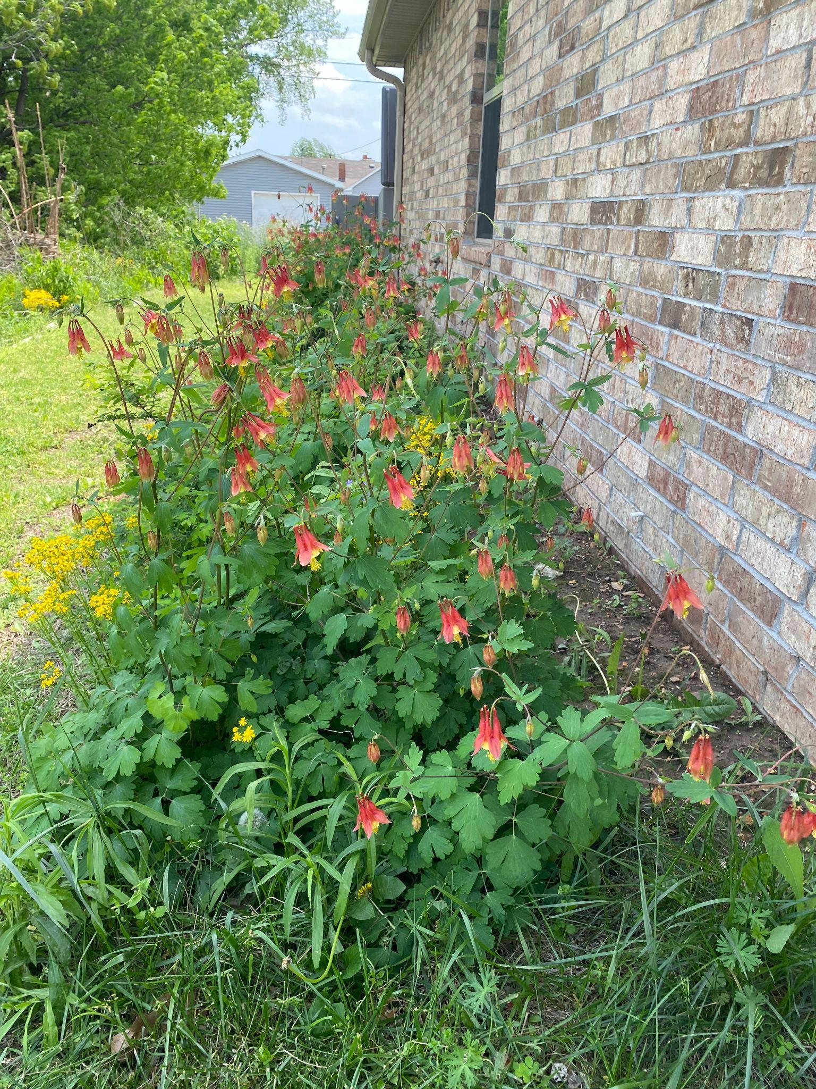
Shady Areas
Traditional garden options are often limited for full shade areas
Many native plants take advantage of shady conditions in woodland and forest habitats
Many spring ephemerals behave like traditional bulbs in the spring

Slide 11
Choosing Your Plants
Once you have an idea of what plant community to copy, it is time to choose your plants
Shrubs as foundation plants
Multiple kinds of flowers for staggered blooms
Don’t forget grasses!

Slide 12

Planning Your New Garden Bed
Plan the size of your bed - make something you can easily access for maintenance
Smaller is better at the start
Make sure that pathways are large enough
Consider any limitations to plant height
Plant layout - you can stagger short to tall, have tall plants in the middle, or some other arrangement
Notes:
MO Wildflower book has Grow Native recommendations and is organized by Color and bloom time

Slide 13
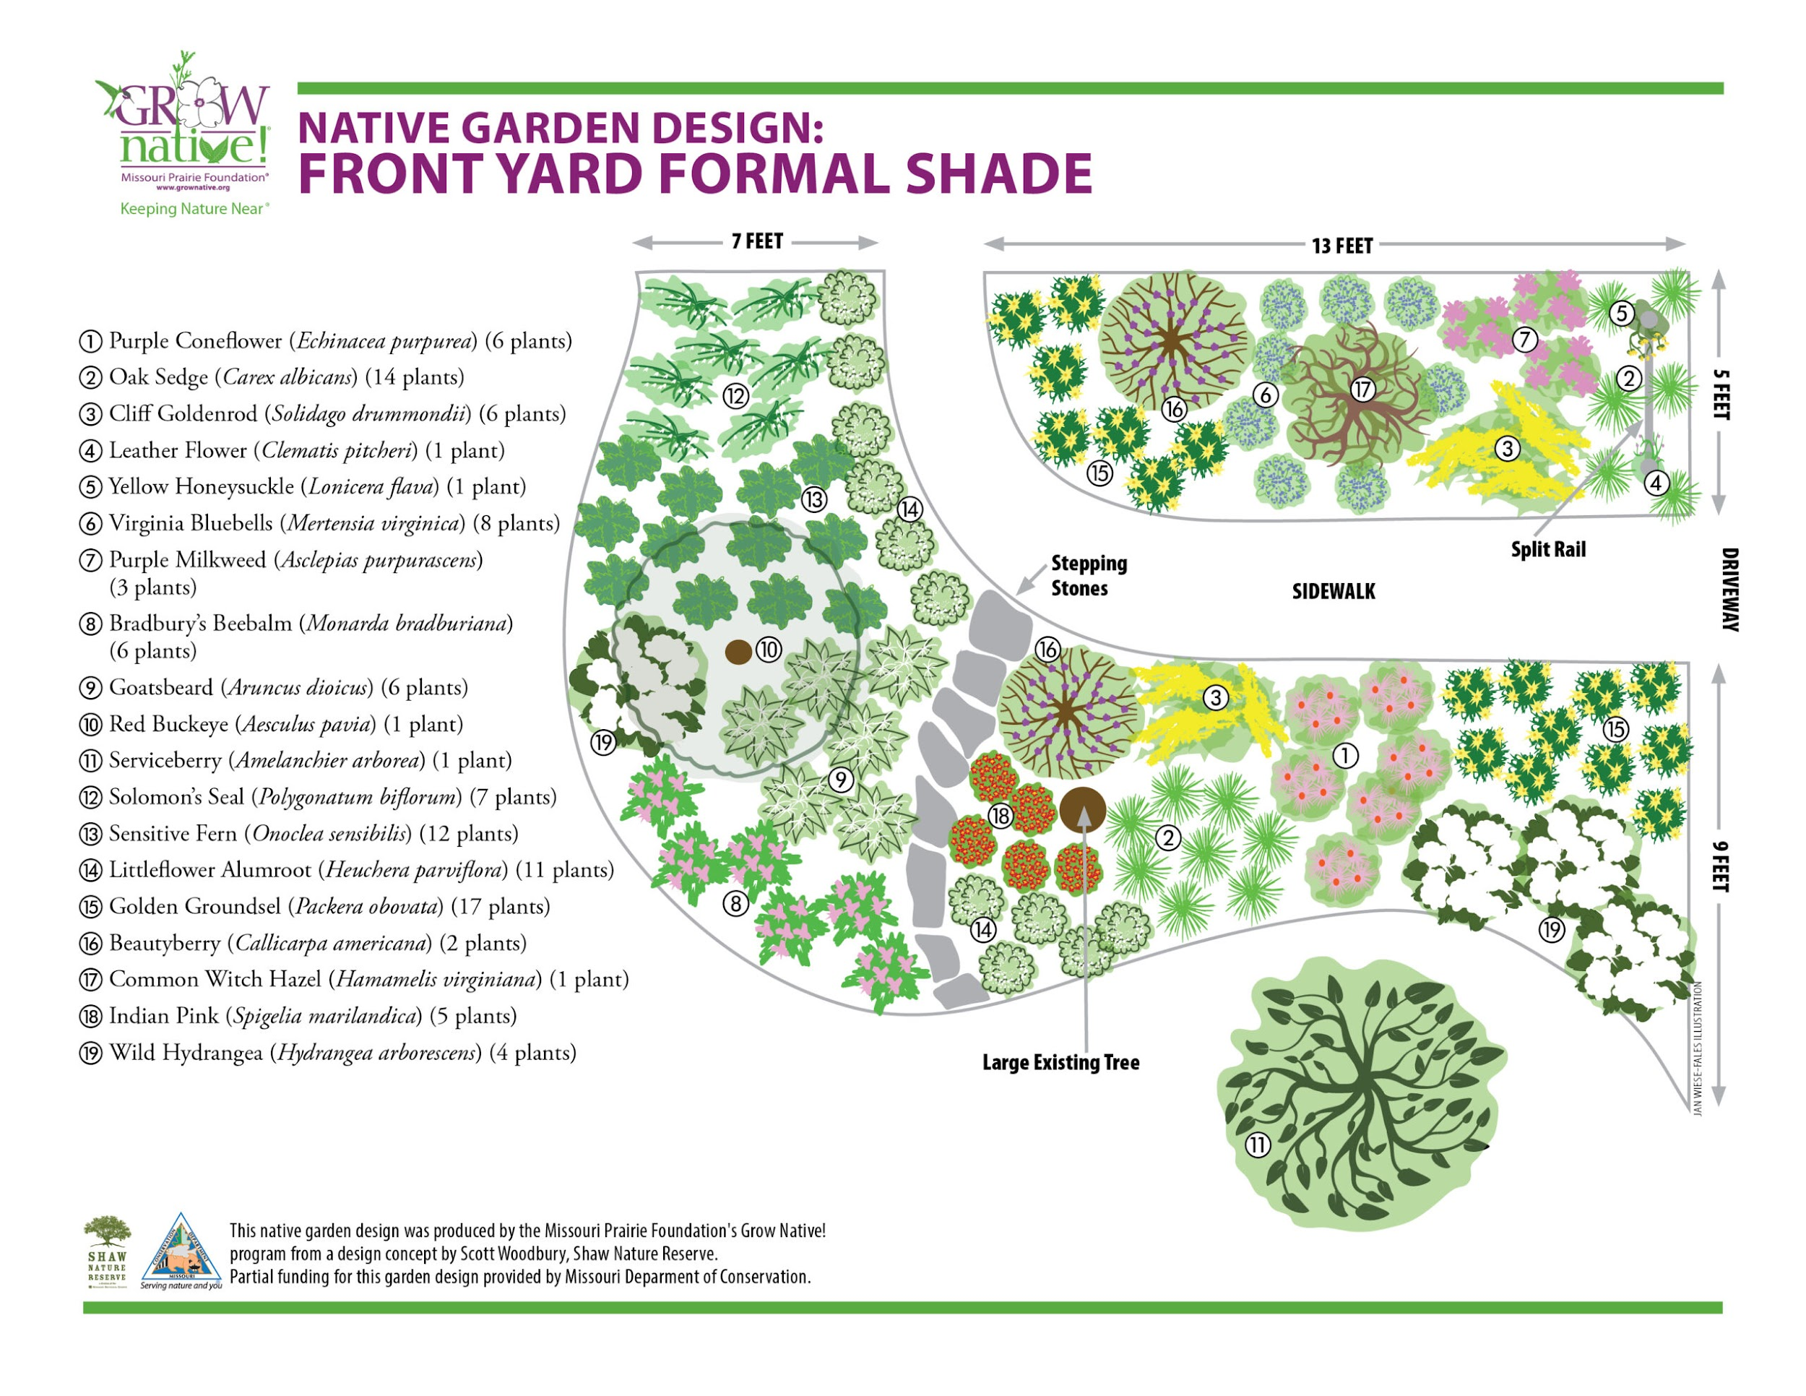

Slide 14
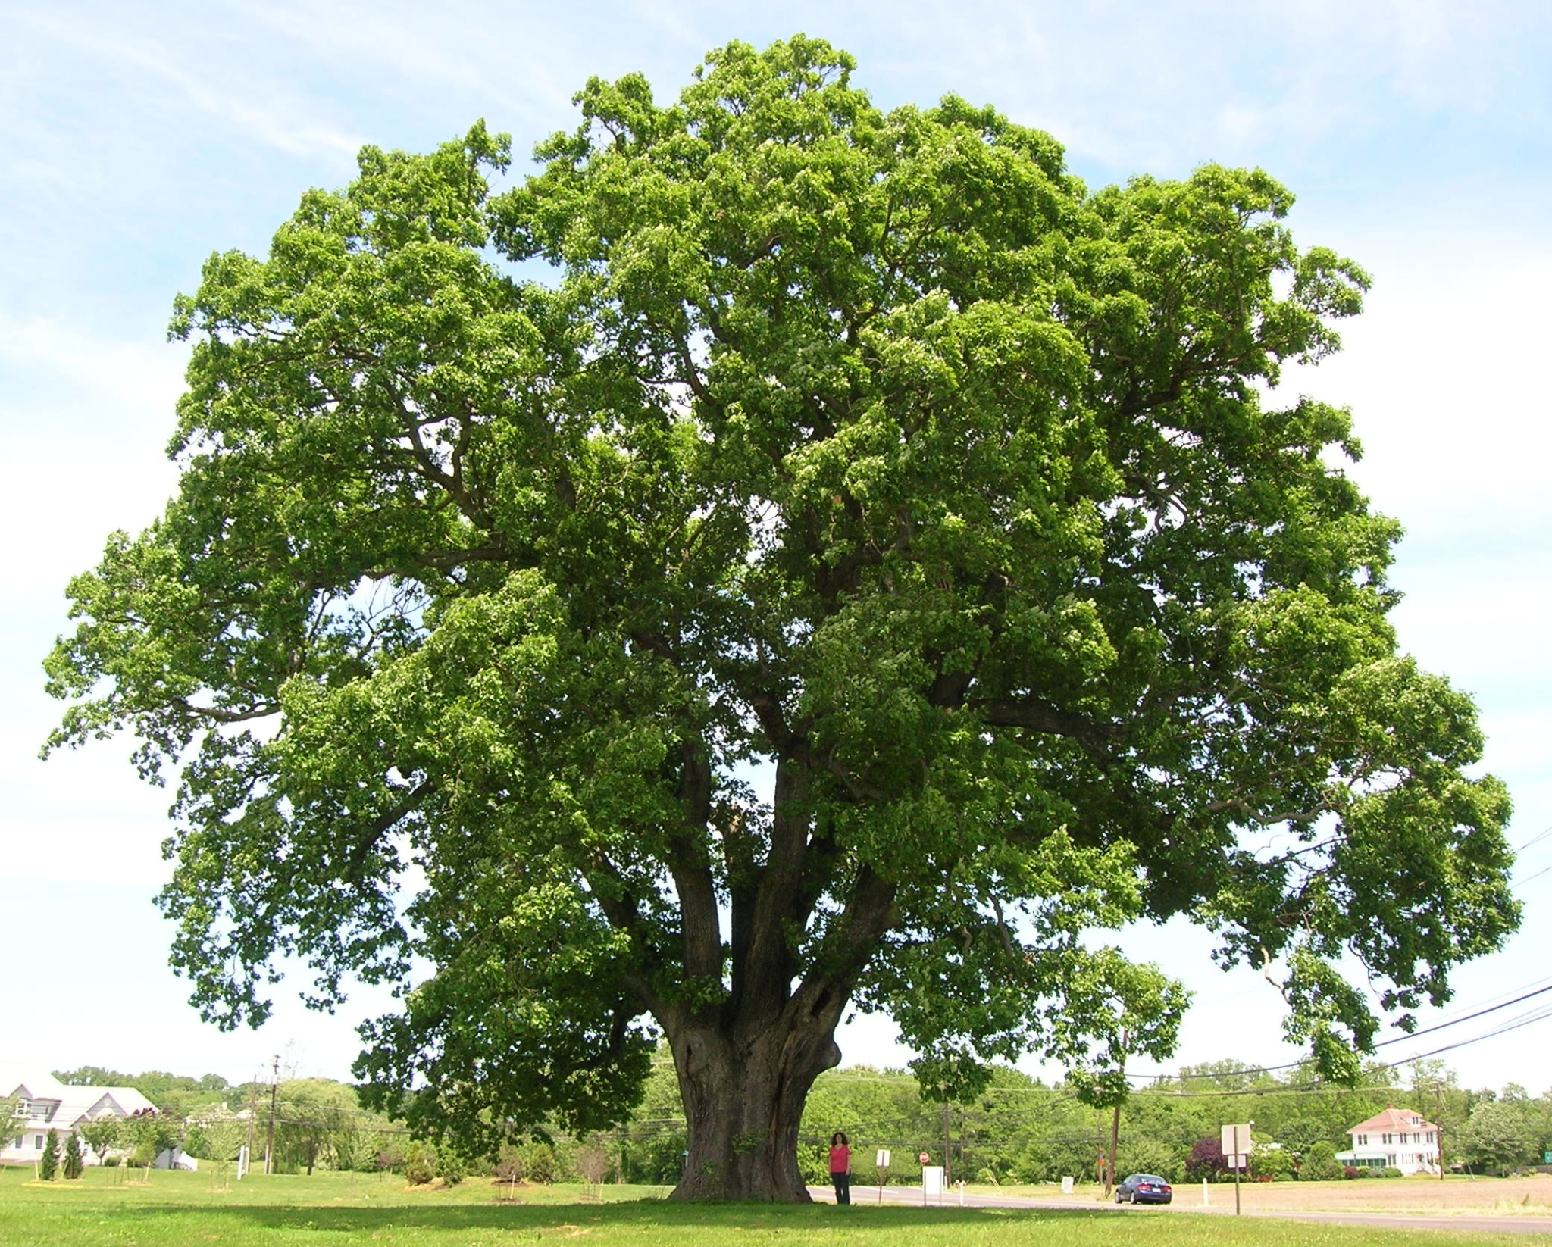
Choosing and Placing Native Trees
Native trees are a great place to start with your native garden - they provide food and shelter for all sorts of wildlife
Trees in the yard also help people - they increase a home’s value, provide shade and reduce the need for air conditioning in the summer
Many people avoid planting trees because they are afraid of the danger they could pose in the future
Notes:
White oaks are host plant to over 500 species of moths and butterflies, as well as providing acorns for larger mammals

Slide 15
Native Trees - Continued
Right tree, right place - choose the right species that will grow to be the desired size
Be aware of your utilities and foundation- while most trees don’t actually break pipes or buckle foundation when placed properly, future work can end up killing a tree that is growing too close
Driving around the roots of a tree can harm its health - this includes driving cars and using a riding lawnmower
  “Soft Landings”, coined by Heather Holm, can be put underneath large shade trees. This is a native garden bed that is arranged in a circle that goes as far as the furthest branches of a native tree
Notes:
While no tree can be guaranteed to be 100% risk free, taking the right steps when planting can help a lot
Planting trees in the city right of way/ parkway requires permission from the city
Trees on a corner lot must be 15 feet from the street corner for visibility purposes

Slide 16
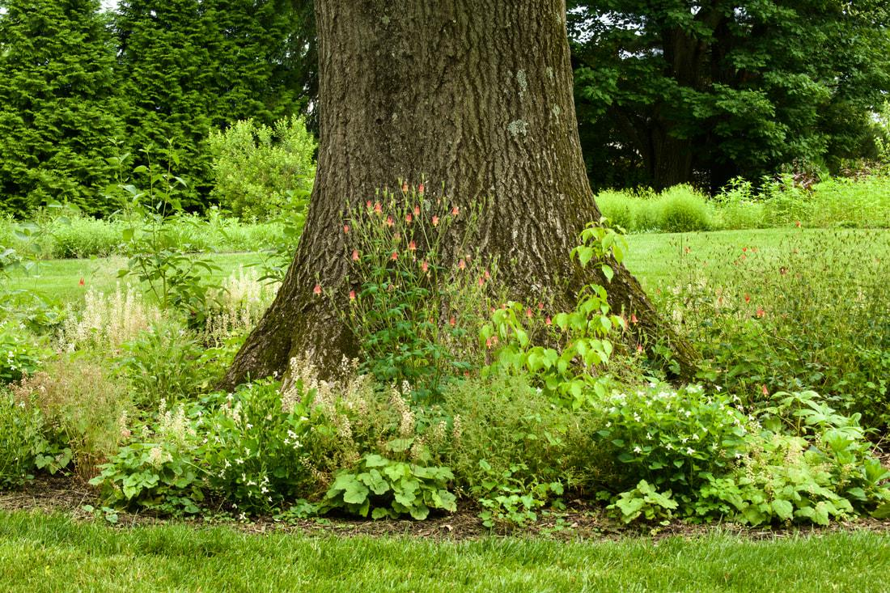
Photo courtesy of Michelle Detwiler (https://www.pollinatorsnativeplants.com/softlandings.html)

Slide 17
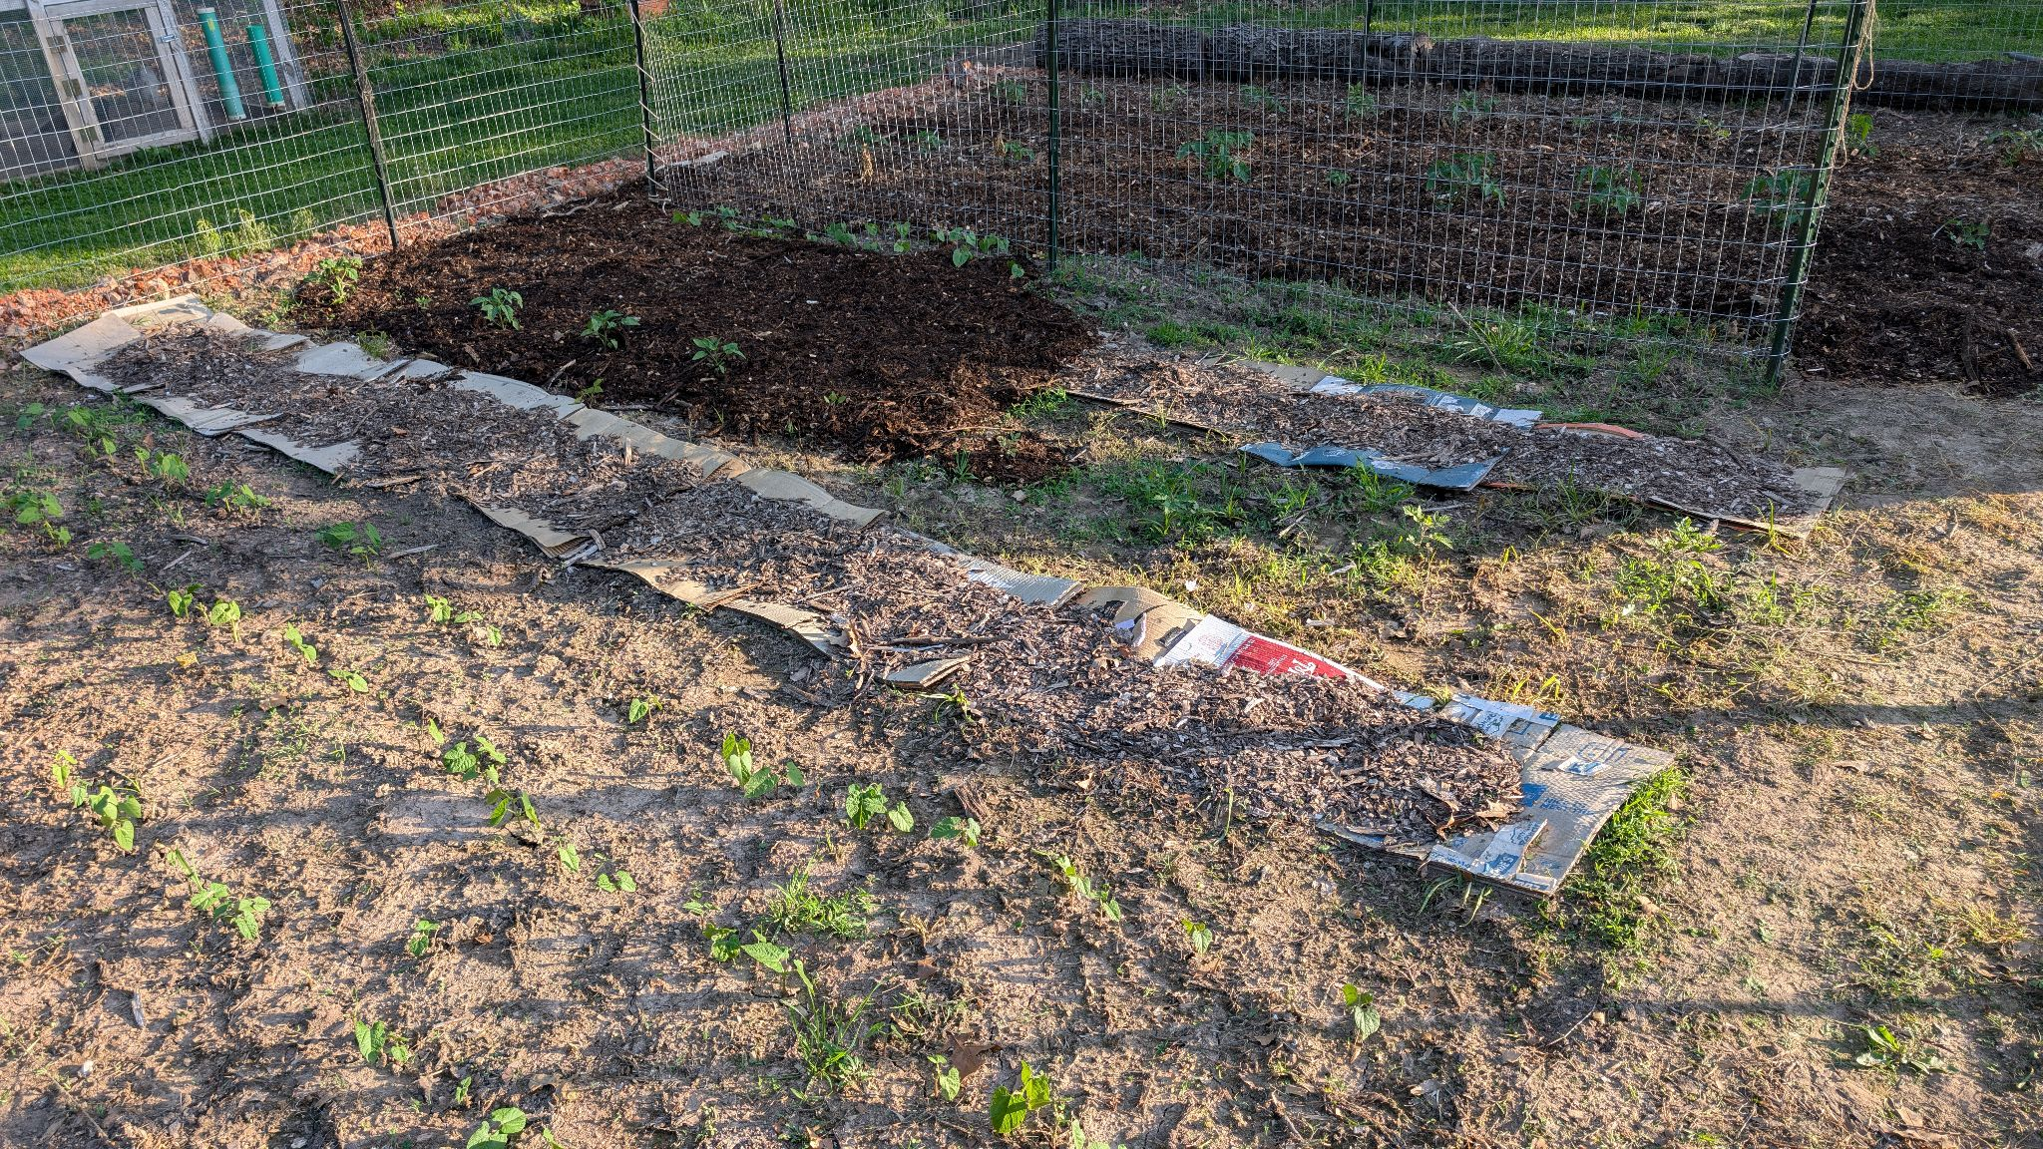
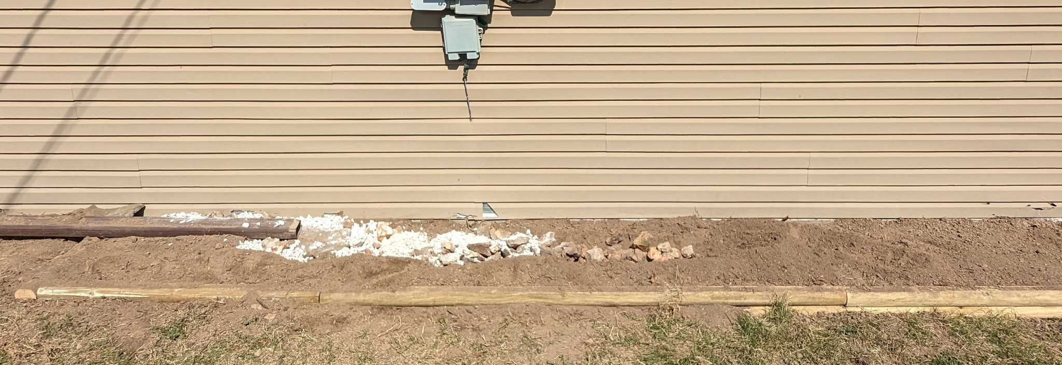
How to Prepare a Native Garden Bed
Removing *all* grass will save you time down the road
Flipping sod, cardboard and wood chips, herbicide - different situations require different techniques
No soil amendments needed
Notes:
Call before you dig - Call the number 811 or use the website 3 business days before you do any digging

Slide 18
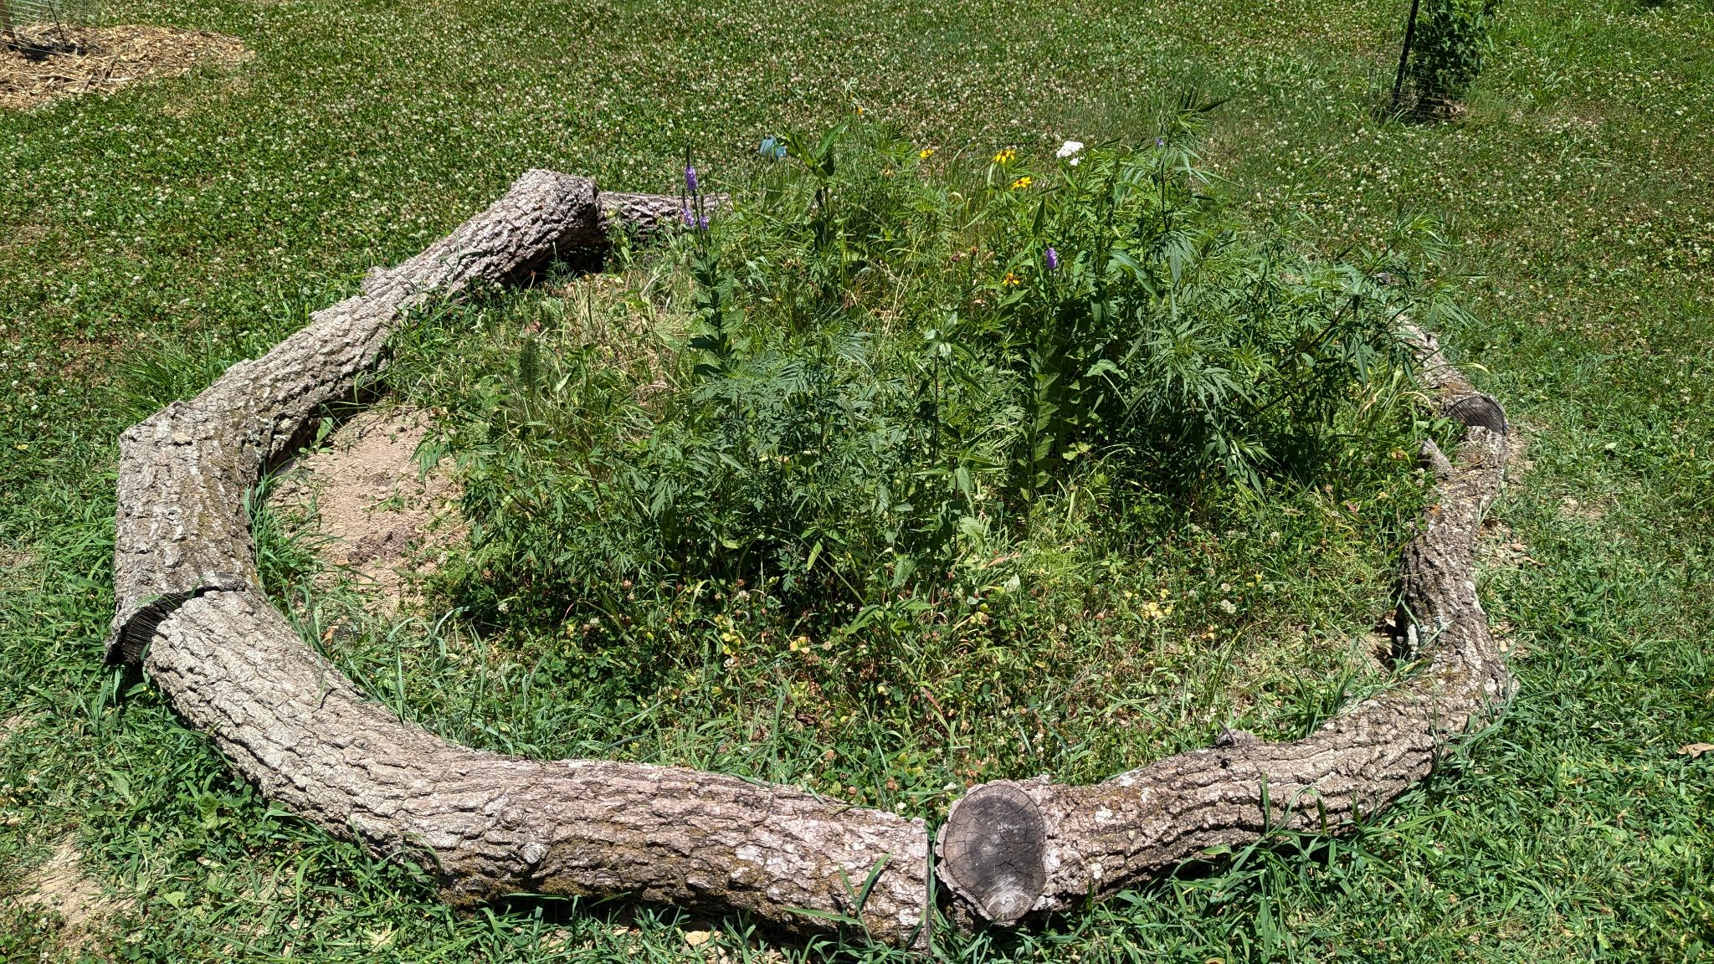
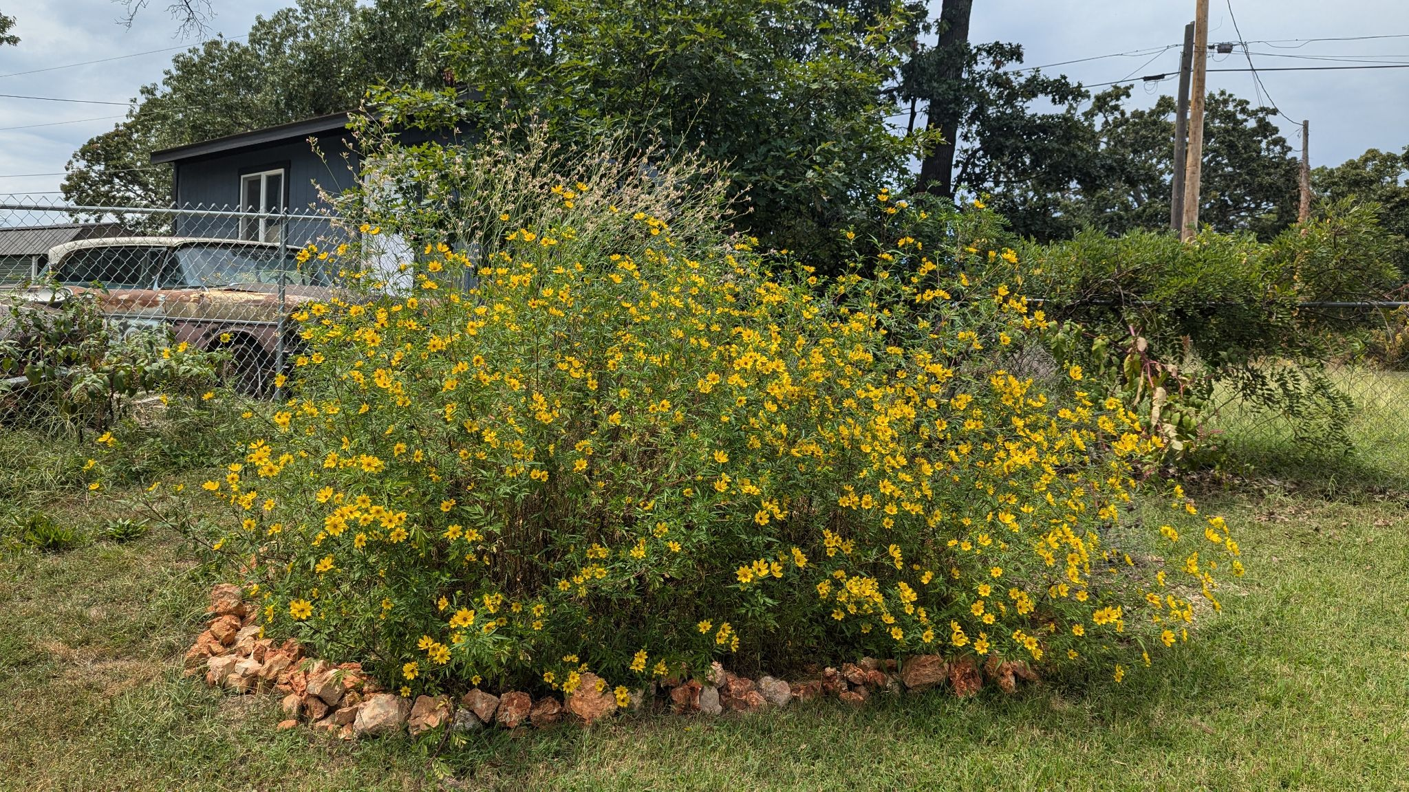
Make It Look Intentional
Adding a border to your bed can prevent things from getting mown down while they are small and communicate to your neighbors that this is an intentional planting

Slide 19
Planting and Sowing
Plants establish the fastest when sown in the fall, if you are planting in the spring or summer be prepared to water the young plants consistently until we get consistent rain or until plants are established
Most native seeds need to be sown in the fall in order to sprout in the spring
Planting seedlings lets you get better control over where they grow, and you will have bigger plants sooner
Sowing seeds is much cheaper, and you won’t have to water them nearly as much as they establish

Slide 20
Maintaining Your New Garden Bed
The first year will require the most work for your garden
Adding mulch in the form of wood chips, leaves, or grass clippings can help prevent weeds and maintain moisture - but make sure you avoid burying seeds
Stay on top of weeds - especially in the spring, but learn what is a weed and what is a native plant
Young plants still need water in their first year - water when plants look wilted or it is very dry

Slide 21
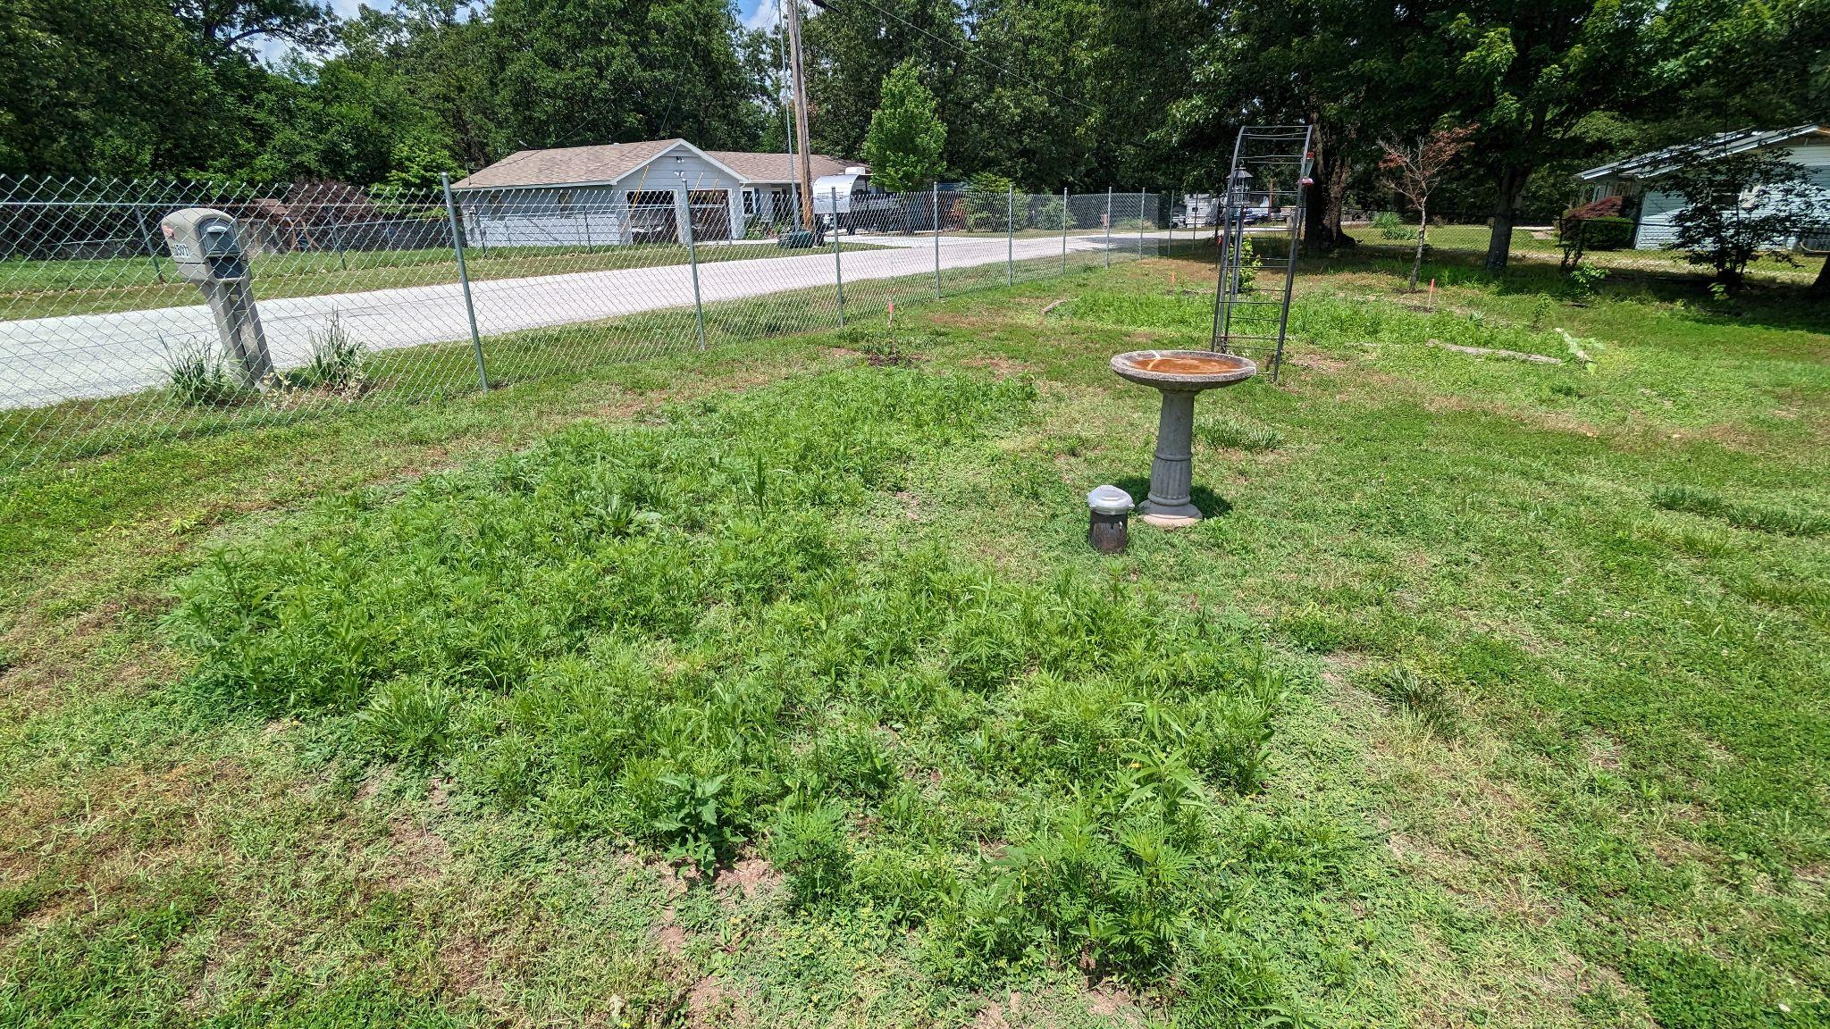
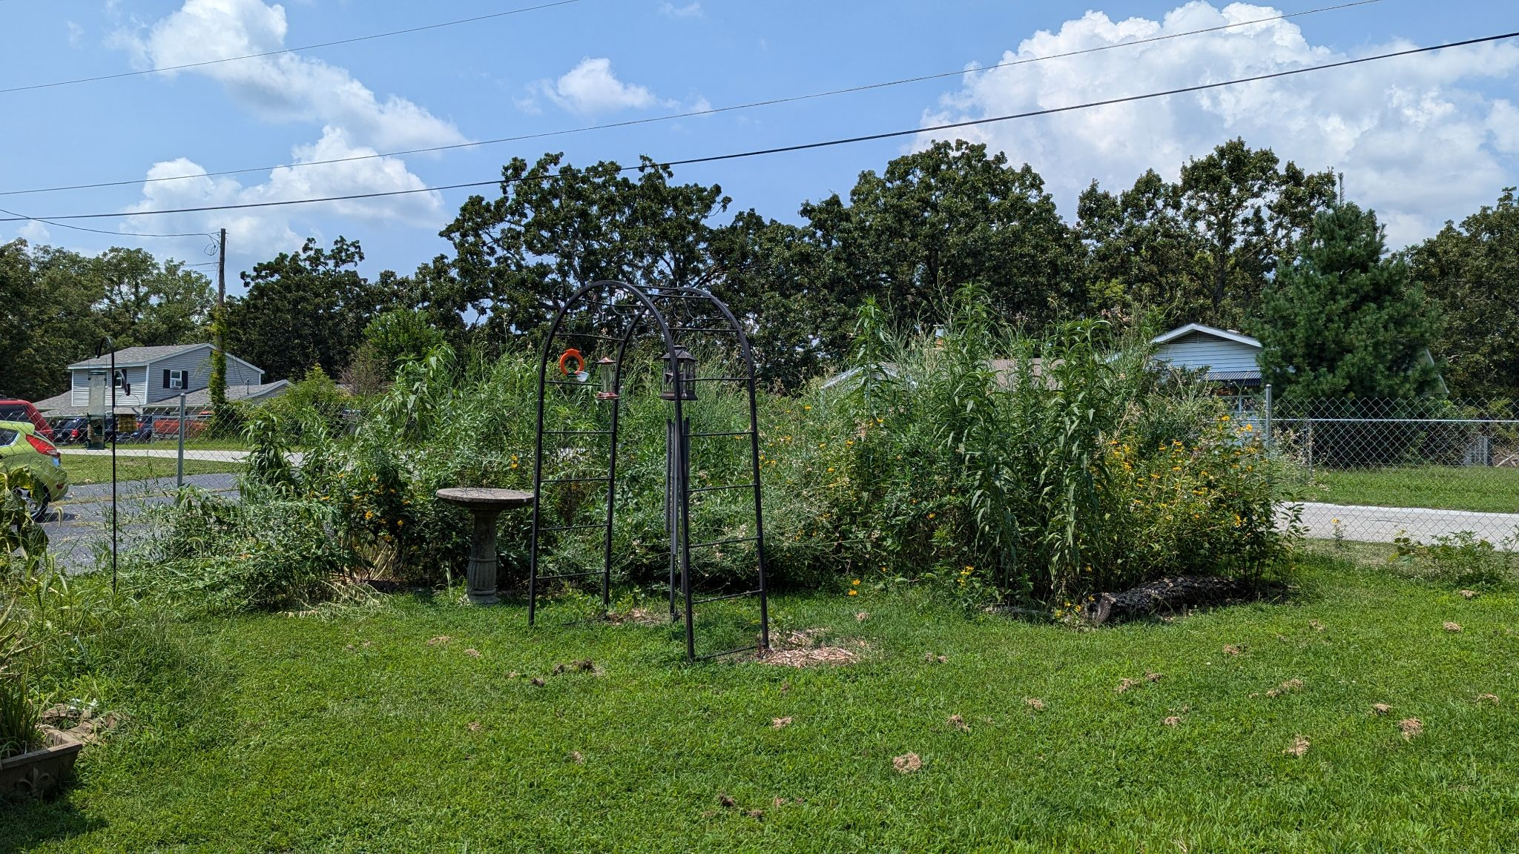
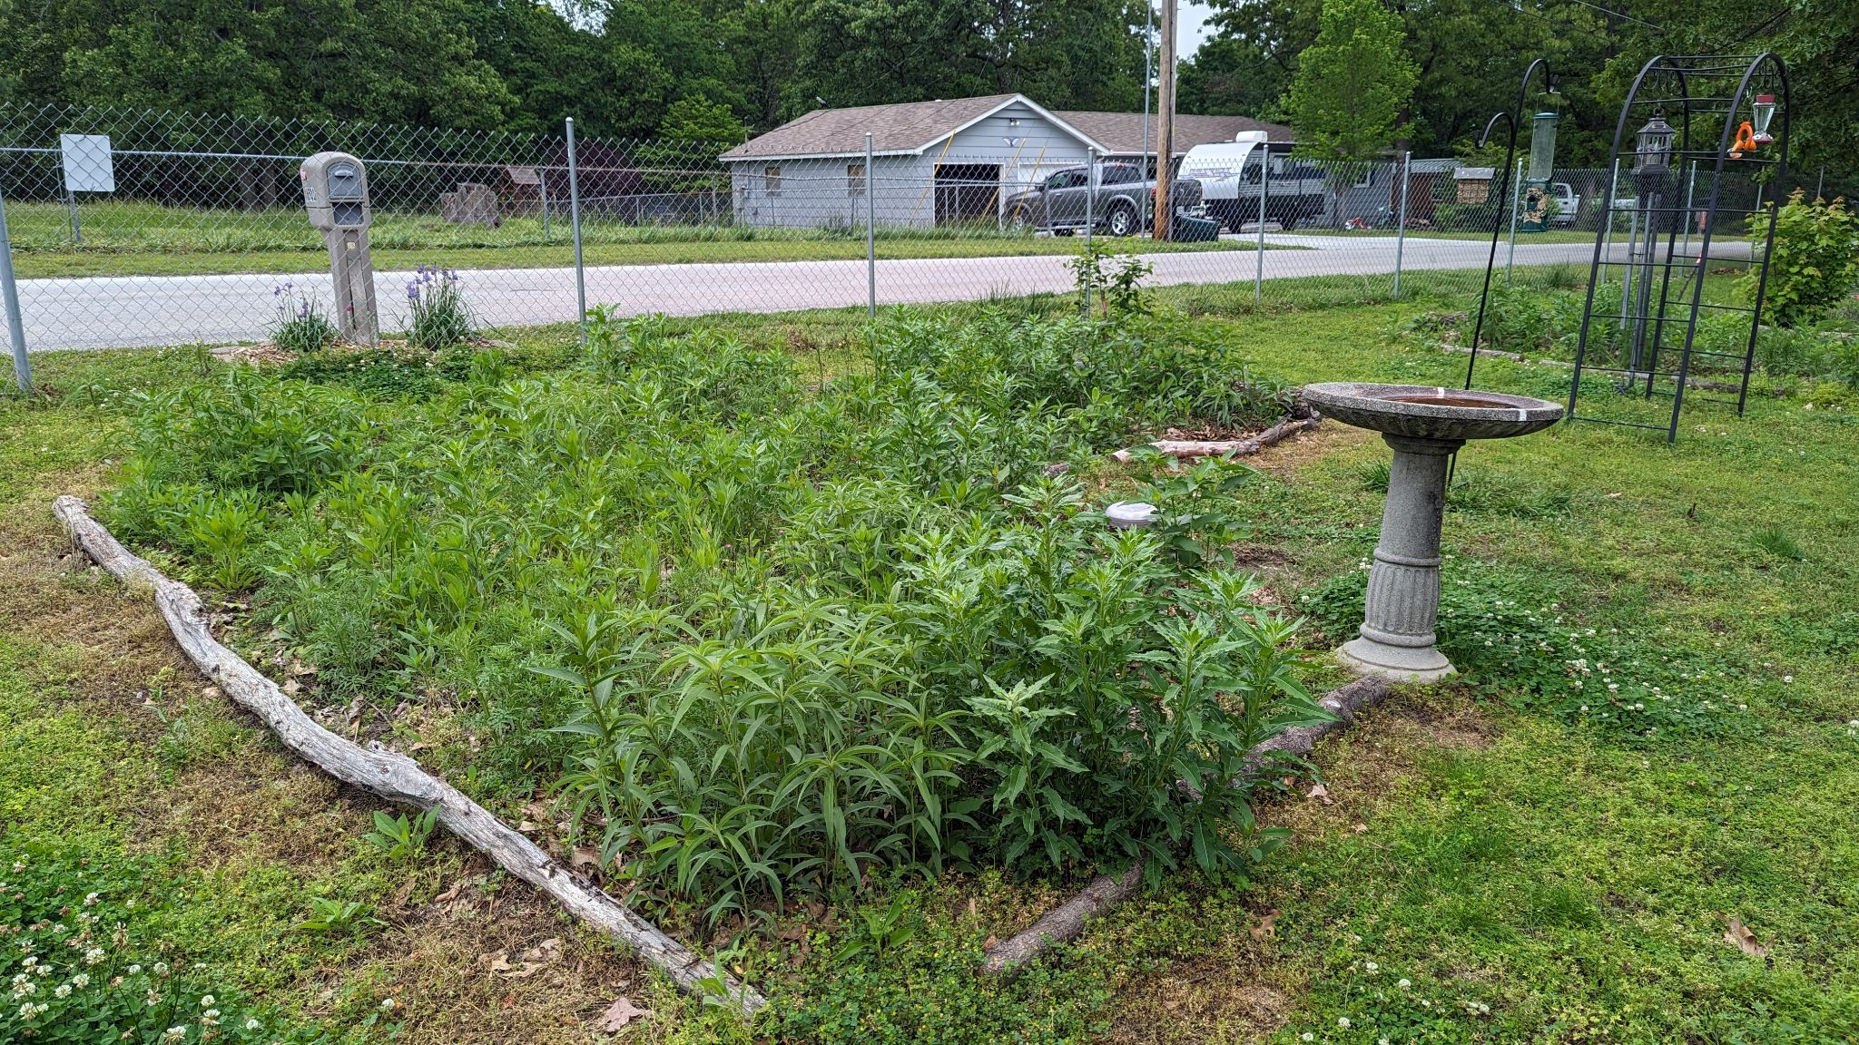
Sleep, Creep, Leap
June 2023
May 2024
July 2024

Slide 22
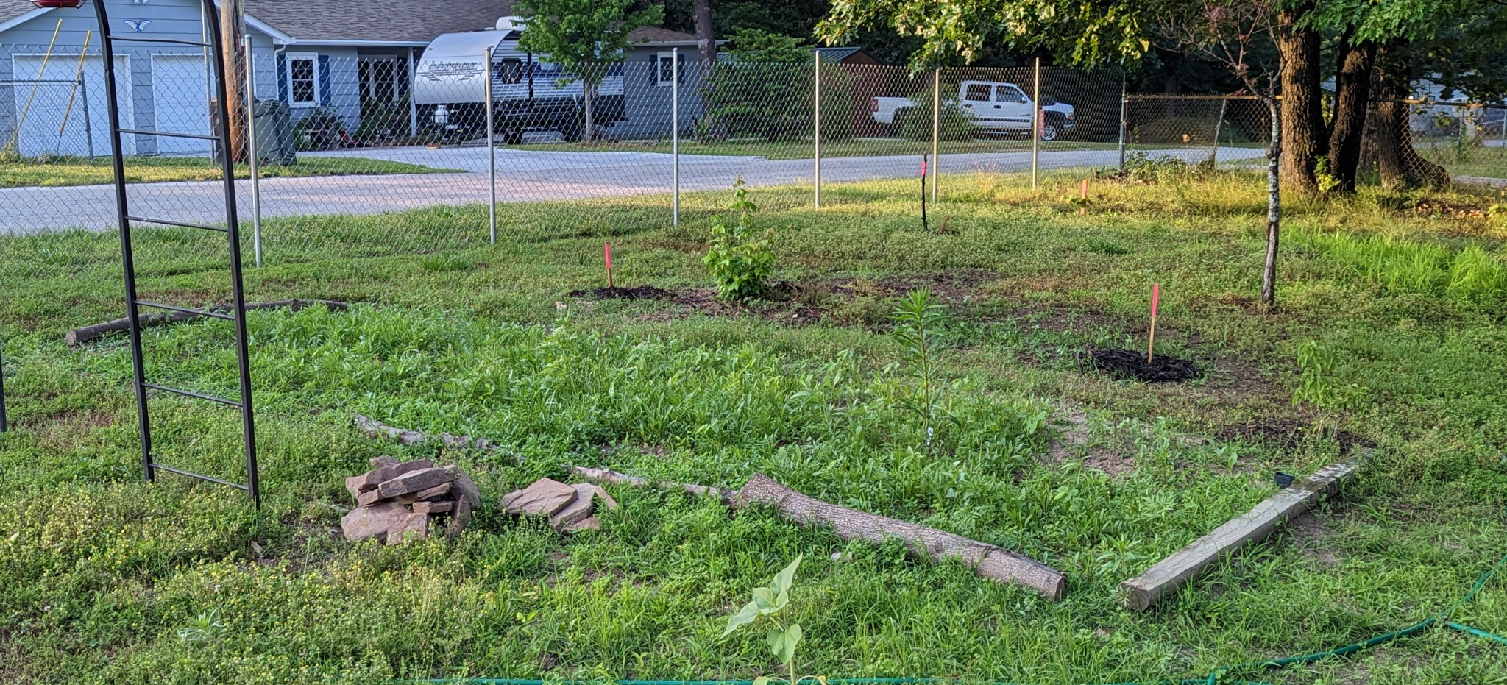
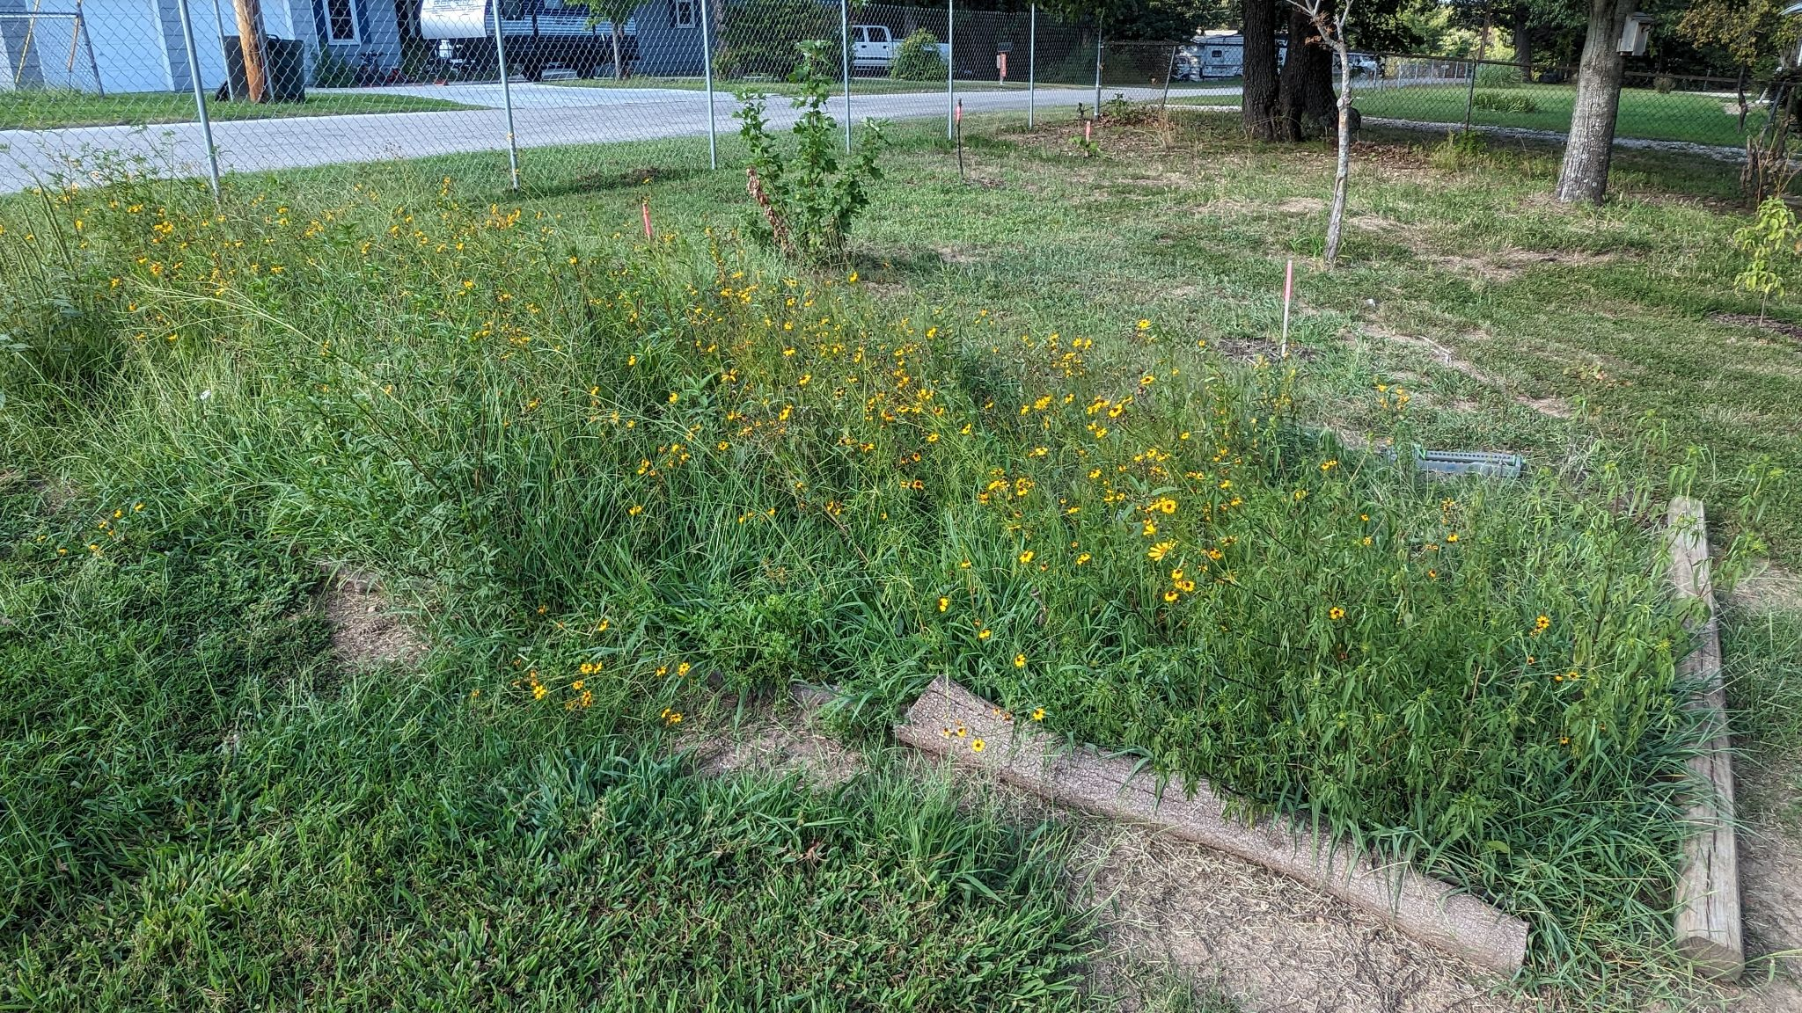
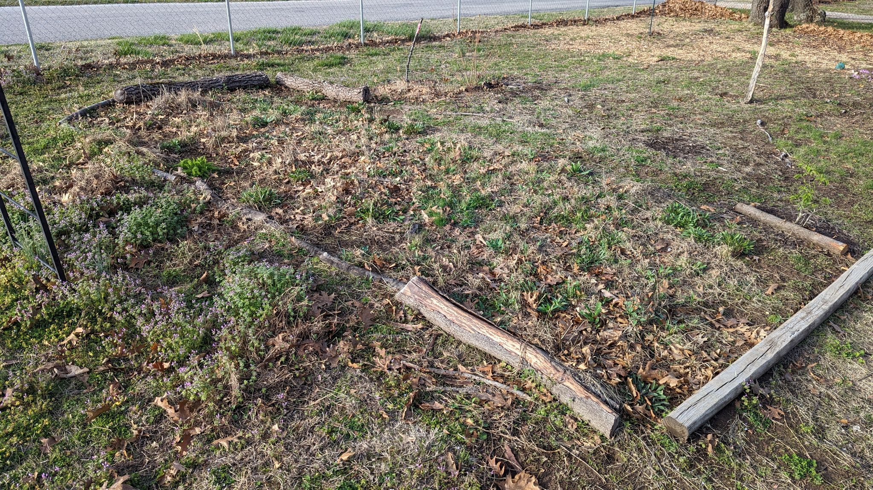
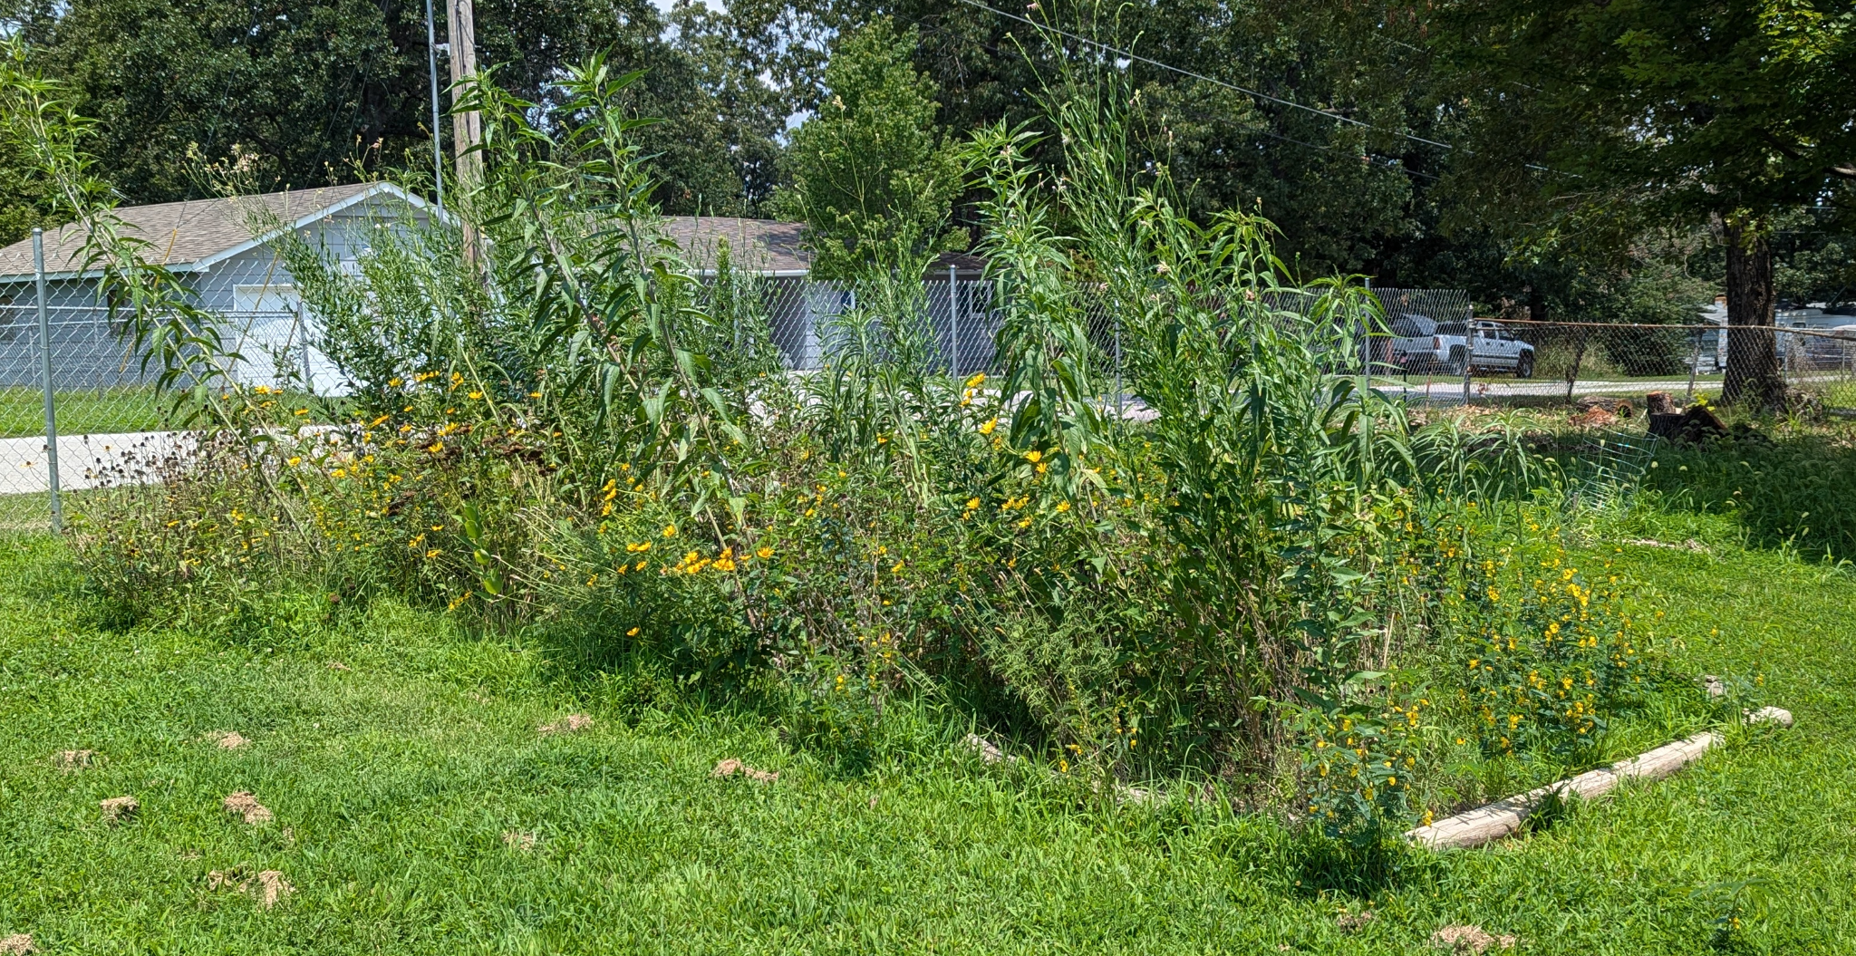
June 2023
August 2023
March 2024
July 2024

Slide 23
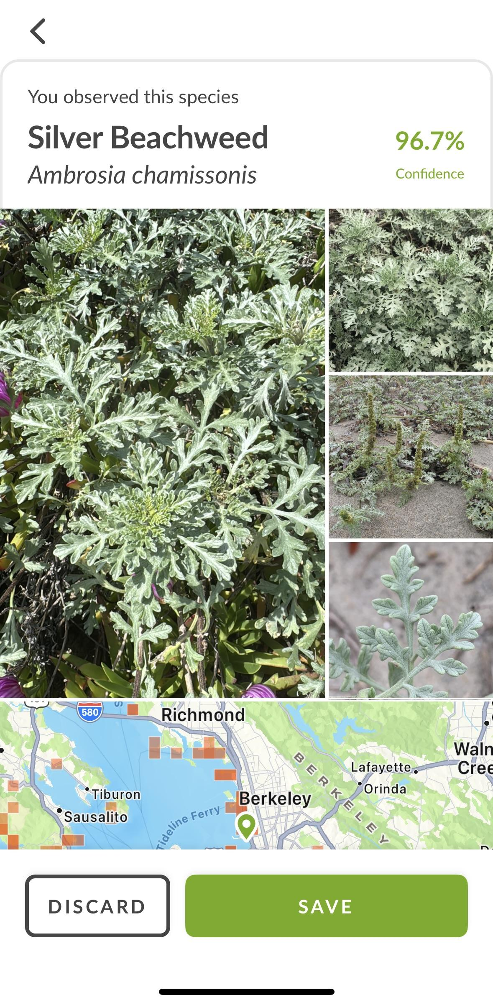
How do I know what’s growing?
iNaturalist
Free for Android
and iPhone
Can ID unlimited
times
Contributes to
science
Other users can
confirm your
Observation
Works for animals
and insects
Other Options:
Google Lense
Visual Look Up (Apple)
Other apps
Field Guides
Social Media groups
Bring a picture w/ multiple angles to
Conservation Dept, Master Gardeners, Master Naturalists
Notes:
A weed is just an unwanted plant.
Having “weed’ in the name doesn’t make it a weed.

Slide 24
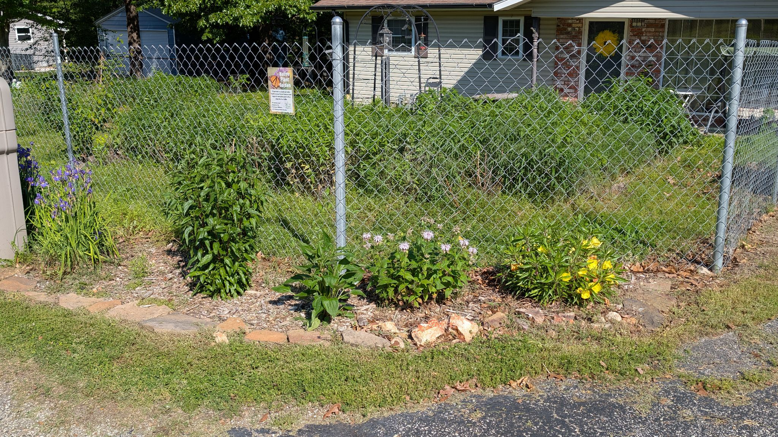

Slide 25
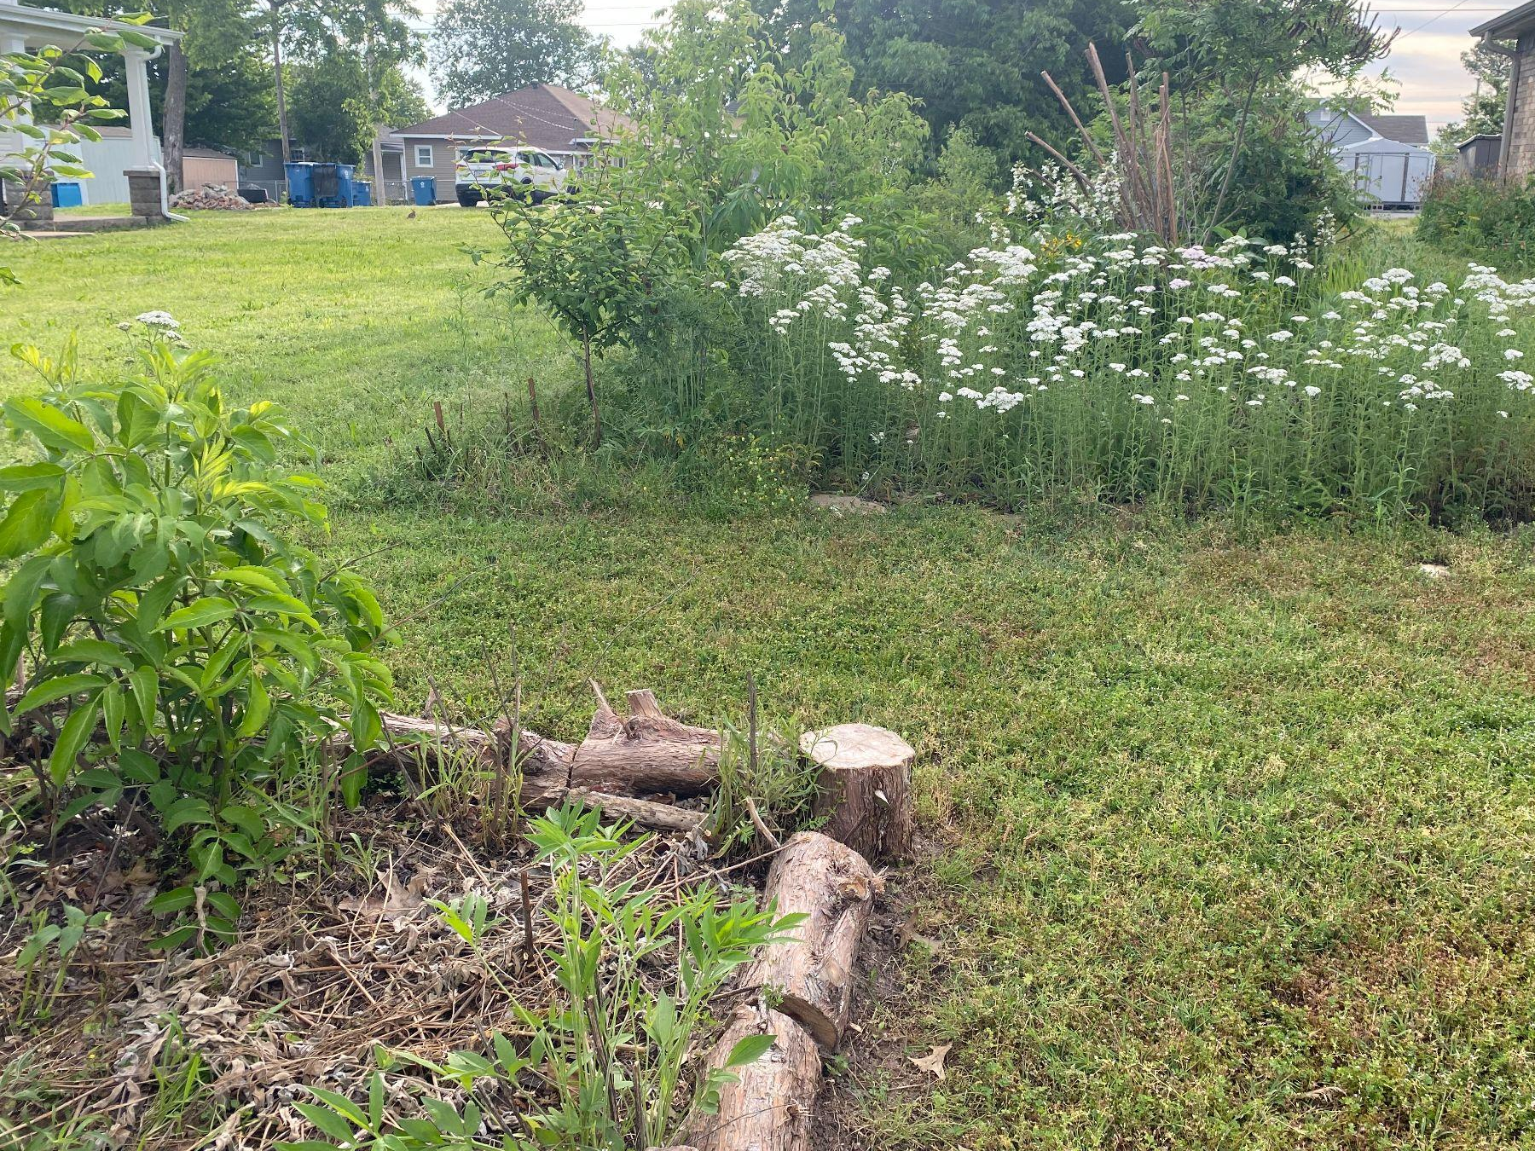

Slide 26
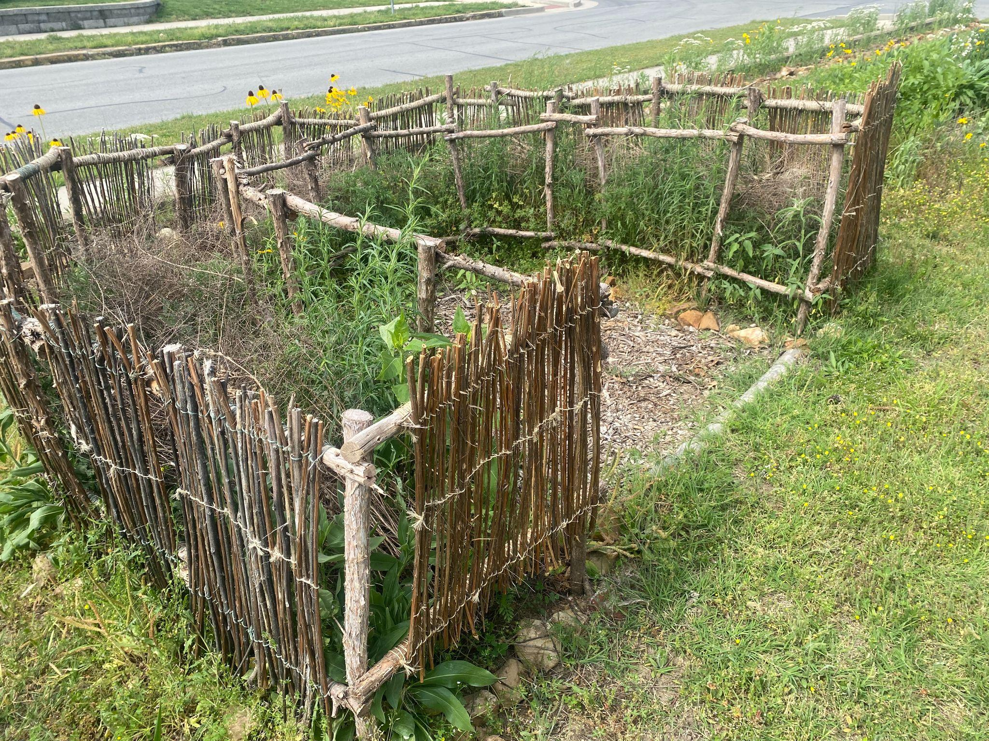

Slide 27
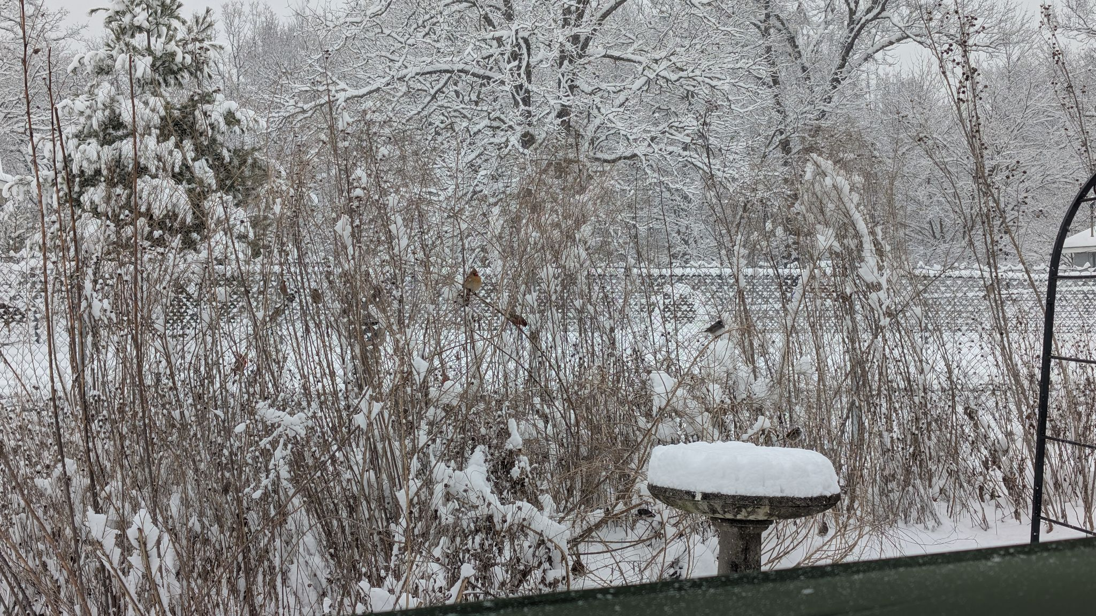
In Conclusion
Native plants provide critical habitat and food for wildlife
Right plant, right place
Native gardens still require some maintenance
A well thought out plan will save time and effort
Make your neighbors jealous!

Slide 28
Resources
Missouri Department of Conservation: https://mdc.mo.gov/trees-plants/native-plants-your-landscape
Grow Native!: https://grownative.org/
Homegrown National Park: https://homegrownnationalpark.org/about-us/
Benjamin Voght Monarch Gardens: https://www.monarchgard.com/benjamin-vogt.html
Missouri Master Naturalists, Chert Glade Chapter: https://www.chertglades.org/
Soft Landing Plantings: https://www.pollinatorsnativeplants.com/
Missouri Wildflowers Nursery: https://mowildflowers.net/
Ozark Soul Native Plants: https://www.ozarksoul.com/

Slide 29
Sources Cited
Lowe’s Garden Center: https://www.lowesfloral.com/sales-and-events/weekly-sale-items/
Xerces Society Eastern Monarch Conservation: https://xerces.org/monarchs/eastern-monarch-conservation
Missouri Department of Conservation: https://mdc.mo.gov/discover-nature/habitats/glades
Soft Landings by Heather Holm: https://www.pollinatorsnativeplants.com/softlandings.html#:~:text=ARE%20SOFT%20LANDINGS%3F-,Soft%20landings%20are%20diverse%20native%20plantings%20under%20keystone%20trees%20(or,fireflies%2C%20lacewings%2C%20and%20beetles.
All unlabeled images taken by Emily Bowyer and Scott Butler

