Slide 1
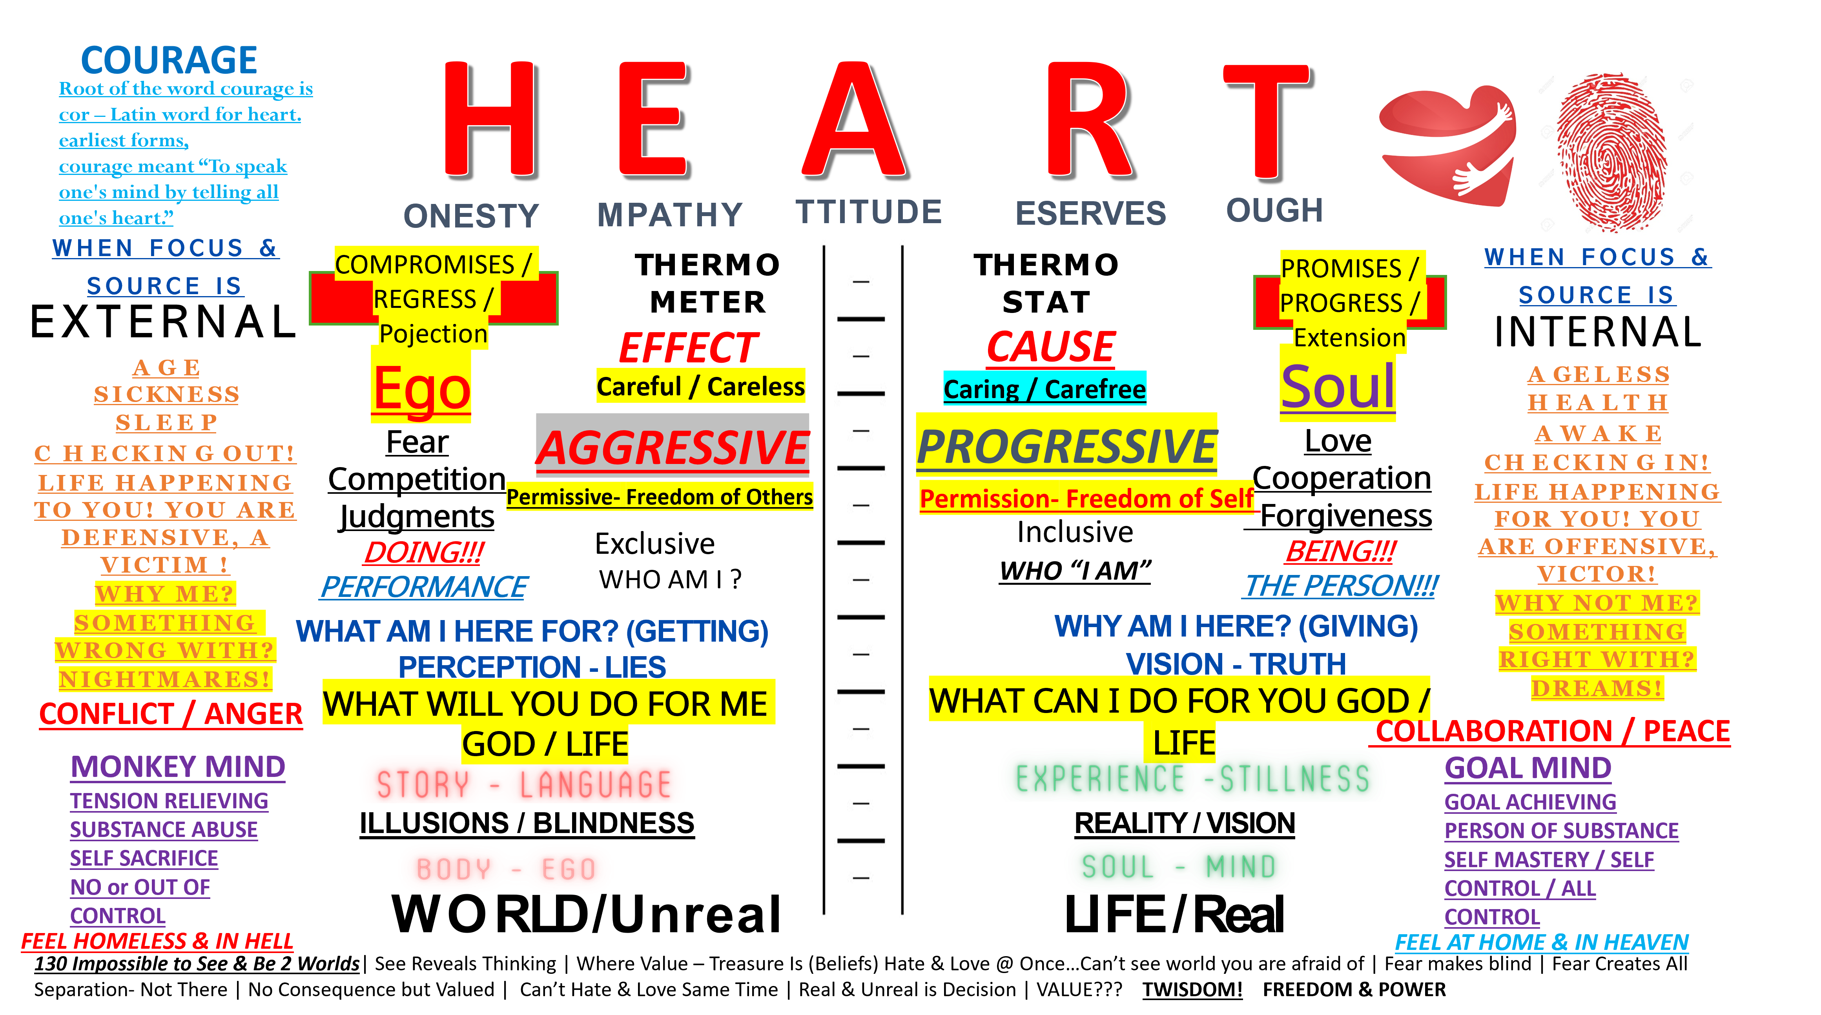
All rights reserved Fred DeFalco and www.920society.org
Print & DNA
1 in 8 Billion,
Soul the same
The Ephemeral
The Eternal
920Society.org

Slide 2
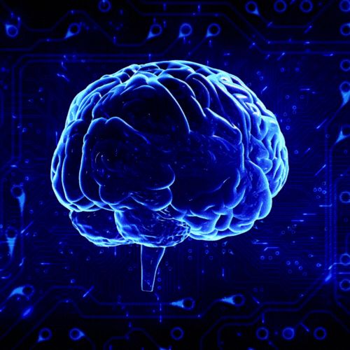
The Power of You!
12,000 to 60,000 thoughts per day, 4-Million to 12-Million per year.
The human brain weighs about 3 pounds, contains approximately 86 billion neurons connected by over 100 trillion synapses (junctions), consumes 20% of the body’s energy while making up only 2% of its weight, processes about 12,000 to 60,000 thoughts per day, can generate around 23 watts of power (enough to light a small bulb), transmits information at speeds of up to 268 miles per hour, stores the equivalent of 2.5 million gigabytes, and operates through 100,000 miles of blood vessels.

