Slide 1
LIFEVANTAGE · THE ACTIVATION COMPANY
Activate Everything
The Science, The Company, and YOU
An opportunity overview
IT STARTS WITH YELLOW

Slide 2


Slide 3
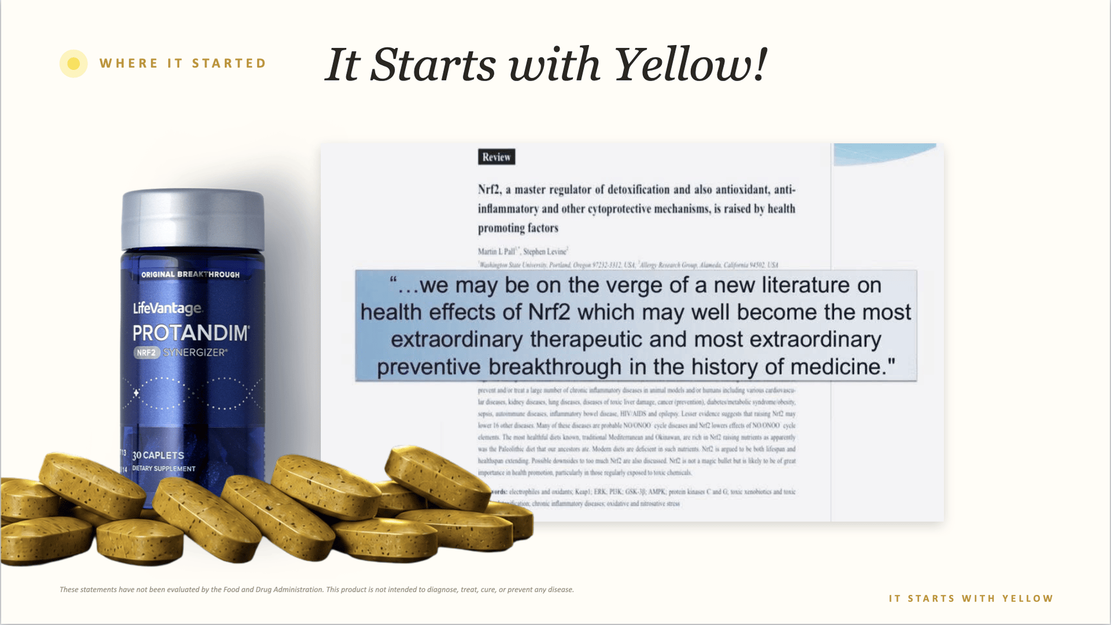

Slide 4


Slide 5
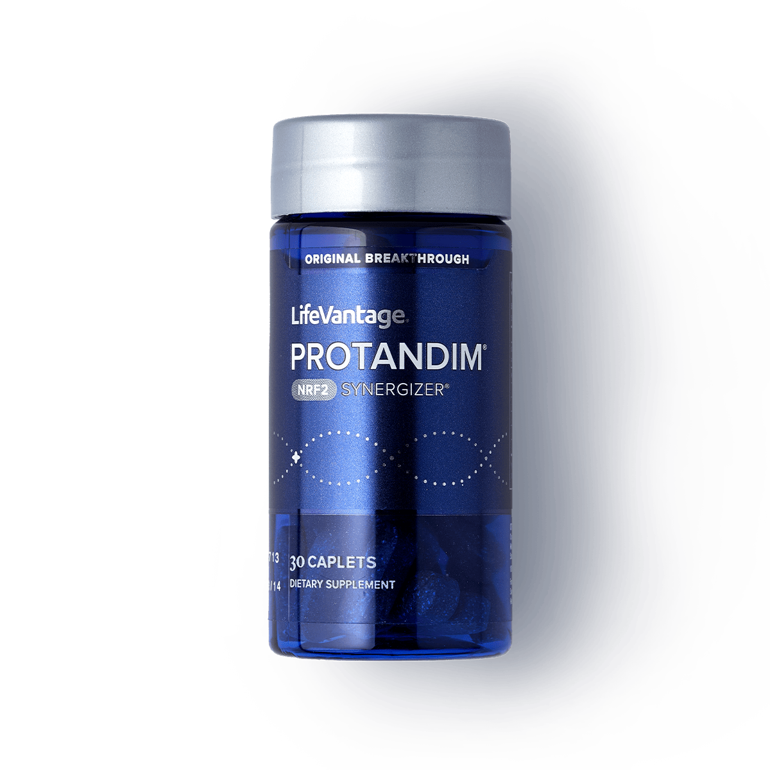

WHERE IT STARTED
2005 — A True Breakthrough
The Company Story
· ABCNEWS.COM
· $5 million in orders
· Stock $1 to $20
· Small Biotech Company
· No infrastructure
· Dropped to 7 cents
· It had a story to be told
These statements have not been evaluated by the Food and Drug Administration. This product is not intended to diagnose, treat, cure, or prevent any disease.
IT STARTS WITH YELLOW

Slide 6















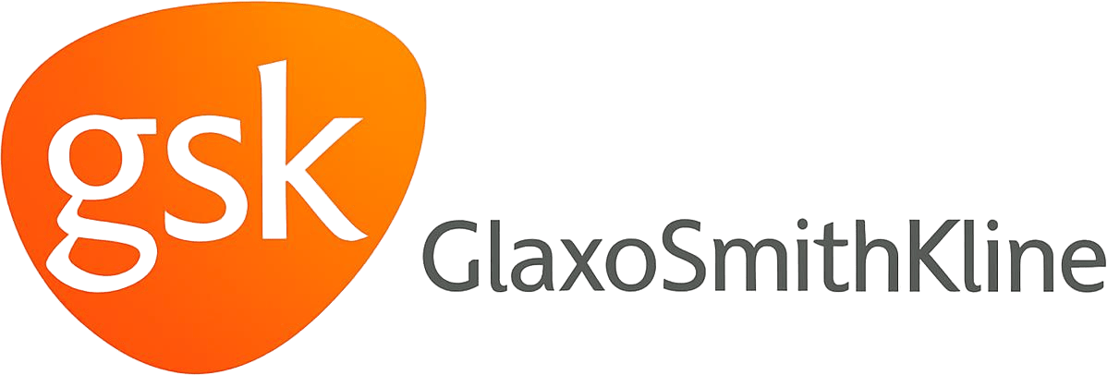
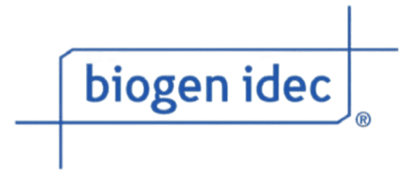
Studied at Institutions YOU Trust
INDEPENDENTLY STUDIED
Independent Researchers — Not Just LifeVantage!
IT STARTS WITH YELLOW

Slide 7
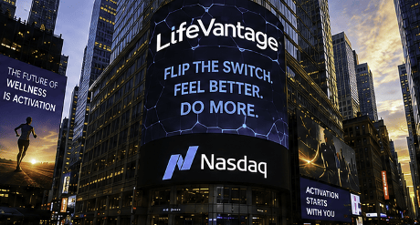
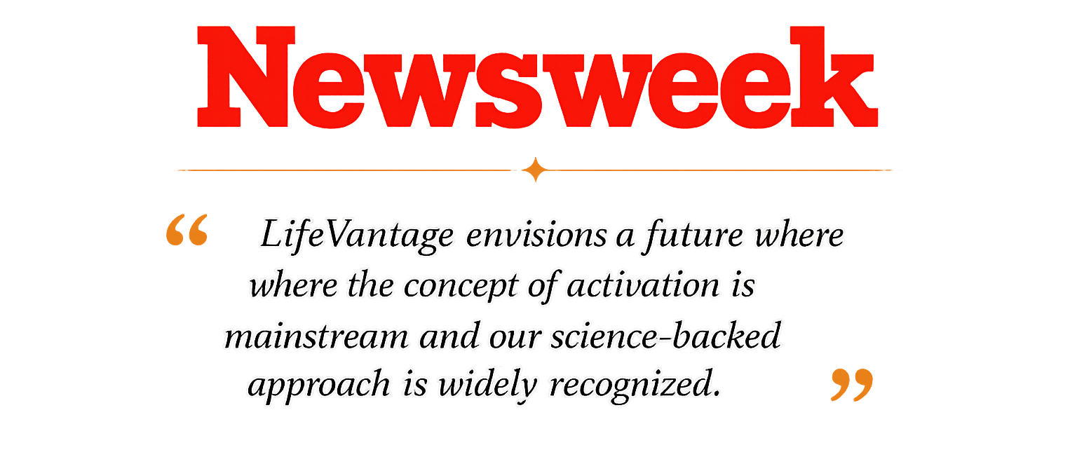




LifeVantage at a Glance
THE COMPANY
Publicly Traded on NASDAQ — and Debt-Free
Newsweek 2024 & 2025 — “The Wellness Revolution”
15 Patents Issued & Pending
$2 Billion+ of Protandim Sold & BSCG Approved
30+ Peer-Reviewed Published Studies in PubMed
IT STARTS WITH YELLOW

Slide 8
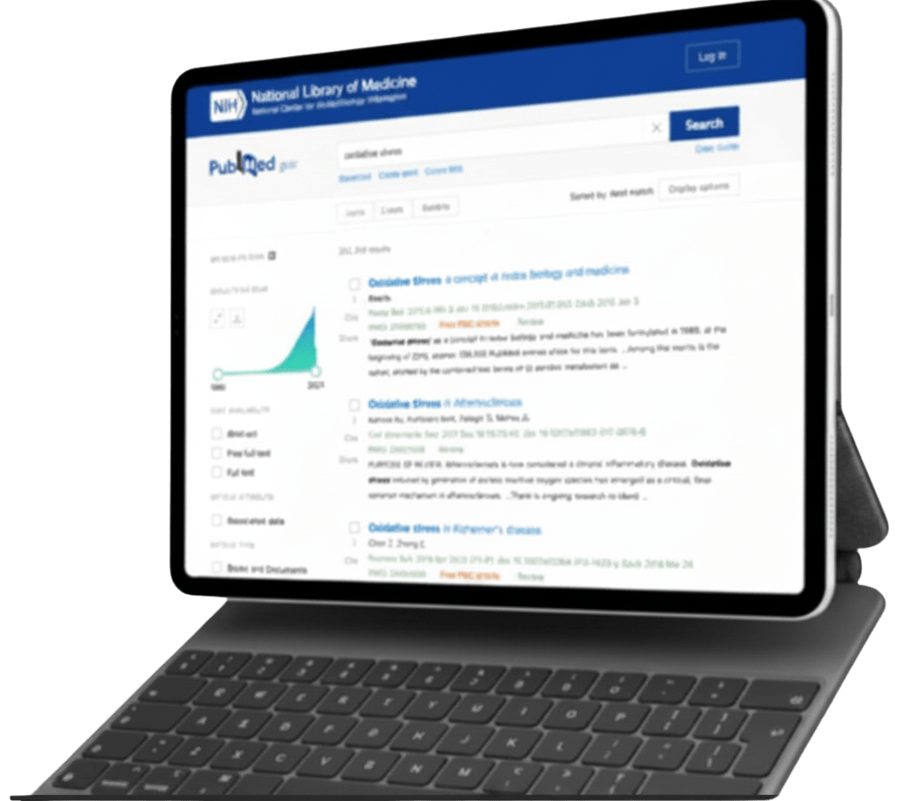
THE SCALE
oxidative stress
It Touches Nearly Everything
405,791 results
Brain
Blood Vessels
Eyes
Immune System
Heart
OXIDATIVE
STRESS
405,000+
Lungs
Skin
peer-reviewed, published
studies referencing oxidative stress
Searchable today in the U.S. National Library of Medicine — one of the most-studied subjects in modern medicine, PUBMED.GOV
Joints
Kidneys
IT STARTS WITH YELLOW

Slide 9
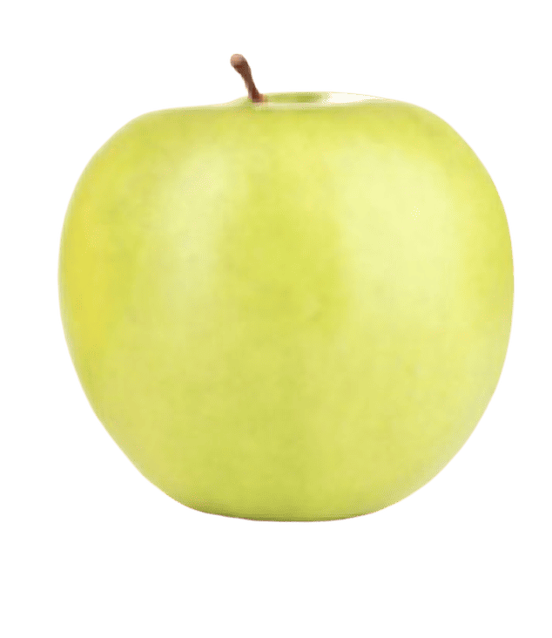
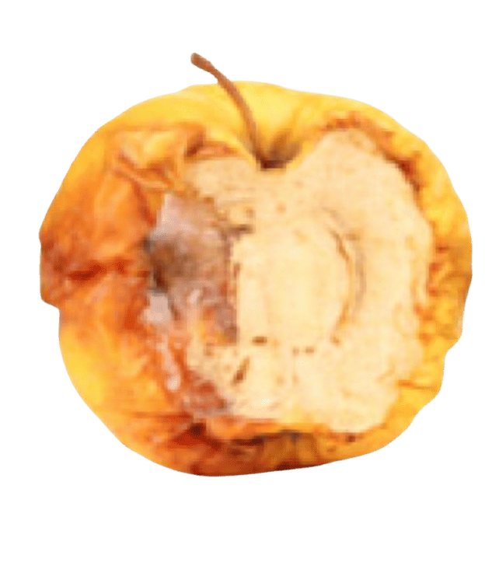
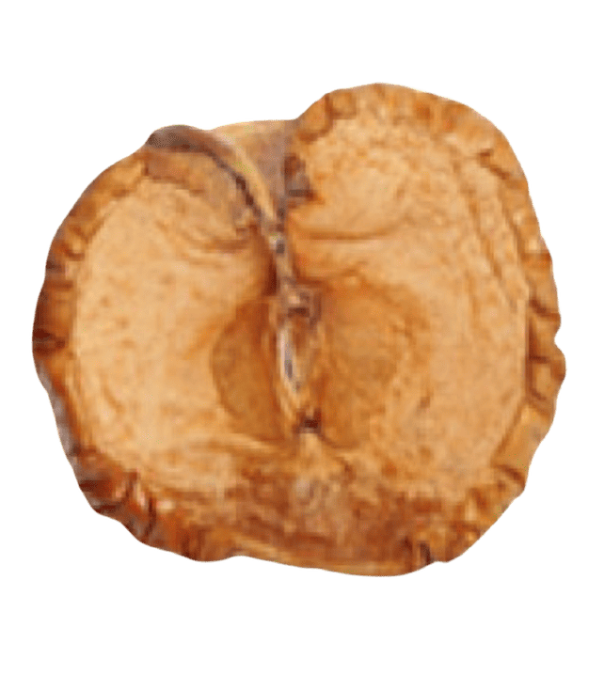
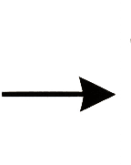
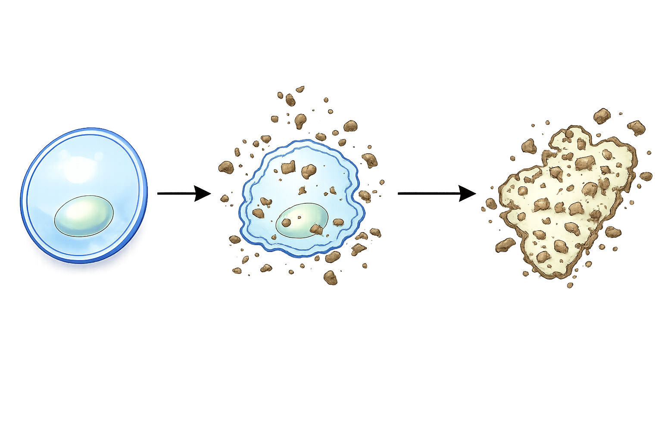
What is Oxidative Stress?
THE PROBLEM
Free radicals outnumber your defenses — and cells start to rust.
You Experience It As:
· Fatigue
· Brain Fog
· Run-Down
· Slower Recovery
· Disrupted Sleep
· Heightened Emotions
· Joint Tension
· Skin Issues
Oxidative Stress on an APPLE
healthy cells free radical attack oxidative stress
The same oxidation impacting our cells
IT STARTS WITH YELLOW

Slide 10

THE MODERN LOAD
What is Free Radical Damage?
Processed and Low-nutrient food
Low-quality water
Contaminated air
Too little — or too much — exercise
Environmental toxins
Wi-Fi, EMFs, 4G / 5G
Medications — and more
IT STARTS WITH YELLOW

Slide 11
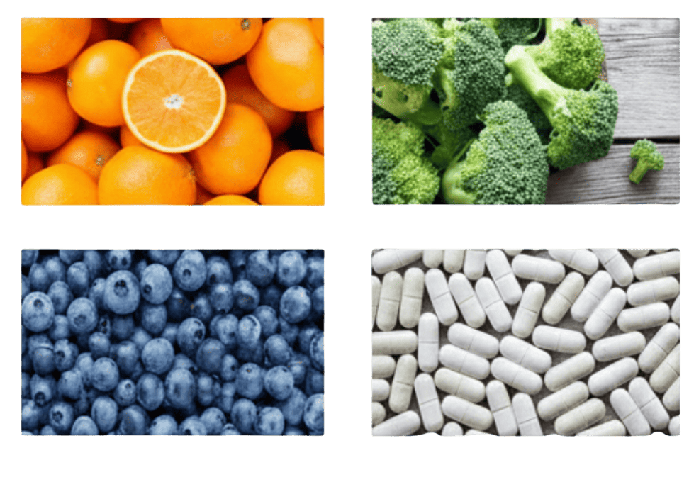
Diet Alone Can’t Win
THE MODERN LOAD
DIETARY ANTIOXIDANTS · 1 : 1 then done
YOUR OWN ENZYMES · 1 : 1,000,000 / sec
OXIDATIVE STRESS OVER TIME
Without Protandim
400 oranges a day
500 cups of broccoli daily
With Protandim
Age 20
40
60
80
With a P Value of 0.0001
110 cups of blueberries
120 vitamin C tablets
IT STARTS WITH YELLOW

Slide 12



Tests show Microplastics were Found in
Of human brain samples
Global convention

Slide 13
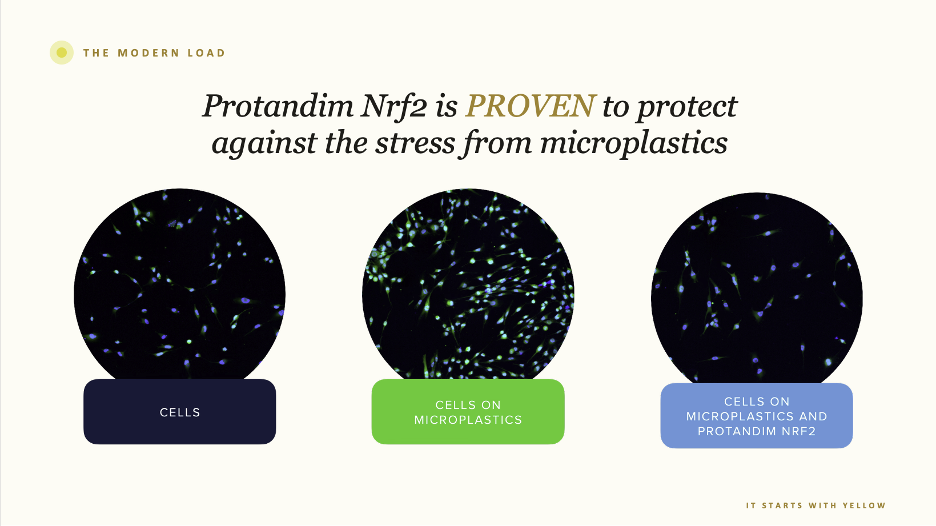

Slide 14


in 2023, pollution was linked to
Worldwide
Global convention

Slide 15
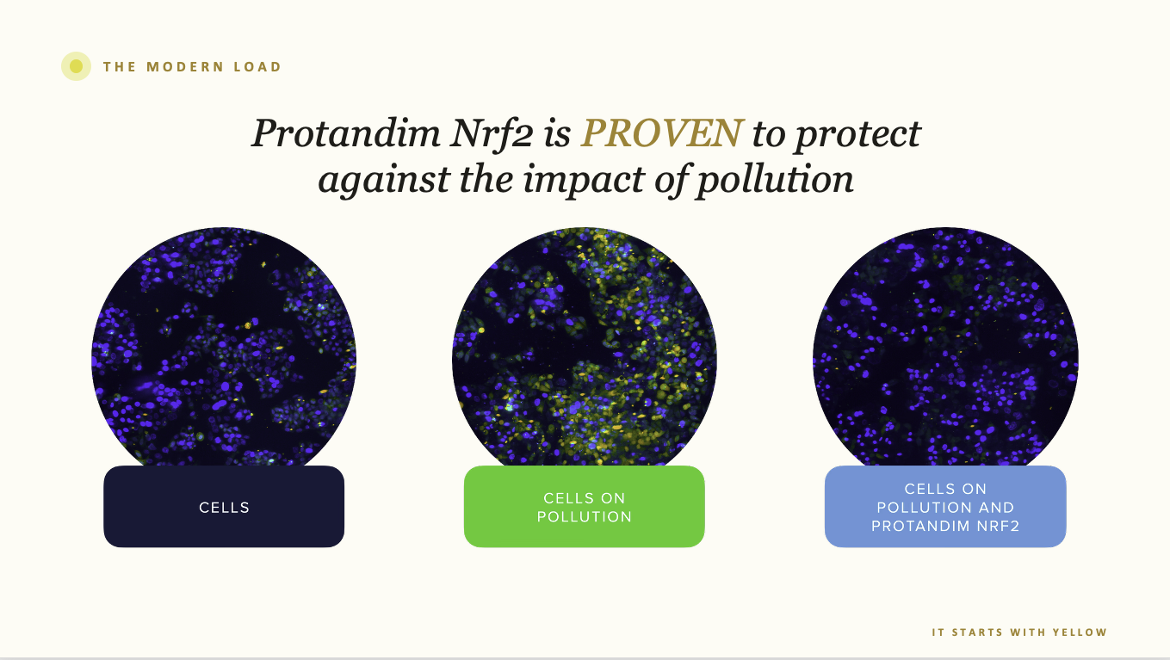

Slide 16
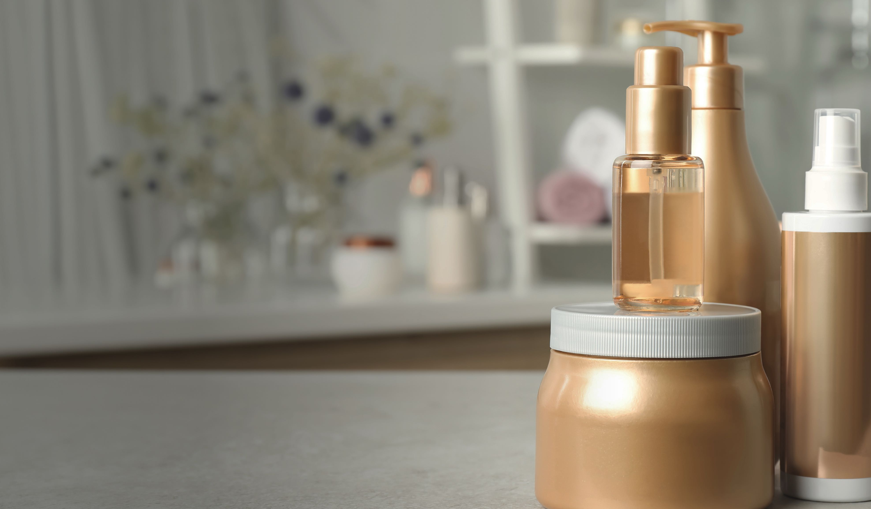

A key hormone disruptor
In the last decade
Global convention

Slide 17
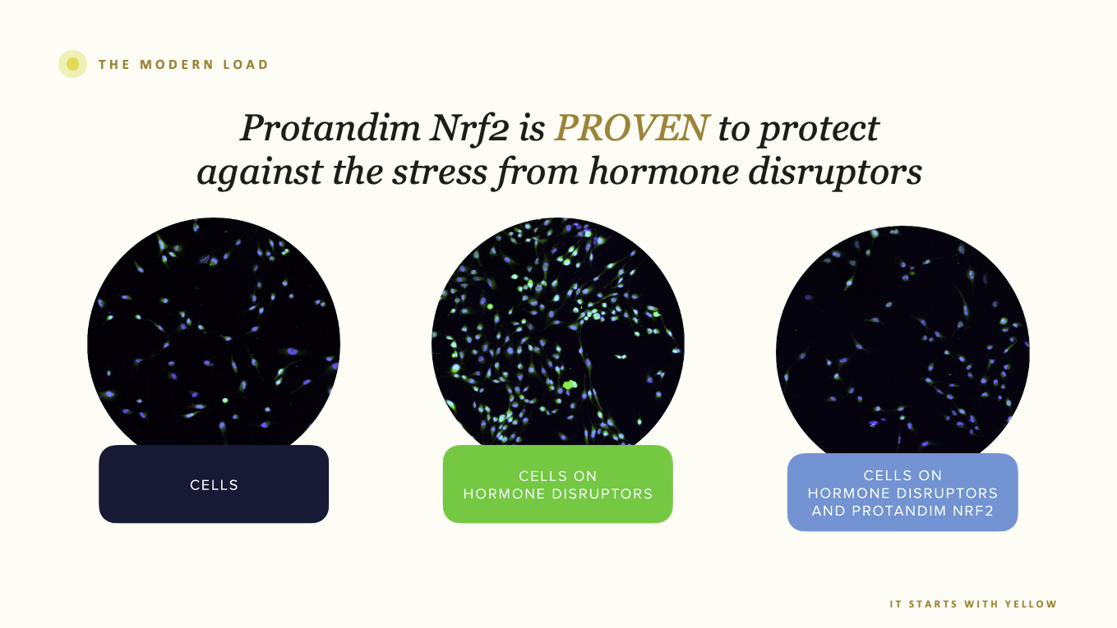

Slide 18


Slide 19
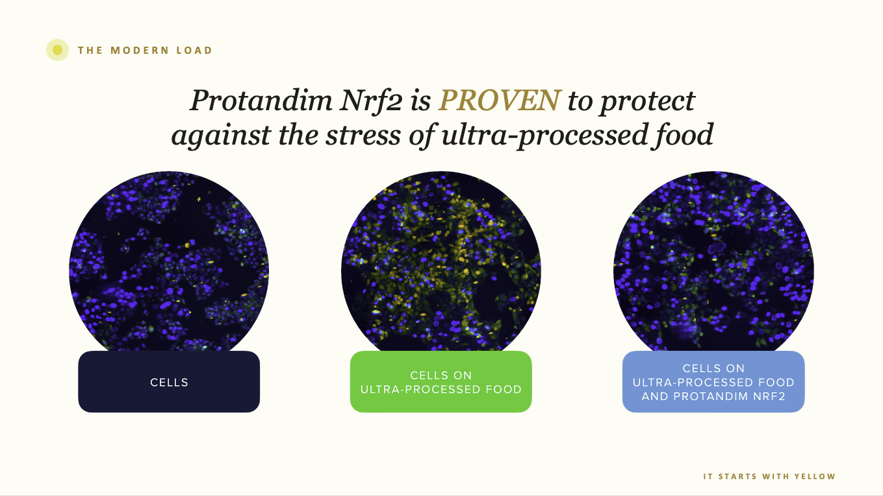

Slide 20


harmful pesticides have been detected in the urine of
Over the age of six
Global convention

Slide 21
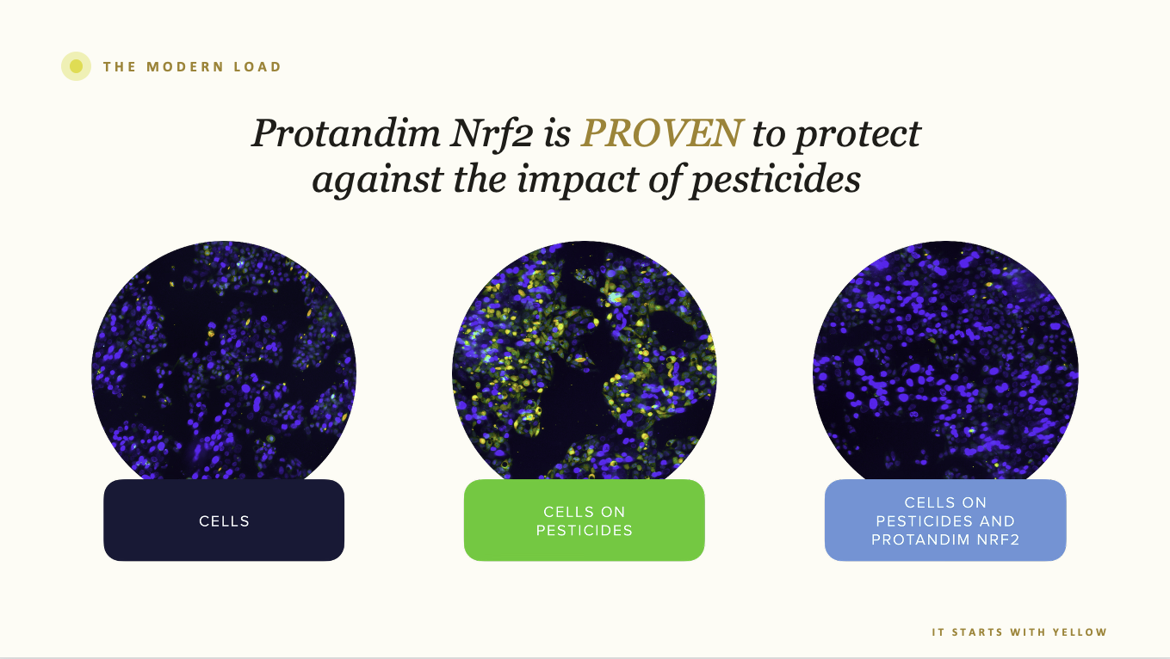

Slide 22
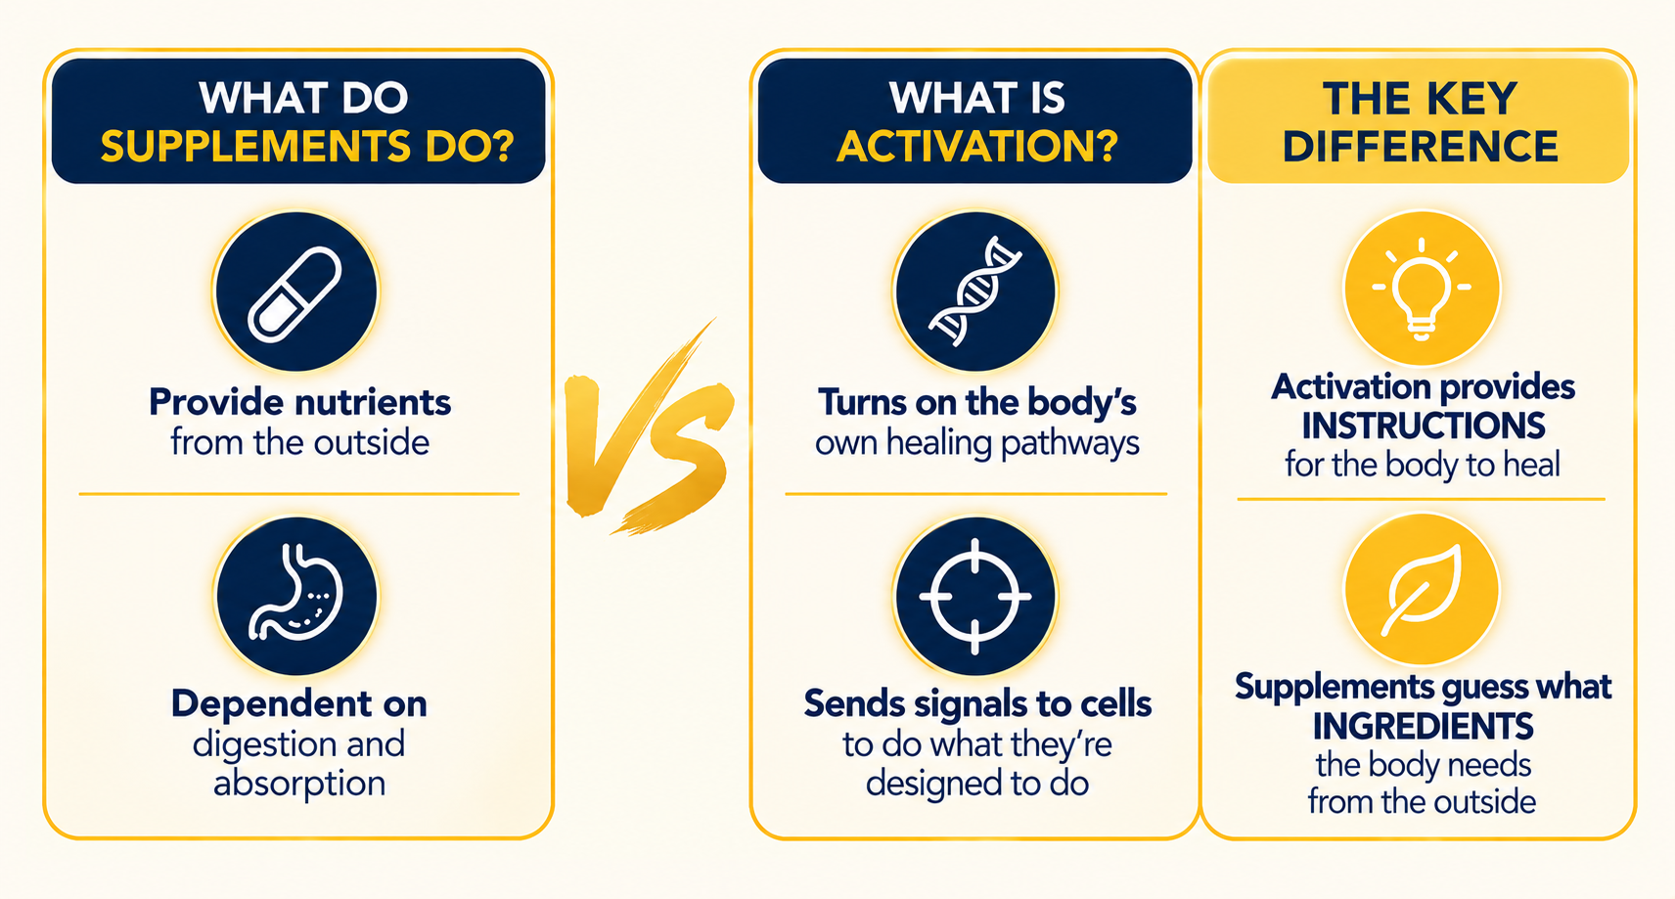
Activation vs Supplementation
A NEW APPROACH
Activation provides you the “Ultimate Personalization”
These statements have not been evaluated by the Food and Drug Administration. This product is not intended to diagnose, treat, cure, or prevent any disease.
IT STARTS WITH YELLOW

Slide 23


It Starts with YELLOW
THE GAP
DIETARY ANTIOXIDANTS · 1 : 1
YOUR OWN ENZYMES · 1 : 1,000,000 / sec
VS
Like a Dixie cup on a house fire
Like a fire hose in every room of the house
Activate the body to do what it was designed to do: literally flip thousands of genes back to the right position
These statements have not been evaluated by the Food and Drug Administration. This product is not intended to diagnose, treat, cure, or prevent any disease.
IT STARTS WITH YELLOW

Slide 24

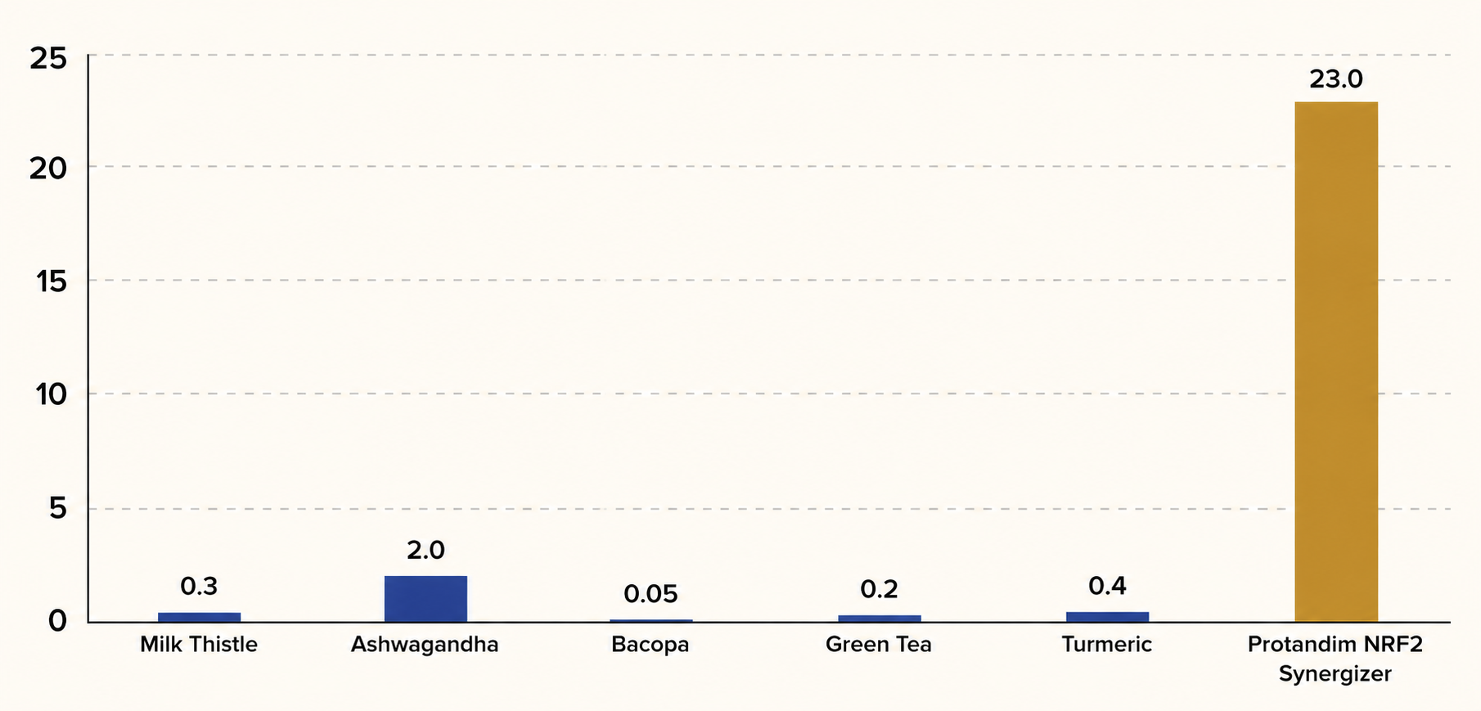
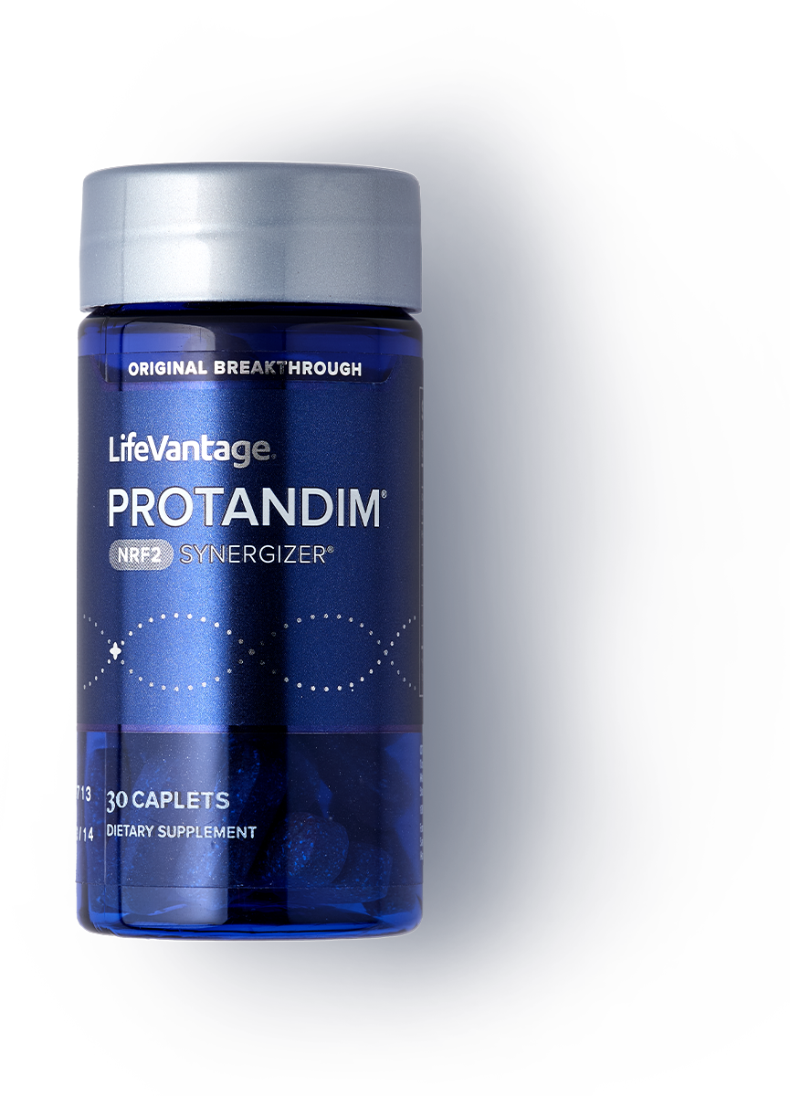
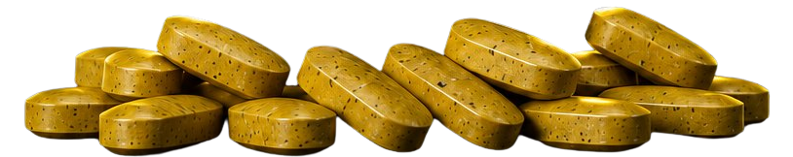
The Synergy is 23× more effective
SYNERGY
23×
Five botanicals studied alone vs. combined — antioxidant-gene response. Each ingredient in Protandim NRF2 slightly activates the NRF2 pathway, but all 5 together, in the exact ratio, increase the activation 23X.
greater than the sum of its individual ingredients*
Shown for educational purposes only. These statements have not been evaluated by the Food and Drug Administration. This product is not intended to diagnose, treat, cure, or prevent any disease.
IT STARTS WITH YELLOW

Slide 25
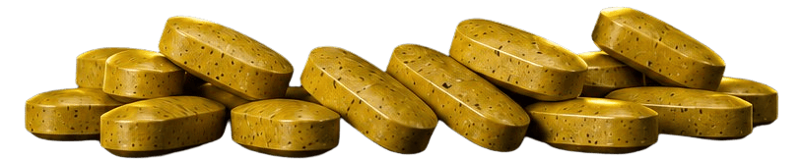
THE FLAGSHIP
Protandim NRF2 Synergizer
Green Tea · Turmeric · Milk Thistle · Ashwagandha · Bacopa
Oxidative stress
Superoxide Dismutase
Glutathione
Catalase
↓ 40%
↑ 30%
↑ 300%
↑ 54%
internal rusting
cellular shield
fire fighters
body’s cleanup crew
Landmark: the only supplement shown to extend lifespan in male mice — National Institute of Health 10-year federally funded study.
These statements have not been evaluated by the Food and Drug Administration. This product is not intended to diagnose, treat, cure, or prevent any disease.
IT STARTS WITH YELLOW

Slide 26
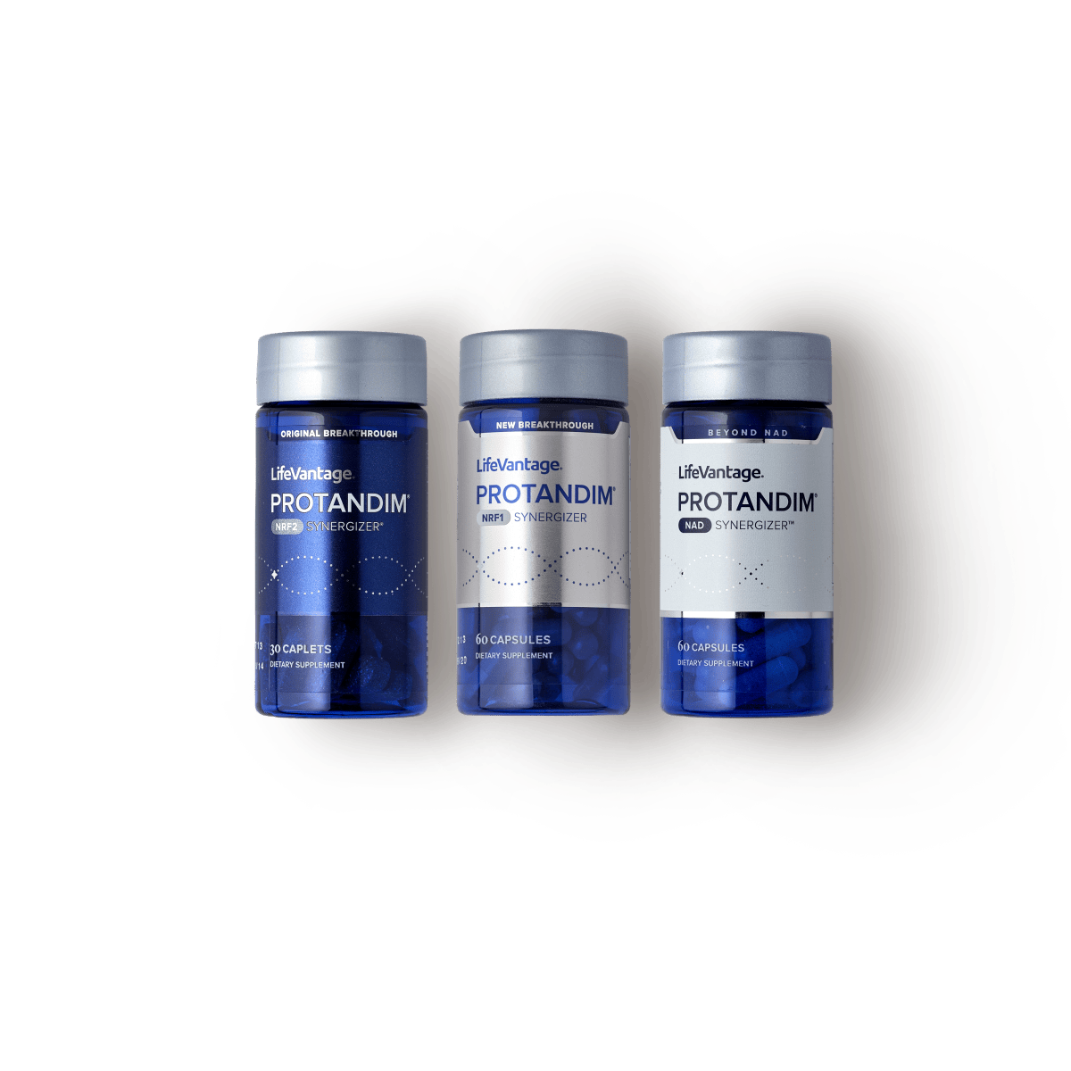




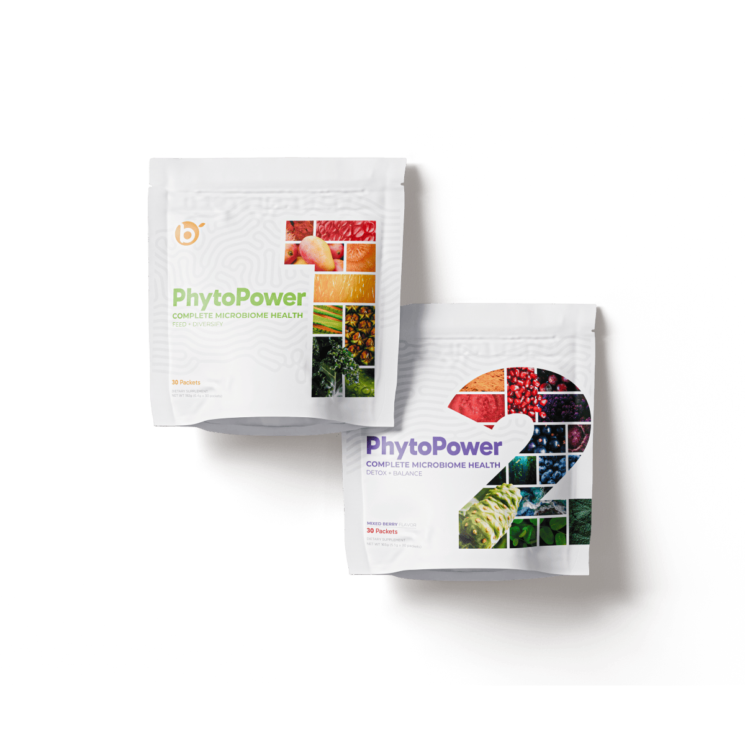
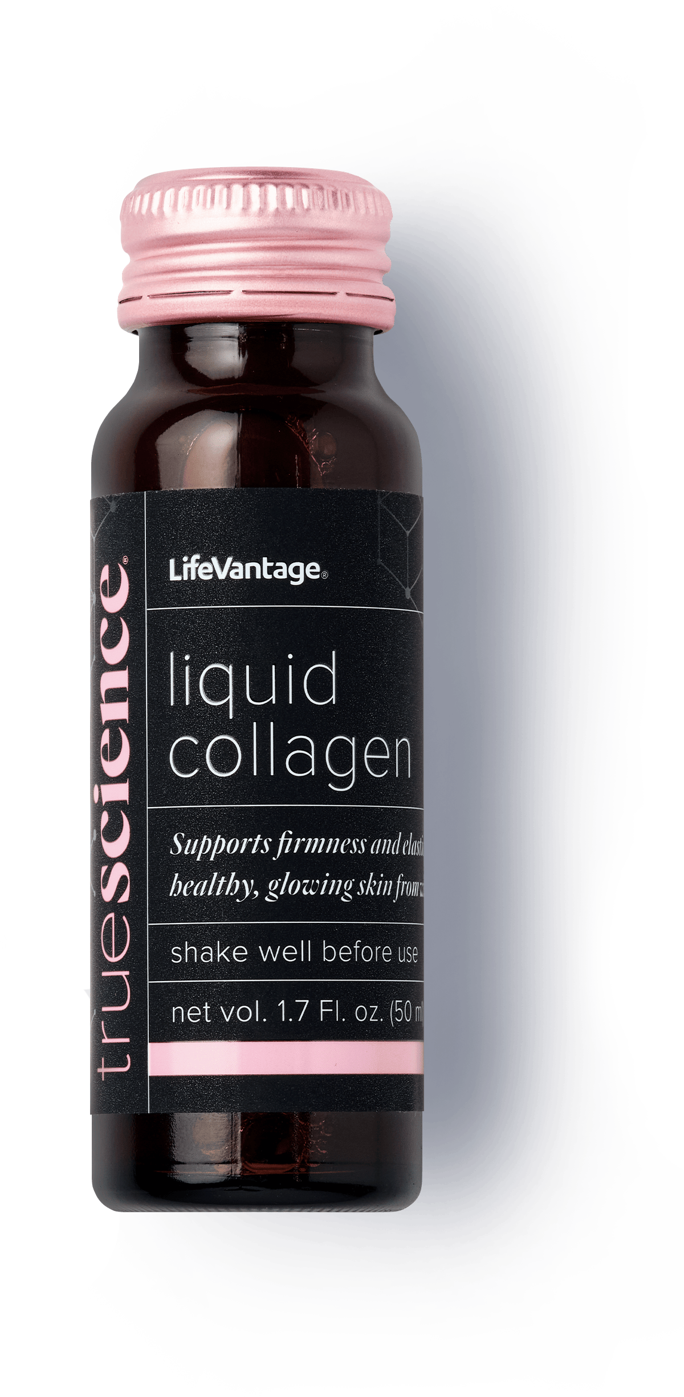
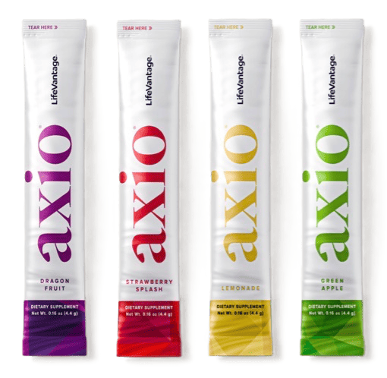
It ALL starts with YELLOW
THE APPROACH
Take It to Make It
It starts with Protandim NRF2 always, what other systems would you like to activate?
PATHWAYS
COLLAGEN
GUT PEPTIDES
AXIO
Activate every CELL
Activate all TISSUES,
TENDONS, ORGANS & More
Activate the GUT
Activate the BRAIN
Tri-Synergizer
Healthy Glow
Healthy Edge
NRF2 + Axio
IT STARTS WITH YELLOW

Slide 27
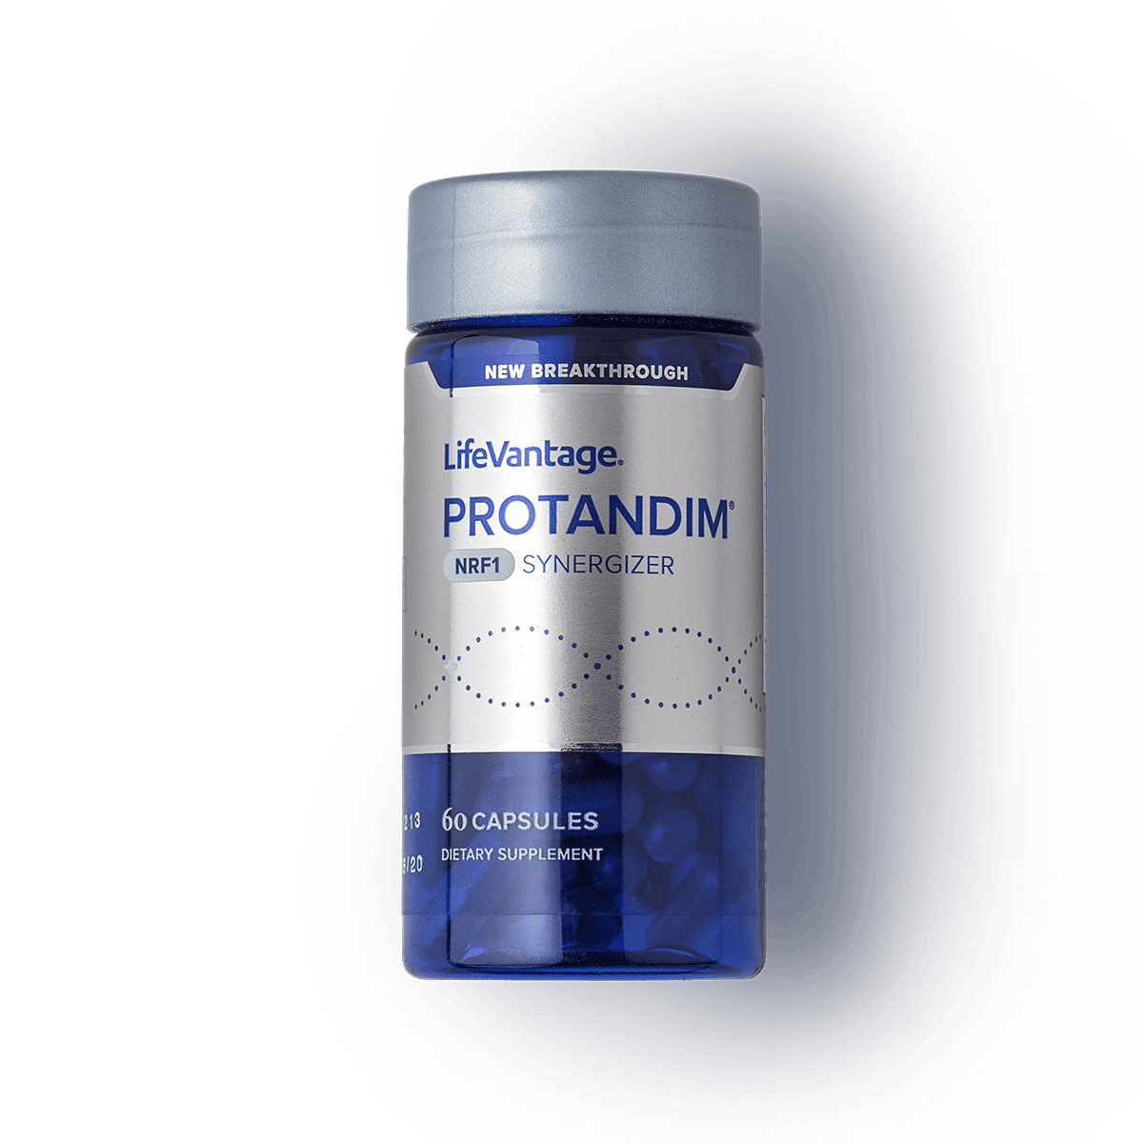
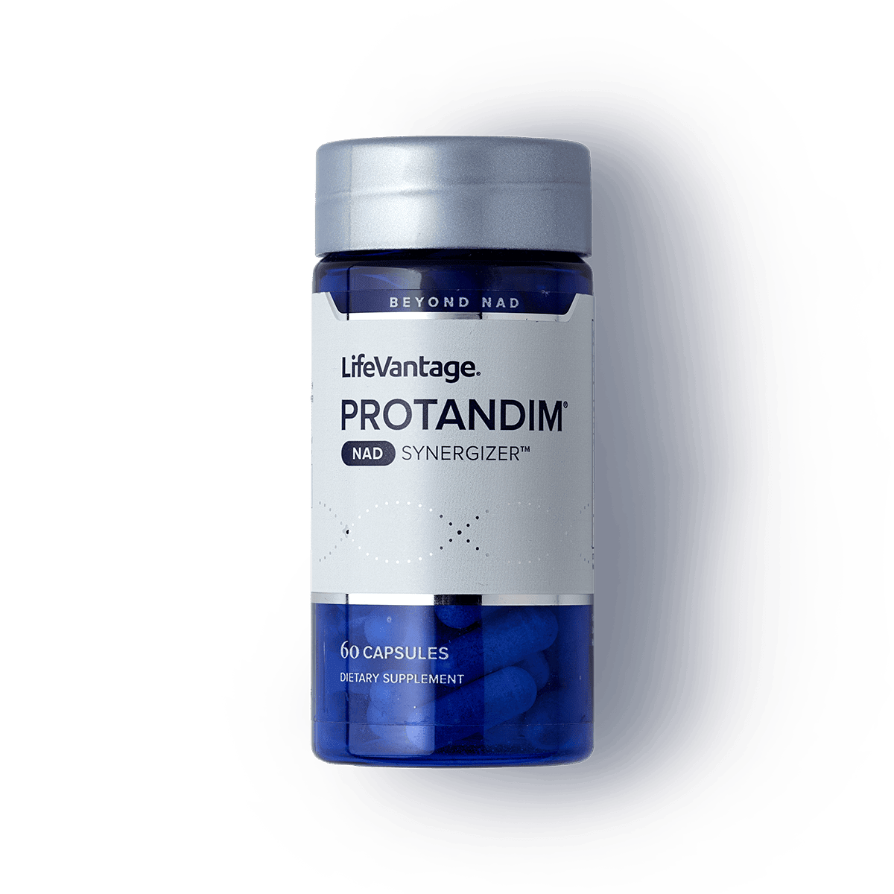



CELLULAR HEALTH
Protandim Tri-Synergizer
Three pathways your cells rely on — switched on together.
NRF2 · PROTECT
NRF1 · POWER
NAD · RENEW
Helps protect cells from oxidative stress.
Helps your cells make energy.
Helps healthy aging and
cellular repair.
Wait until you see what happens to the effectiveness with ALL 3 together!
These statements have not been evaluated by the Food and Drug Administration. This product is not intended to diagnose, treat, cure, or prevent any disease.
IT STARTS WITH YELLOW

Slide 28
GENE EXPRESSION
Protandim Tri-Synergizer
Tri-Synergizer
Single-pathway Synergizer
838%
NRF2 PATHWAY
NRF1 PATHWAY
NAD PATHWAY
118%
226%
73%
84%
40%
64%
69%
127%
50%
12%
12%
NQO1
HMOX1
NRF1
PGC1-a
NAMPT
NMNAT1
antioxidant & detoxification
healthy inflammatory response
regulates key
metabolic genes
regulator of mitochondrial biogenesis
key enzyme in NAD recycling pathway
central enzyme in
NAD synthesis
*These statements have not been evaluated by the Food and Drug Administration. This product is not intended to diagnose, treat, cure, or prevent any disease.
IT STARTS WITH YELLOW

Slide 29
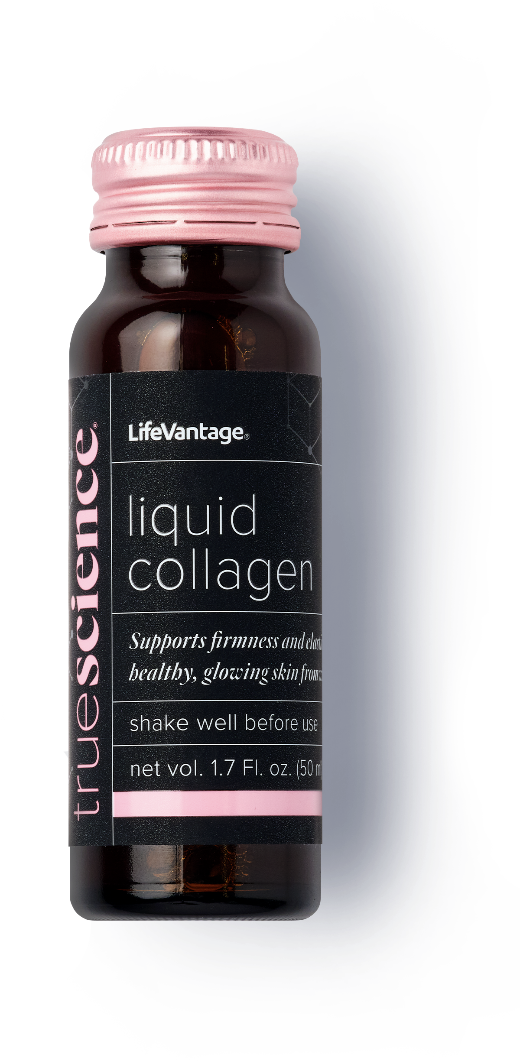
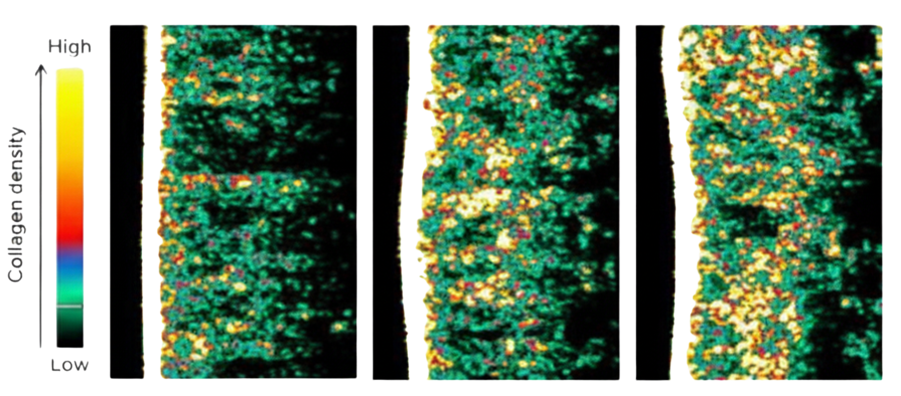
The first clinically proven collagen activator
HEALTHY GLOW
Over 100% Collagen Density Increase in 8 Weeks
Week 0
Week 4
Week 8
Collagen Density
30.5%
Collagen Density
57.5%
Collagen Density
68.5%
These statements have not been evaluated by the Food and Drug Administration. This product is not intended to diagnose, treat, cure, or prevent any disease.
IT STARTS WITH YELLOW

Slide 30
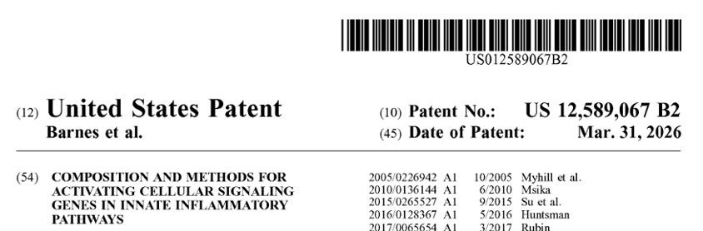
Why Settle When You Can Have These Results!
HEALTHY GLOW
TrueScience Liquid Collagen — Activate · Replenish · Maintain
THE HEALTHY GLOW SYNERGY
13,708
18,671
+
=
across
GENES INFLUENCED
CELLULAR PATHWAYS
PATHWAYS
Collagen activates. Protandim activates. But together — far more than either alone.
Breaks heightened stress to support a balanced inflammatory response.
IT STARTS WITH YELLOW

Slide 31
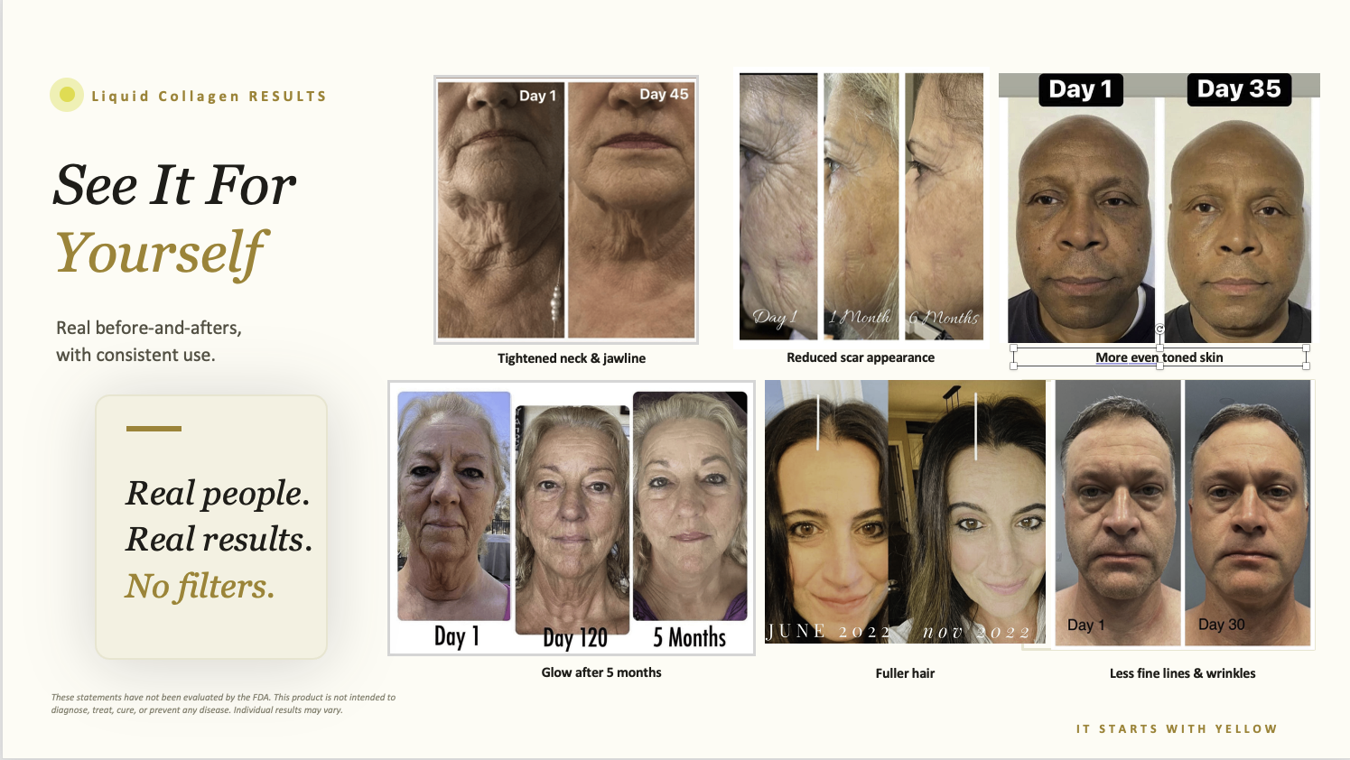

Slide 32
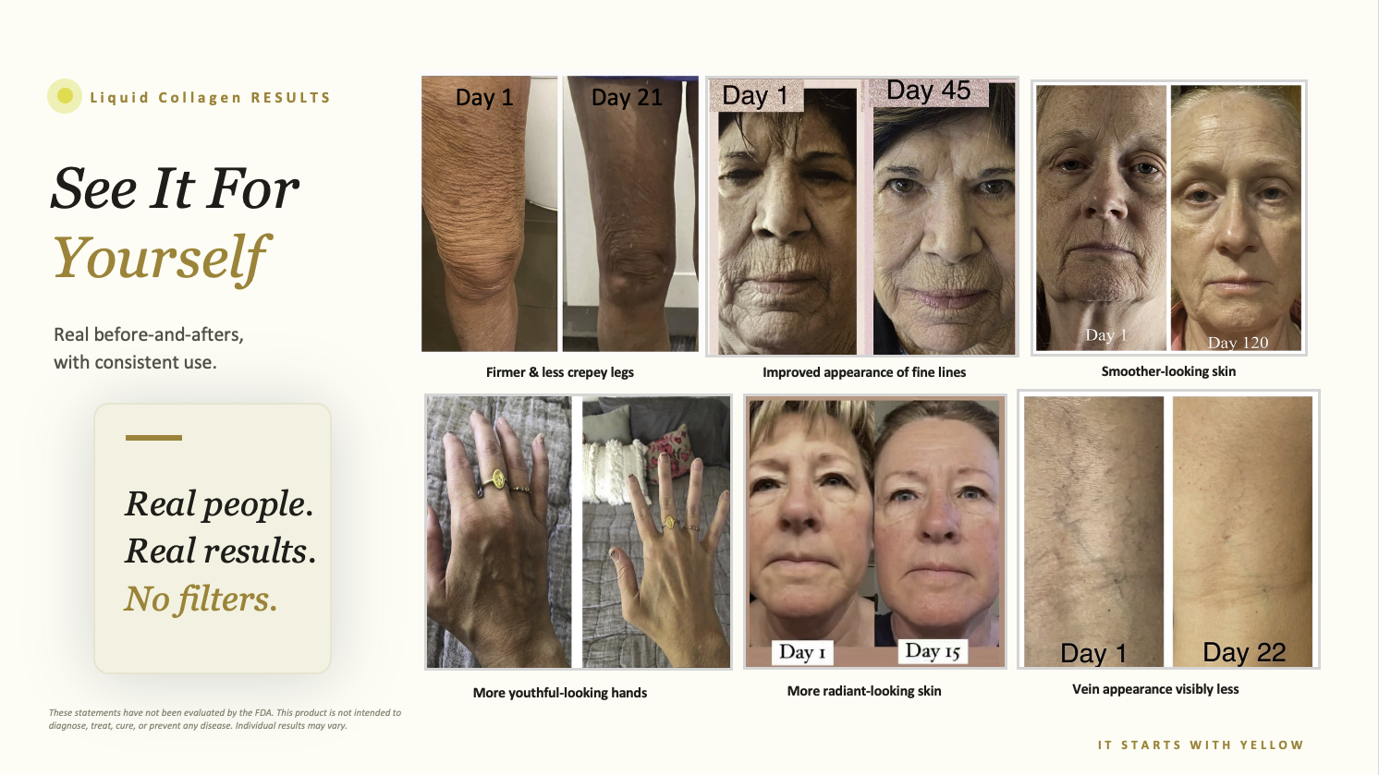

Slide 33


Slide 34

GUT HEALTH
P84 — Make Your OWN Gut Peptides
A daily drink. 84 ingredients. Activated all 14 tested key gut peptides.
MICROBIOME
GUT BARRIER
CONTROL CENTER
Digestive enzymes. Pre, pro, &
post biotics feed the good bacteria — 20 billion CFUs.
Botanicals support a strong, sealed gut lining, nutrient absorption & short-chain fatty acid balance.
Regulate, repair, and restore.
Human Clinical Study:
81% saw improvement in 7 markers that support the body’s natural inflammatory response.
77% showed an improvement in diversity of their gut microbiome.
70% showed an improvement in a key peptide in supporting a strong gut barrier.
These statements have not been evaluated by the Food and Drug Administration. This product is not intended to diagnose, treat, cure, or prevent any disease.
IT STARTS WITH YELLOW

Slide 35
P84 · COMPLETE FORMULA
WHOLE FOODS
BOTANICAL BLENDS
PRE, PRO, POST BIOTICS
GREEN
YELLOW/ORANGE
PHYTONUTRIENT
GLUTATHIONE
PREBIOTICS
Immunity/anti-aging
Energy/Vitality
Detox Blend
Precursor Blend
Full of Beneficial Bacteria
Barley grass
Green apple
Kale
Spinach
Broccoli
Chlorella
Watercress
Kelp
Asparagus
Leek
Garlic
Carrot
Papaya
Sweet potato
Mango
Goldenberry
Sea buckthorn
Orange
Pumpkin
Marigold
Yellow bell
Blueberry
Grape seed
Noni
Acai
Beet root
Cranberry
Pomegranate
Chlorella
Spinach
Moringa leaf
Kale
Kelp
Spirulina
Jerusalem artichoke
Inulin
Baobab
PROBIOTICS
20 Billion CFUs
Lactobacillus rhamnosus LRa05
Lactobacillus reuteri LRO8
Lactobacillus plantarum Lp05
Bifidobacterium longum BL21
Lactobacillus acidophilus LA85
Lactobacillus helveticus LH76
Bifidobacterium breve BBr60
Bifidobacterium bifidum BBi32
Lactobacillus paracasei LC86
Lactobacillus casei LC89
TOXIN BINDING
FERMENTATIVE
Blend
Assistance Blend
BLUE/PURPLE
Blackberry
Raspberry
Currant
Purple carrot
Inulin (chicory root)
Plum ferment
Kombucha
Umeboshi
RED
Mental Health
Circulation/Blood
Blueberry
Black currant
Bilberry
Blackberry
Purple coneflower
Eggplant
Grape
Purple cabbage
Ebony Carrot
Pomegranate
Rosehip
Prickly pear cactus
Tomato
Acerola cherry
Red bell pepper
Dulse
Red beet
Cranberry Raspberry
PROBIOTIC ROS/SCFA GUT BARRIER
Integrity Blend
POSTBIOTICS
Lactobacillus Sakei LSa79
Bifidobacterium adolescentis BAC30
Saccharomyces boulardii SBO1
Weizmannia coagulans BC99
Bifidobacterium lactis BLa80
Digestive Enzymes
Papain
Amylase
Cellulase
Bromelain
*These statements have not been evaluated by the Food and Drug Administration. This product is not intended to diagnose, treat, cure, or prevent any disease.
IT STARTS WITH YELLOW

Slide 36
SMART ENERGY
AXIO — Smart Energy
Clean focus without the crash.
Sharper focus, mental acuity & memory
Less mental fatigue & brain fog
Supports mood and resilience to stress
Clean, low-cal, low-carb, vegan — BSCG approved
Decaf and caffeine options
These statements have not been evaluated by the Food and Drug Administration. This product is not intended to diagnose, treat, cure, or prevent any disease.
IT STARTS WITH YELLOW

Slide 37
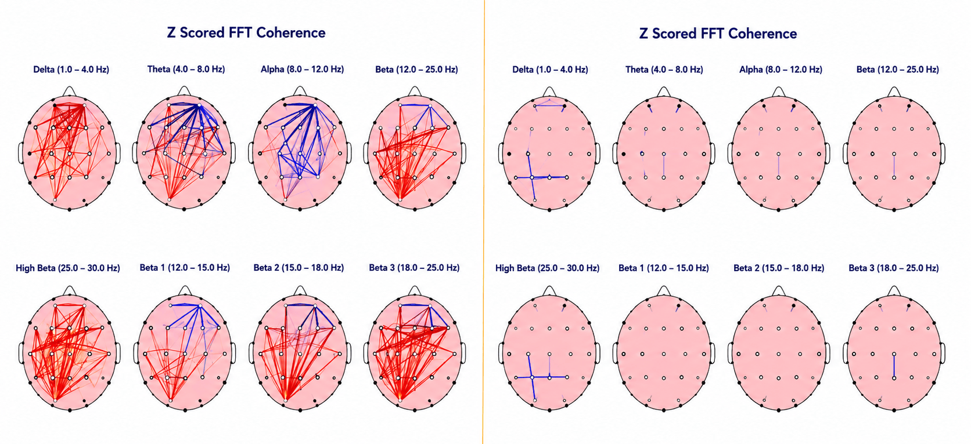
AXIO — Smart Energy
SMART ENERGY
Left scans are before Protandim NRF2, NRF1 & AXIO and right scans are after 12 days on them
These statements have not been evaluated by the Food and Drug Administration. This product is not intended to diagnose, treat, cure, or prevent any disease.
IT STARTS WITH YELLOW

Slide 38
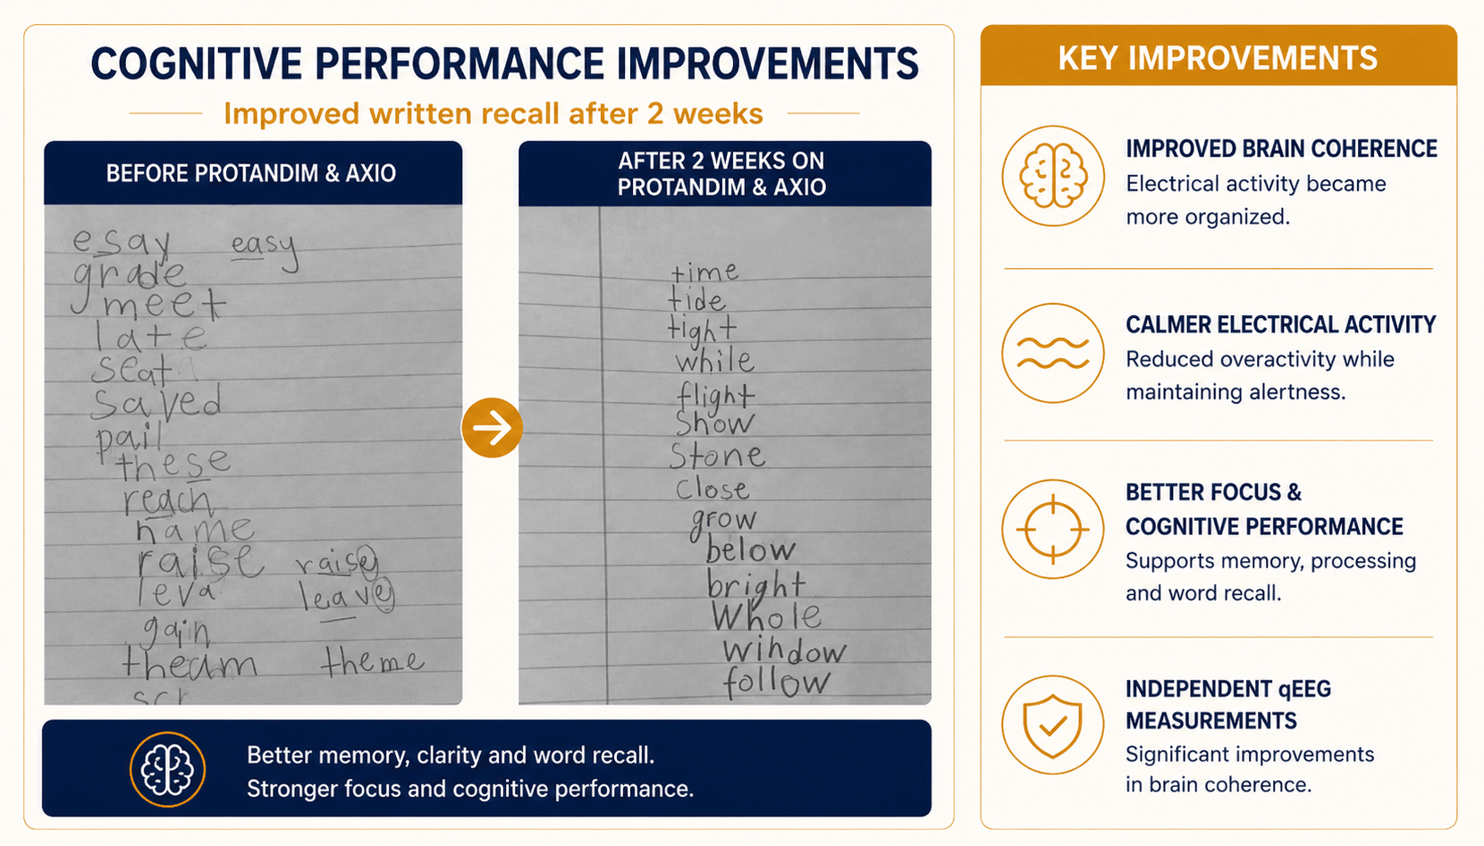
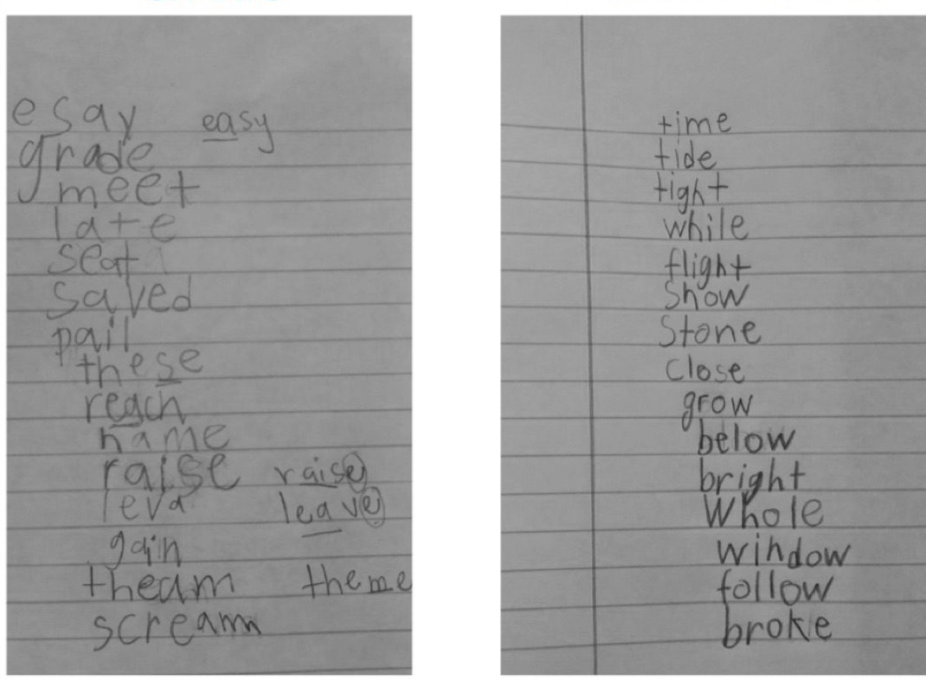
AXIO — Smart Energy
SMART ENERGY
Left writing sample is before Protandim NRF2 & AXIO and right is after 2 weeks on them
These statements have not been evaluated by the Food and Drug Administration. This product is not intended to diagnose, treat, cure, or prevent any disease.
IT STARTS WITH YELLOW

Slide 39
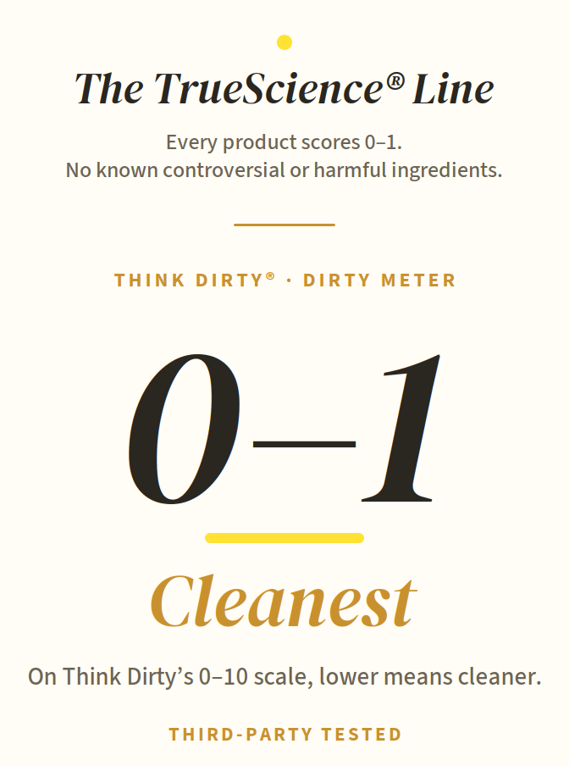
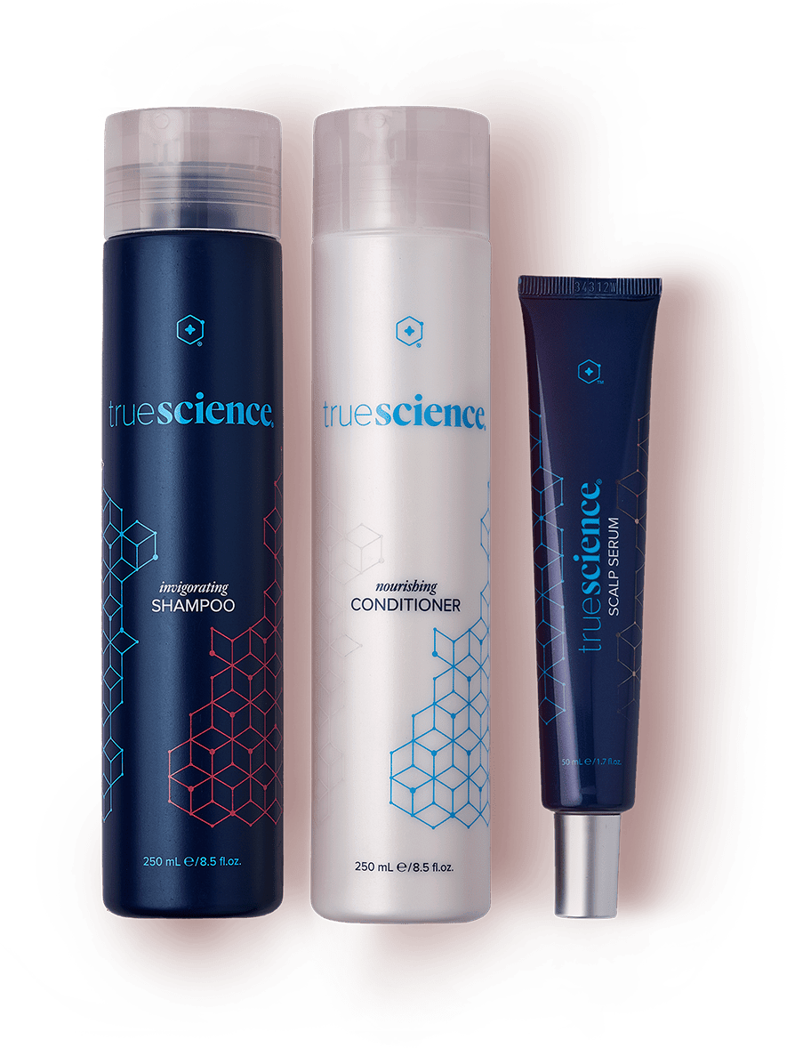

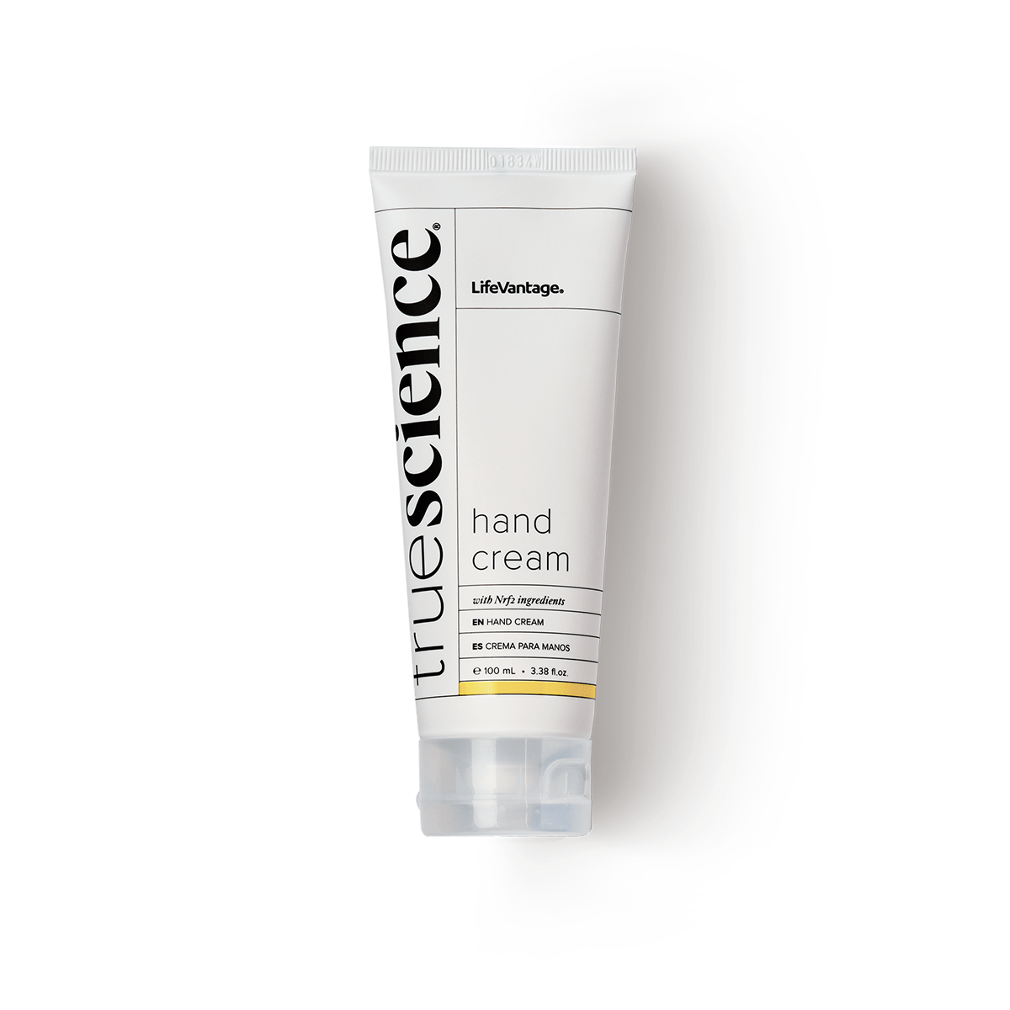
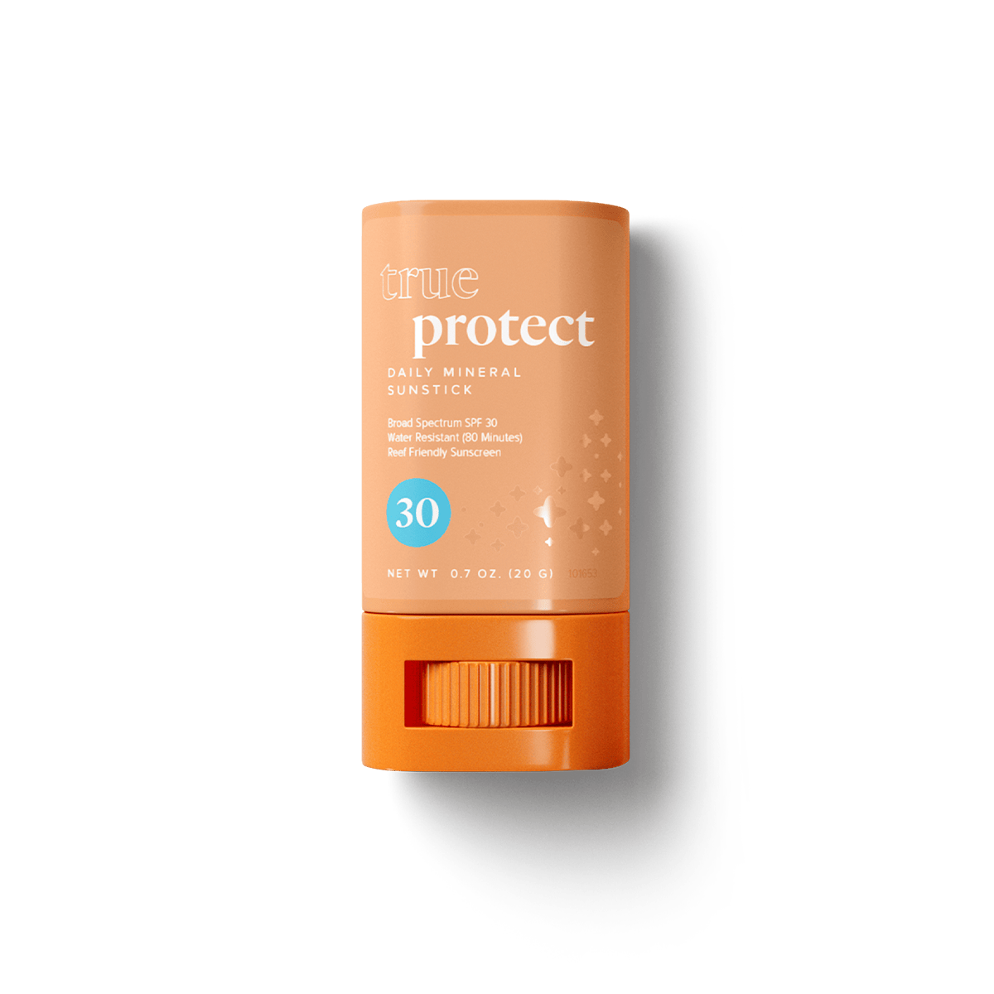
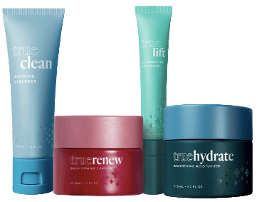
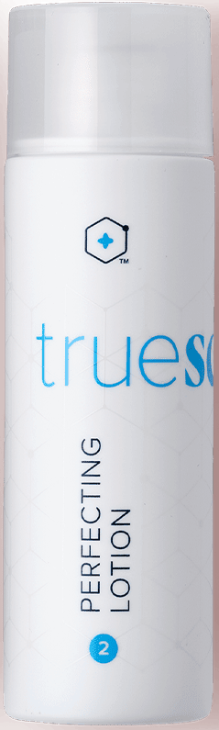
SKIN & HAIR
TrueScience — Activated Skin & Hair
ACTIVATED HAIR CARE
Nrf2 shampoo, conditioner & serum protect against oxidative stress, balance the scalp, strengthen strands, and cut frizz & split ends.
ACTIVATED SKIN CARE
Cleanses, firms & smooths in 21 days, brightens, lifts the eye area — plus SPF 30 Protect & an Nrf2 hand cream.
These statements have not been evaluated by the Food and Drug Administration. This product is not intended to diagnose, treat, cure, or prevent any disease.
IT STARTS WITH YELLOW

Slide 40

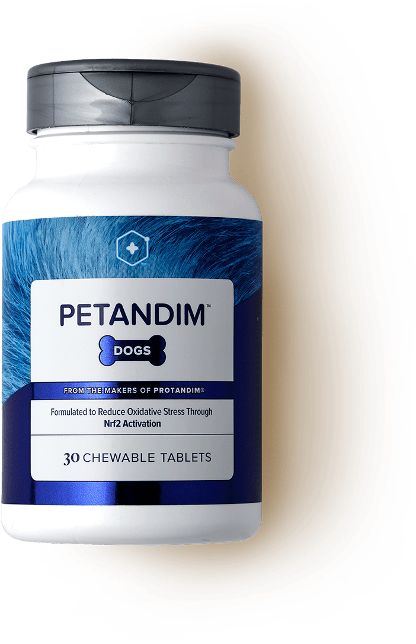

FOR YOUR PETS
Petandim — Nrf2 for Dogs
A double-blind, placebo-controlled study showed reduced cellular stress, better mobility, & improved cognition
Supports playfulness & energy
Joint, hearing & eyesight support
A healthier, shinier coat
The same Nrf2 science — for your best friend
These statements have not been evaluated by the Food and Drug Administration. This product is not intended to diagnose, treat, cure, or prevent any disease.
IT STARTS WITH YELLOW

Slide 41
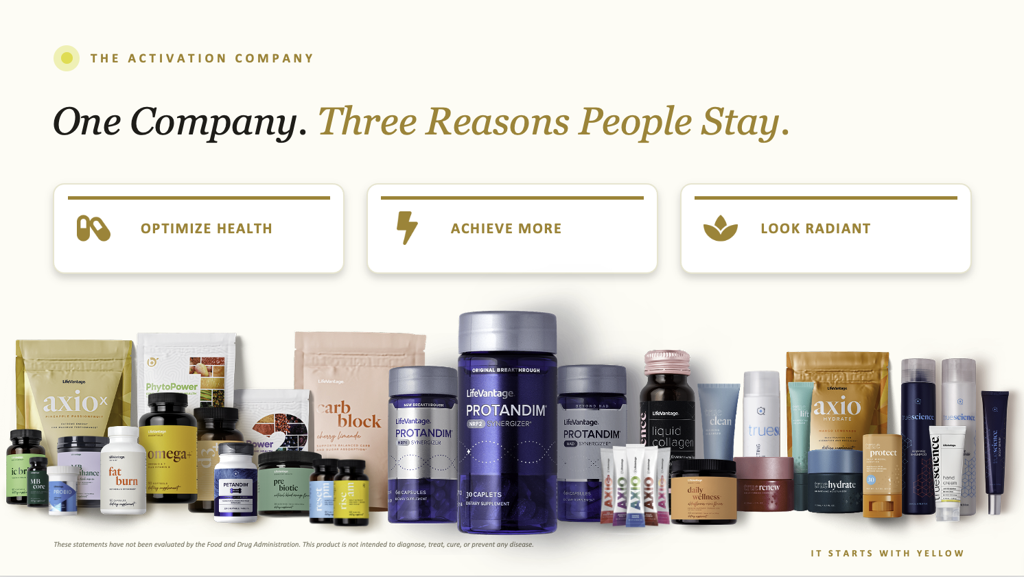

Slide 42
THE LENS
6 Things to Weigh in Any Opportunity
1
Company
2
Trends
3
Products
Who’s behind it?
Is the market growing?
Real, unique, consumable?
4
Timing
5
Compensation
6
Systems
Early or late?
How does it pay?
Can it be duplicated?
IT STARTS WITH YELLOW

Slide 43
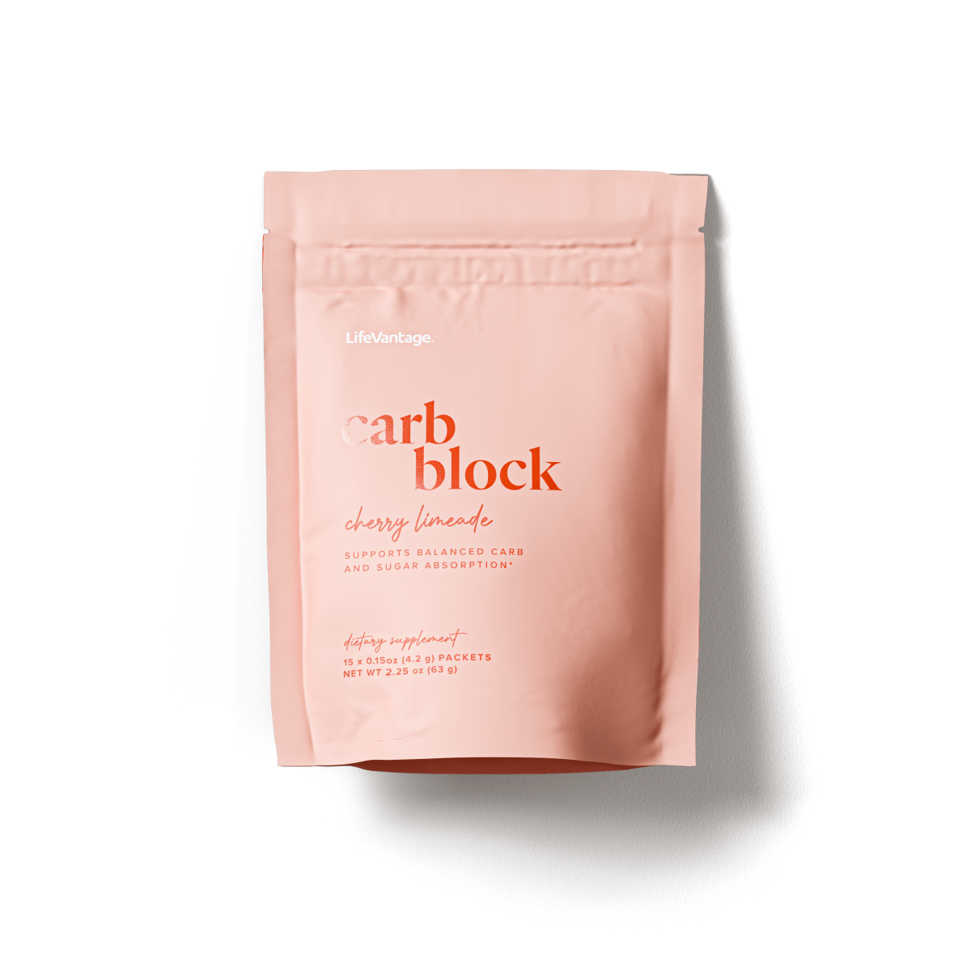
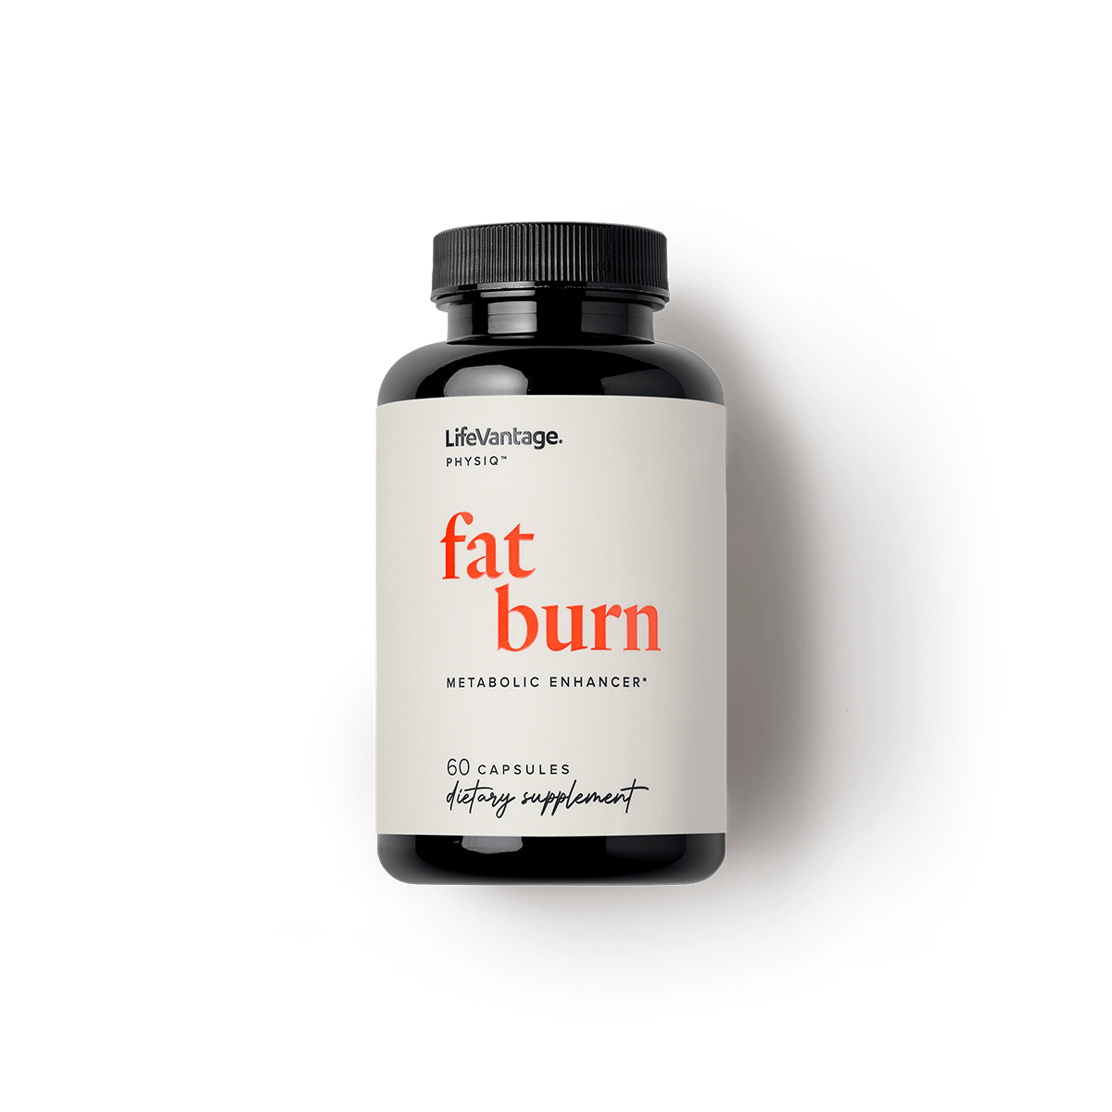
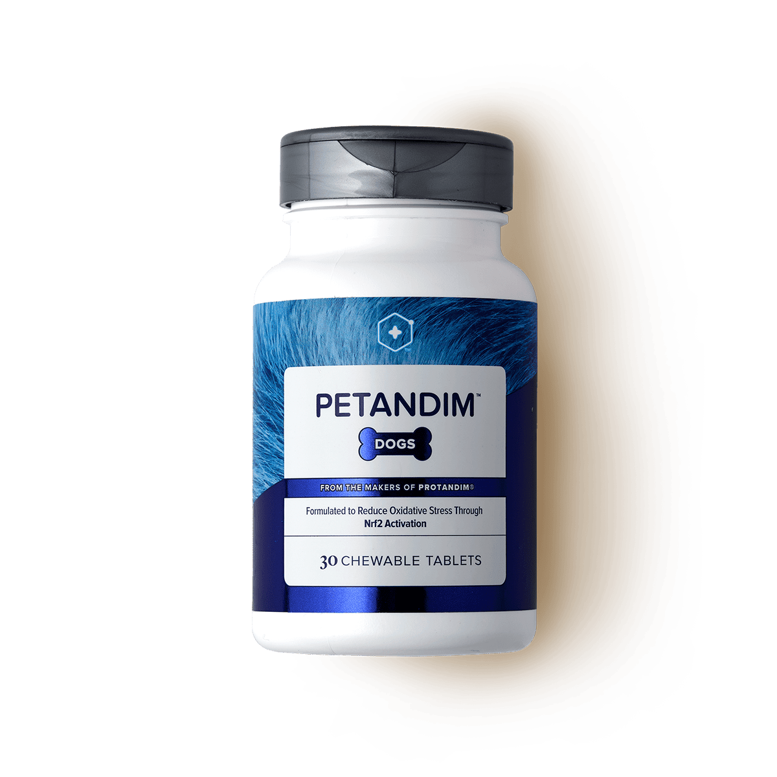
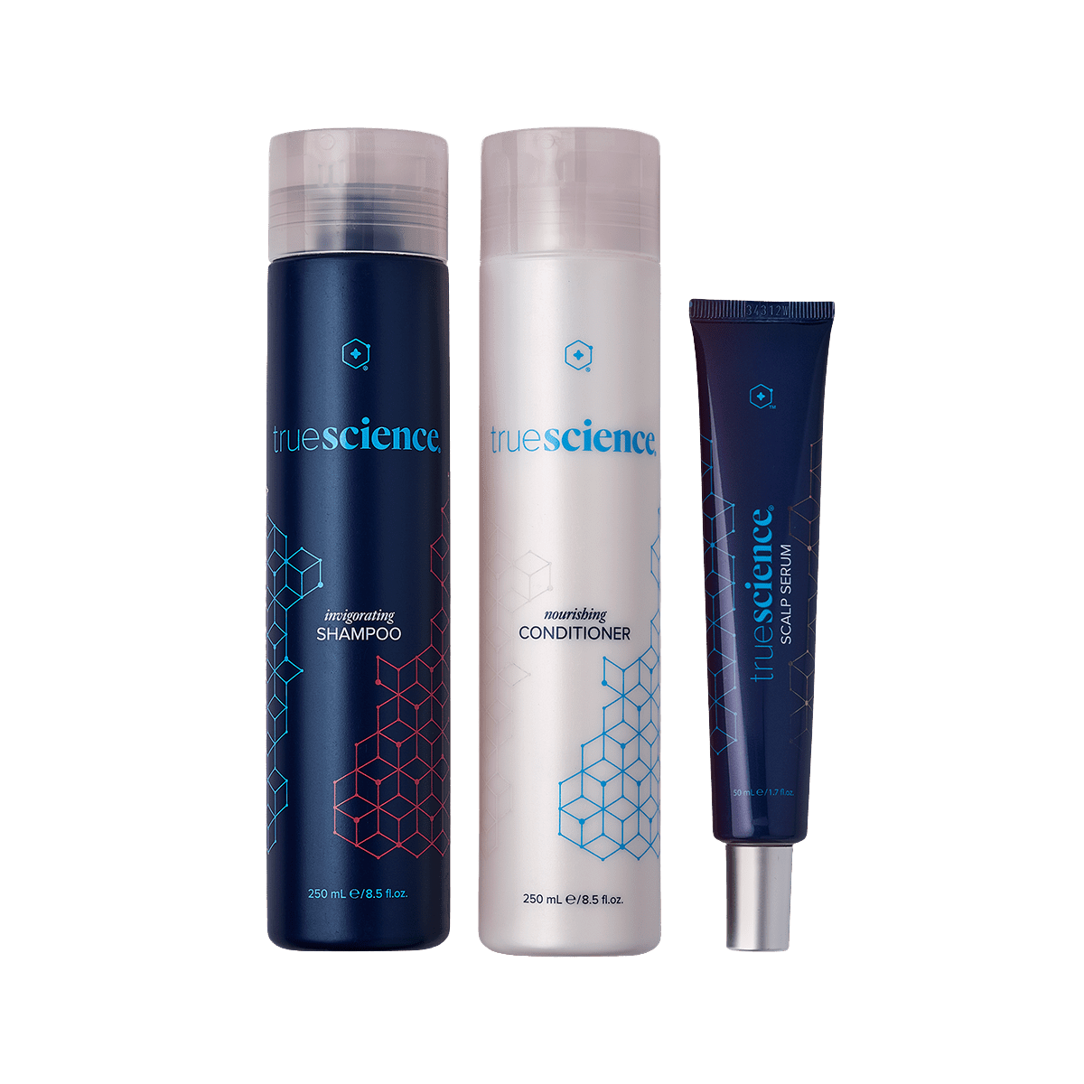

THE TREND
Riding a $600B+ Wave
The categories LifeVantage plays in — and their size.
$300B
$121B
$67B
$85B
$37B
$50B
Weight
Energy
Pet Care
Hair Care
Skin Care
Anti-Aging
Category figures from third-party market research.
IT STARTS WITH YELLOW

Slide 44
THE TIMING
The Adoption Curve
Cumulative adoption — where growth and the biggest rewards happen
Most of the growth is still ahead.
WE’RE HERE
Innovators
2.5%
Early Adopters
13.5%
Early Majority
34%
Late Majority
34%
Laggards
16%
DSA: “The first 135,000 to join a network-marketing company with predictable success take part in a once-in-a-lifetime opportunity.”
IT STARTS WITH YELLOW

Slide 45
























GLOBAL REACH
Open Around the World
OPEN MARKETS
Thailand
USA
Mexico
Canada
Australia
Scotland
Hong Kong
Germany
Japan
Great Britain
Wales
N. Ireland
Netherlands
Taiwan
Iceland
Spain
Portugal
GLOBAL CUSTOMER PROGRAM
Italy
France
Ireland
Austria
Belgium
New Zealand
Dominican Republic
IT STARTS WITH YELLOW

Slide 46

INCOME OPPORTUNITY
“Success is nothing more than a few simple disciplines, practiced every day.”
— Jim Rohn
IT STARTS WITH YELLOW

Slide 47
INCOME OPPORTUNITY
The Math Is Transparent.
Public company. Audited numbers. Anyone can look it up.
“Success is nothing more than a few simple disciplines, practiced every day.”
— Jim Rohn
PAID-AS RANK
AVG MONTHLY
$316 per month
CONSULTANT
$27
$75,840 invested
CONSULTANT 1
$26
SENIOR CONSULTANT 1
At 5% interest to earn $316/mo
CONSULTANT 2
$84
CONSULTANT 3
$161
SENIOR CONSULTANT 1
$316
SENIOR CONSULTANT 2
$531
SENIOR CONSULTANT 3
$934
$1,740 per month
$417,600 invested
MANAGING CONSULTANT 1
$1,740
At 5% interest to earn $1,740/mo
MANAGING CONSULTANT 2
$3,403
MANAGING CONSULTANT 1
MANAGING CONSULTANT 3
$6,715
EXECUTIVE CONSULTANT 1
$14,491
EXECUTIVE CONSULTANT 2
$20,759
EXECUTIVE CONSULTANT 3
$43,591
$6,715 per month
$1,611,600 invested
EXECUTIVE CONSULTANT 4
$67,783
At 5% interest to earn $6,715/mo
PRESIDENTIAL CONSULTANT
$131,108
MANAGING CONSULTANT 3
Average monthly earnings by paid-as rank, from LifeVantage’s official Income Disclosure Statement. Averages are not typical results and are not a guarantee of income; individual earnings vary widely, and many participants earn little or nothing. Earnings depend on effort, skill, and time invested. The interest comparison is illustrative only. See LifeVantage’s full Income Disclosure Statement for details.
IT STARTS WITH YELLOW

Slide 48


WHERE YOU FIT
Where Do YOU Fit In?
Activate life — two simple doors.
CUSTOMER
CONSULTANT
You just want the products — get the best customer price on subscription. Set your body up for success and give it a minimum of 4-6 months.
You want to build something real and bring others along. We will lock arms with you as you earn money as you’re learning what to do and helping others.
IT STARTS WITH YELLOW

Slide 49

BECOME A CUSTOMER
Become a Product User
Pick your stack
Subscribe for the best price and never run out
Get excited for what you have coming
These statements have not been evaluated by the Food and Drug Administration. This product is not intended to diagnose, treat, cure, or prevent any disease.
IT STARTS WITH YELLOW

Slide 50

Become a Consultant
GREAT VALUE
Total Value $1,837+ — Yours for $999
The Business Enrollment Pack, line by line.
WHAT’S IN THE BOX
Products
$1,538
Protandim Nrf2
Protandim Tri-Synergizer (Nrf2 · NRF1 · NAD)
P84 Microbiome
Activated Liquid Collagen
AXIO — Regular, Decaf, X, & Hydrate
Daily Wellness, D3+, & ProBio
TrueScience Skincare: Cleanser, Renew, Hydrating Moisturizer, & Eye Lift
Omega+, Fat Burn, & Mind Body
Petandim
1 Event Ticket
Business Start Kit
Mentorship & Coaching
Event tickets
$249
Enrollment fee
$50
Business tools
Included
Mentorship
Priceless
$1,837+
TOTAL VALUE
YOUR INVESTMENT $999
46% off!
$838 Savings!
IT STARTS WITH YELLOW

Slide 51


Slide 52






THE SYSTEM
Simple System. Proven Plan.
EXPOSE, PROMOTE, BUILD COMMUNITY
The Proven Plan
Earn as you Learn
EVENT TO EVENT
Duplicate the plan for your success.
Ongoing training & support with a community every step of the way.
Build momentum from one event to the next.
IT STARTS WITH YELLOW

Slide 53
Activate Life!
We’re excited for your Yellow journey to begin!
What IF??
Get back to the person who invited you to see this information
IT STARTS WITH YELLOW

