Slide 1
CRN
CHRISTIAN REVIVAL NETWORK
FROM REVIVAL
TO GLOBAL HARVEST
To Every Nation. For All Nations.
Revival awakens the heart. Fruit becomes the witness. Testimony travels. The Body connects. Partnership mobilizes. The Harvest becomes visible.
ONE KINGDOM. MANY VOICES. ONE MISSION.
CHRISTIANREVIVALNETWORK.COM

Slide 2
CRN
CHRISTIAN REVIVAL NETWORK
THE CENTER
THE HARVEST IS HIS.
“The Harvest is not ours to manufacture.
It is His to bring forth.”
We are not building our own kingdom. We are learning to recognize what God is already doing — and to serve it faithfully.
LISTEN
RESPOND
SERVE
CONNECT

Slide 3
CRN
CHRISTIAN REVIVAL NETWORK
THE POSTURE
WE BEGIN WHERE THE DOOR OPENS.
We do not force expansion. We respond to invitation, honor relationship, and serve what God is already doing.
01
02
03
04
OPEN DOOR
→
INVITATION
→
RELATIONSHIP
→
SERVICE
A relationship or invitation creates access.
We are welcomed into what is already happening.
Trust comes before structure.
We ask how CRN can strengthen the work.
THE OPEN DOOR CHANGES. THE POSTURE DOES NOT.

Slide 4
CRN
CHRISTIAN REVIVAL NETWORK
REVIVAL & SPIRITUAL AWAKENING
REVIVAL BEGINS IN THE HEART.
Before the Harvest moves through nations, revival moves through hearts.
AWAKENING
SURRENDER
Awakening is not simply emotion. It is the heart turning again toward the King — and what changes within begins to shape what becomes visible without.
OBEDIENCE
FRUIT
What God changes within becomes visible through the fruit of a life.

Slide 5
CRN
CHRISTIAN REVIVAL NETWORK
THE WITNESS
FRUIT BECOMES THE WITNESS.
When revival is real, something becomes visible.
WHAT FRUIT REVEALS
FRUIT GIVES TESTIMONY A VOICE.
A heart has awakened
Priorities have shifted
Changed lives become evidence that others can see, hear, recognize — and carry forward.
Obedience is becoming visible
Love, truth and courage are multiplying
THE FRUIT IS THE WITNESS.

Slide 6
CRN
CHRISTIAN REVIVAL NETWORK
THE STORY
TESTIMONY MAKES THE HARVEST VISIBLE.
What God is doing in one person, church, ministry or nation should not remain hidden.
1
→
2
→
3
→
4
→
5
TESTIMONY
STORY
PRAYER
TEACHING
ENCOURAGEMENT
What changed?
What did God do?
How can we stand together?
What truth can strengthen others?
Who needs to hear this now?
A testimony can cross an ocean. A ministry can find a partner. A leader can strengthen another nation.

Slide 7
CRN
CHRISTIAN REVIVAL NETWORK
THE CARRIER
MEDIA CARRIES THE MESSAGE.
VIDEO IS NOT THE MESSAGE. IT IS A DOORWAY.
Technology serves the mission when it helps a faithful message travel farther without replacing relationship, discipleship or the Body of Christ.
VIDEO
DIGITAL
TRANSLATION
SEARCH
ONE MESSAGE. MANY DOORS.
SHARE
Media helps what God has already entrusted to a ministry become visible, searchable, shareable and translatable.
THE MESSAGE DOES NOT CHANGE. THE CHANNEL CAN.

Slide 8

CRN
CHRISTIAN REVIVAL NETWORK
THE BODY
CONNECTION BRINGS THE BODY TOGETHER.
CRN creates a place for believers, churches, ministries and leaders to find one another — across cities, cultures and nations.
CHURCHES
LEADERS
CRN
CONNECTING THE BODY
MINISTRIES
NATIONS
FIND ONE ANOTHER. ENCOURAGE ONE ANOTHER. CARRY IT FARTHER TOGETHER.

Slide 9
CRN
CHRISTIAN REVIVAL NETWORK
THE MULTIPLIER
CONNECTION BECOMES PARTNERSHIP.
NOT CONTROL. NOT OWNERSHIP.
KINGDOM RELATIONSHIP.
YOUR
ASSIGNMENT
THEIR
ASSIGNMENT
HONOR
We recognize what God has entrusted to one another.
TRUST
Relationship grows before responsibility expands.
SHARED
HARVEST
MUTUAL STRENGTH
Each ministry keeps its assignment while strengthening others.

Slide 10
CRN
CHRISTIAN REVIVAL NETWORK
THE ACTION
PARTNERSHIP BECOMES MOBILIZATION.
Relationship becomes powerful when agreement turns into action.
SUPPORT
SERVE
SHARE
PRAY
TEACH
PARTICIPATION IS THE BRIDGE
MOBILIZATION SERVES THE HARVEST
SEND

Slide 11
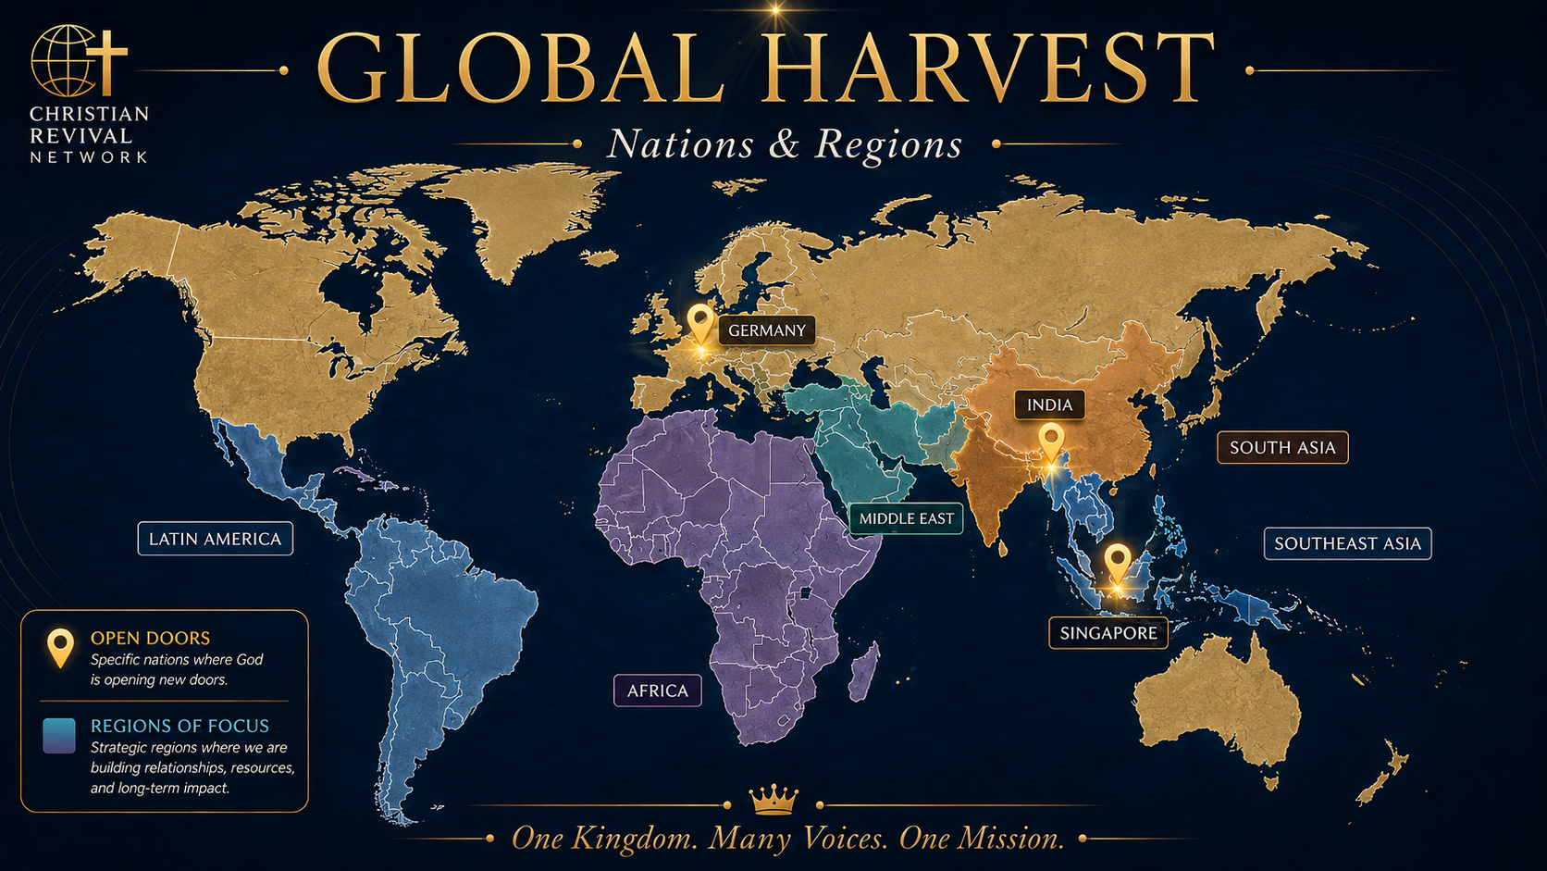
CRN
CHRISTIAN REVIVAL NETWORK
INDIA. GERMANY. SINGAPORE.
AND THE NEXT OPEN DOOR.

Slide 12
CRN
CHRISTIAN REVIVAL NETWORK
ALL NATIONS.
THE GLOBAL HARVEST.
Revival awakens the heart. Fruit becomes the witness. Testimony makes the work visible. Media carries the message. Connection forms relationship. Partnership mobilizes the Body.
ONE KINGDOM. MANY VOICES. ONE MISSION.
Together, we serve what God is bringing forth.
TOGETHER FOR THE
GLOBAL HARVEST.
“Go therefore and make disciples of all nations…”
MATTHEW 28:19
ChristianRevivalNetwork.com

Slide 13
CRN
CHRISTIAN REVIVAL NETWORK
ALL NATIONS.
THE GLOBAL HARVEST.
Revival awakens the heart. Fruit becomes the witness. Testimony makes the work visible. Media carries the message. Connection forms relationship. Partnership mobilizes the Body.
ONE KINGDOM. MANY VOICES. ONE MISSION.
Together, we serve what God is bringing forth.
TOGETHER FOR THE
GLOBAL HARVEST.
“Go therefore and make disciples of all nations…”
MATTHEW 28:19
ChristianRevivalNetwork.com

